Slide 1
EPAC Compressor
ISTAC Meeting, May 2024

Slide 2
Compressor Overview
Compress pulses from <50J, 3ns to 30J, 30fs in-vacuum.
Key design challenges:
Operable with varying thermal load (10Hz, 1Hz, shot-on–demand).
Management of LIDT (grating coatings, contamination).
On-shot, full power pulse characterisation and grating monitoring.
High alignment stability:
No mechanical deflection air-vacuum.
<1μrad mechanical stability per optic.
Diags
Ti:Sa
Expander
Compressor
Report
Report
Poster
Camera Diagnostics
50J, 3ns
Ti:Sa Output
Φ220mm
750-860nm
Poster
Achromatic Expander
Pulse Diagnostics
3-colour CW injection
4-grating
Compressor
1PW, 10Hz Beam Propagation to EAs
Forward + Retro Diagnostics
30J, 30fs

Slide 3
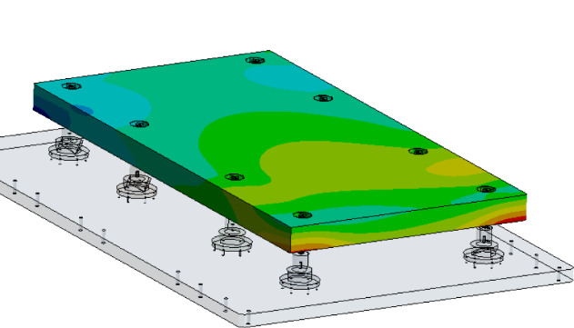
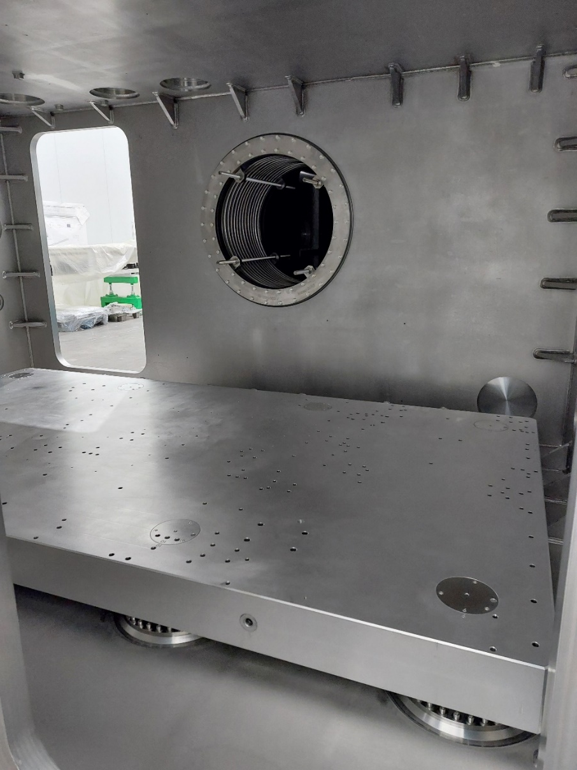
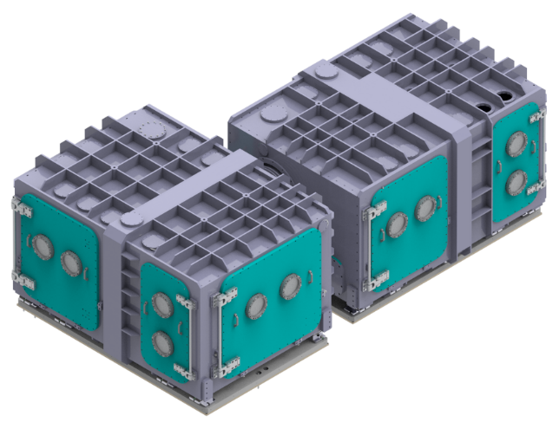
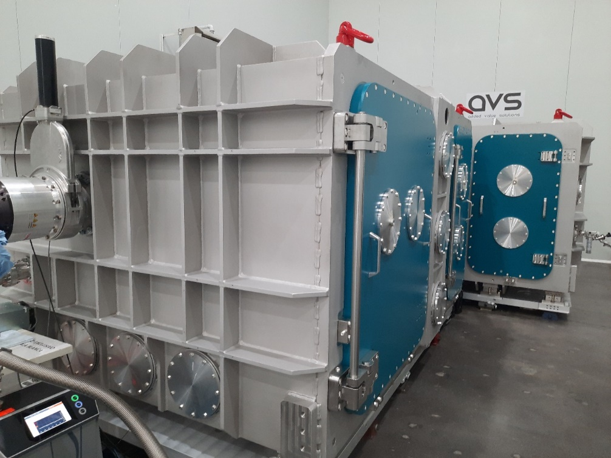
Chamber Update
The compressor chambers have been installed in EPAC (May-2024).
<1um deflection air-vacuum of chamber breadboard (design).
Next steps:
Electrical, mechanical & vacuum commissioning.
Grating mount installation & testing.
Compressor grating delivery Jan-Mar 2025.
See the chambers in-person at the EPAC lab tour.

Slide 4
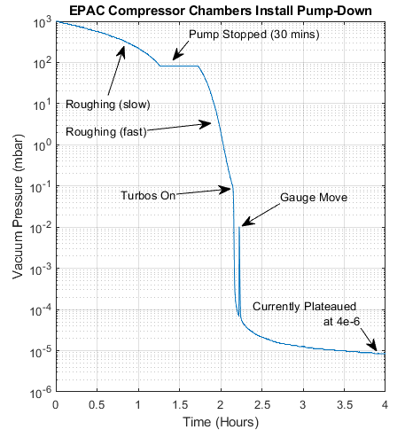
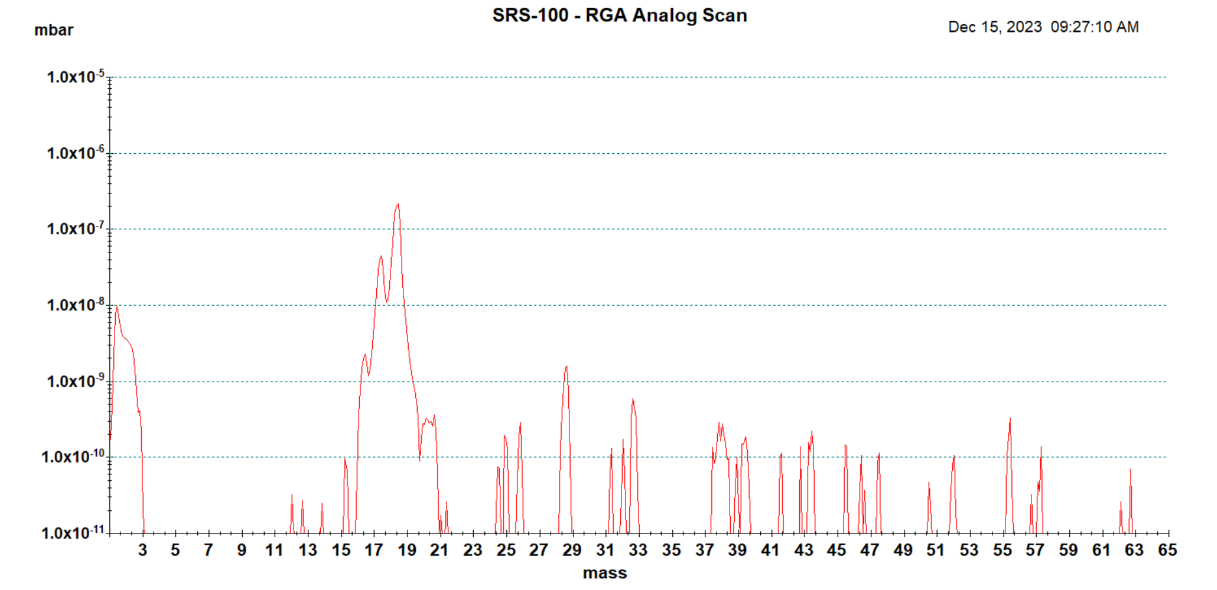
Chamber Vacuum Quality
4x10⁻⁶ mbar pressure.
<2 hours pump-down target met.
No concerning contamination from residual gas analysis.
Chamber cleanliness, methods avoiding grating contamination ->optic damage being considered:
RF plasma cleaning, optic handling.
Monitoring: optical diagnostics, vac RGA monitoring, other?
Water peak

Slide 5
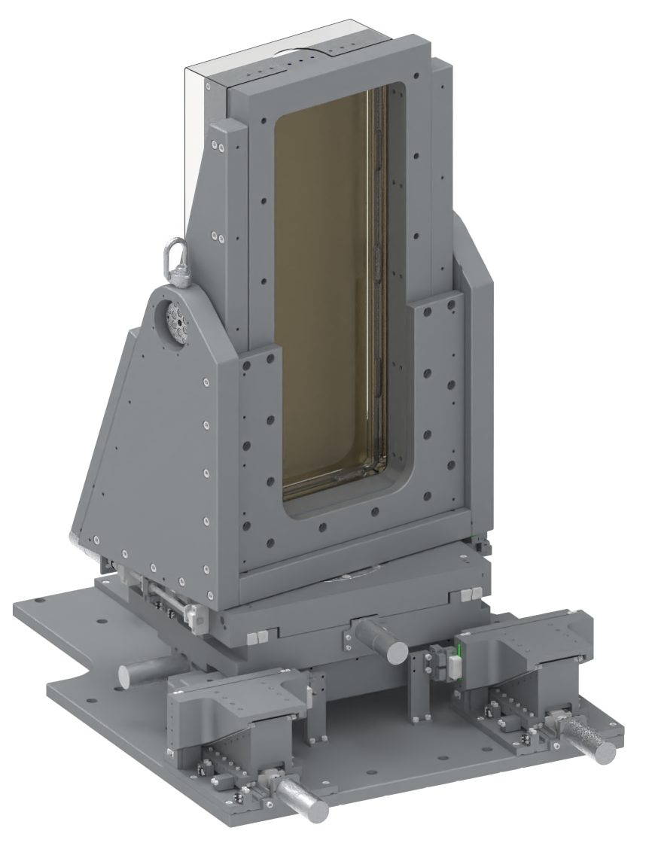
Compressor Grating Mounts
New grating mount design, improving on previous “VOPPEL” iteration.
Rear optic access (e.g. cooling).
Greater stability.
Balanced load (pitch).
3-point kinematic. 6 axes of motion (3 translation + 3 rotation).
Mount bases are currently in assembly. Optic holder “bezel” in design.
Stability Information
Angular Stability | VOPPEL | EPAC
RX, pitch (nrad) | 167.7 | 58.7
RY, roll (nrad) | 145.6 | 79.5
RZ, yaw (nrad) | 477.8 | 22.3
(Sept-2024) Encoders & optical diagnostics to measure final stability in the vacuum chamber.

Slide 6
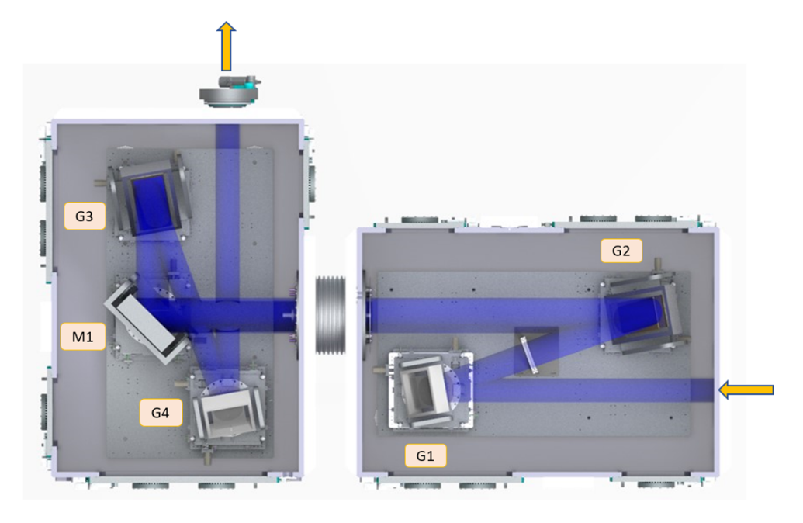
Compressor Gratings
Requirements:
Efficient diffraction, >90% per grating for 750-860 nm.
High damage threshold. Tested and proven > 200mJ / cm² LIDT in vacuum for long-term 1 PW, 10 Hz.
Minimal deformation. Optic sag (gravity) + Thermal Expansion (1PW, 10Hz) < 80 nm.
Modelling capability.
Engineered solutions.
Apertures | 300 x 300 mm , 760 x 300 mm
Line density | 1480 lines / mm
Incidence angle | 37.24° (Littrow), 10° out-of-plane.
Peak fluence @ 1PW | 80 mJ / cm² (30 fs)
30 J Out
G3
G2
M1
G4
50 J In
G1

Slide 7
Gold Coated Gratings (Uncooled)
Contract placed with Lawrence Livermore National Laboratory (LLNL) for Au coated grating set.
Low thermal expansion ceramic glass (Clearceram-Z) substrates, supplied by CLF (delivered Mar-2024).
Chrome/HfO2 grooved sublayer with + Au overcoat.
High damage threshold (>200mJ/cm²).
~4.9% absorption. Active cooling is expected for 10 Hz operation.
Solution for “Day 1” delivery of pulses to experiments at a likely reduced average power e.g. 1PW @ 1Hz.
Enables first user experiments to commence on a timely schedule, whilst further development of 10Hz solution continues simultaneously.
ETA Full-sized Au gratings: Jan-Mar 2025

Slide 8
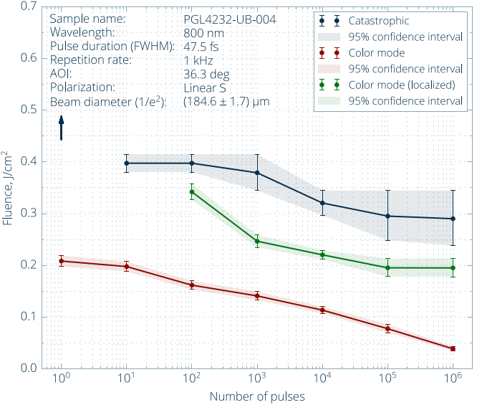
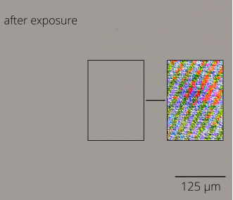
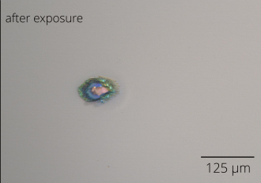
Multilayer Dielectric (MLD) Gratings
Plymouth Grating Laboratory (PGL) developed coating for EPAC.
Low absorption, thermally stable across all EPAC rep. rates.
Test sample(s) LiDT and diffraction efficiency investigated. “Colour mode” a concern. Impact of this type of damage on compression performance is not fully understood.
Similar gratings purchased and in use in CLF Astra TA2.
EPAC-like experimental campaign + results later slide.
Nov-2022, MLD LiDT (Lidaris)
Colour mode
(localised)
Colour mode
Catastrophic
EPAC 1PW

Slide 9
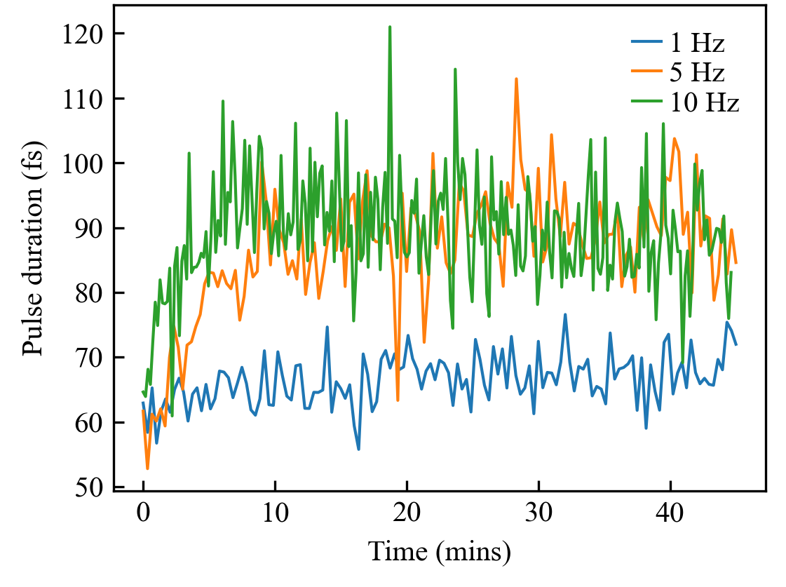
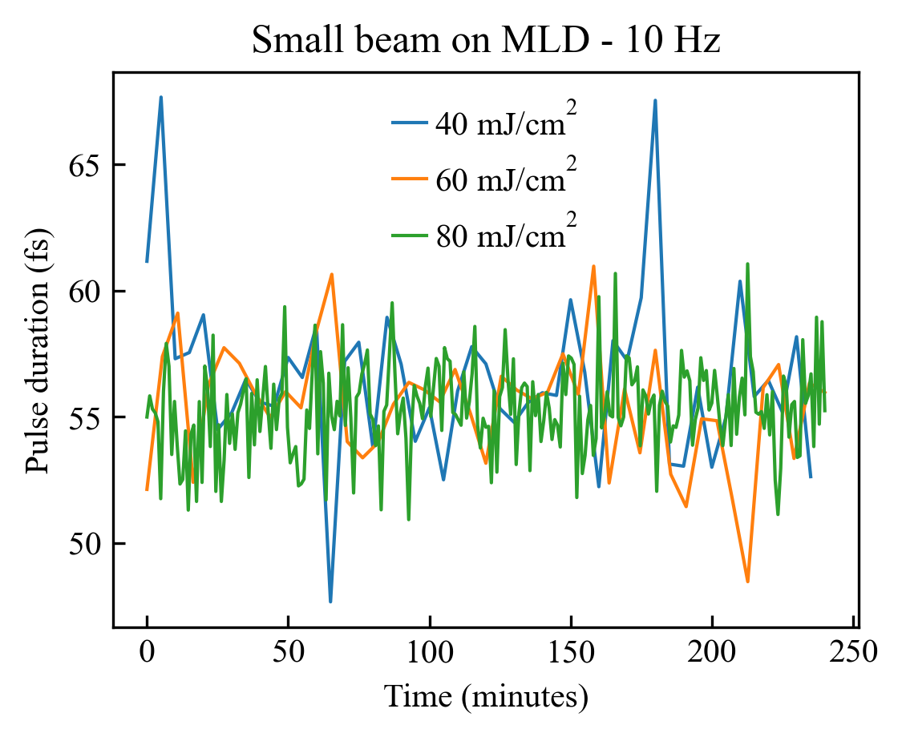
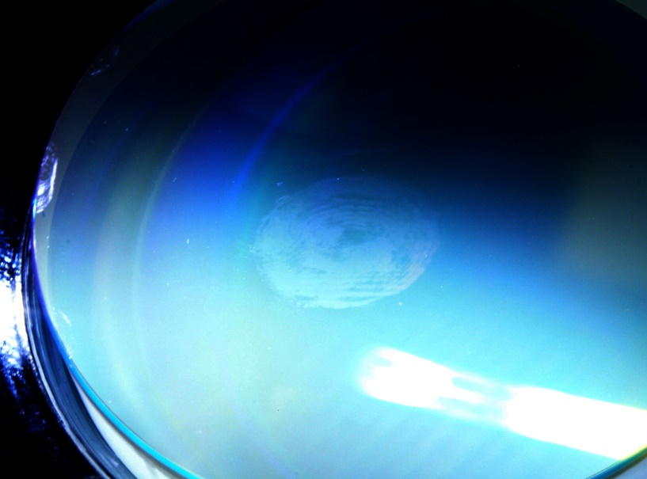
ATA2: 10 Hz Au / MLD Grating Pulse Duration
An experimental campaign using CLF Astra TA2 facility’s compressor to gain greater understanding of the grating types being considered for use at EPAC.
Used 1J, 10Hz front-end without firing slower rep rate (20s) high-energy amplifiers.
Au coated 1480l/mm gratings
(Jobin Yvon, fused silica substrate)
MLD gratings
(PGL, fused silica substrate)
Fluence: 40mJ / cm²
Cosmetic beam imprint on MLD after EPAC 1PW fluence run.
MLD grating maintained pulse duration at 10Hz.
Slight heating effects on MLD wavefront. EPAC design to consider & remove.
Beam imprint on grating surface after 80 mJ/cm² (diff. efficiency unchanged)…
Au gratings work at 1Hz. Compensation/cooling required for 10Hz.

Slide 10
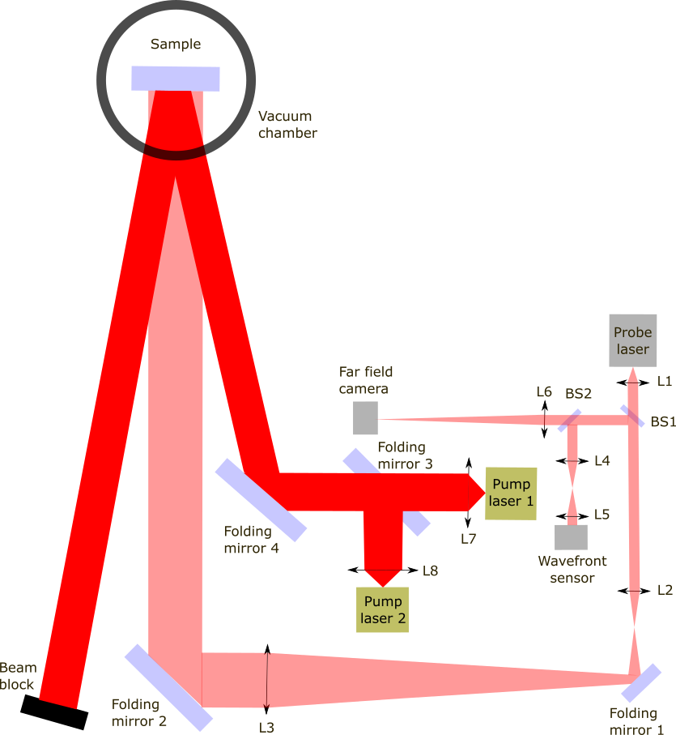
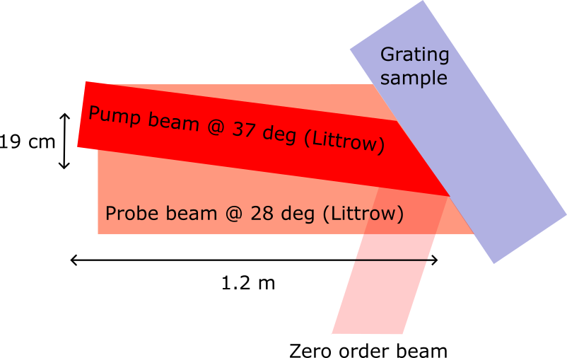
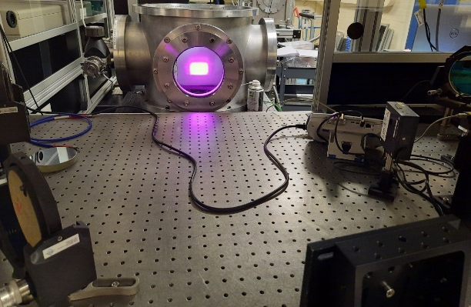
Cooled Gold Grating Prototype
A 130 x 160mm water-cooled gold coated grating substrate was heated with 120W under vacuum.
Laser parameters:
 | Prototype | EPAC
Average Power | 120 W | 500 W
Beam Diameter | 60 x 40 mm | 220mm
Fluence | 5 W/cm² | 1 W/cm² (G1, G4) 0.5 W/cm² (G2, G3)
120W, 800nm
635 nm

Slide 11
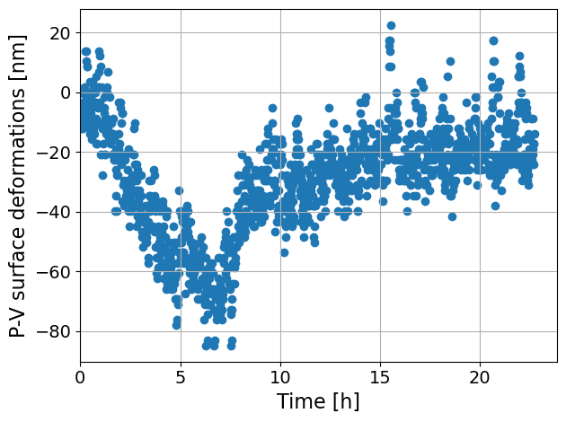
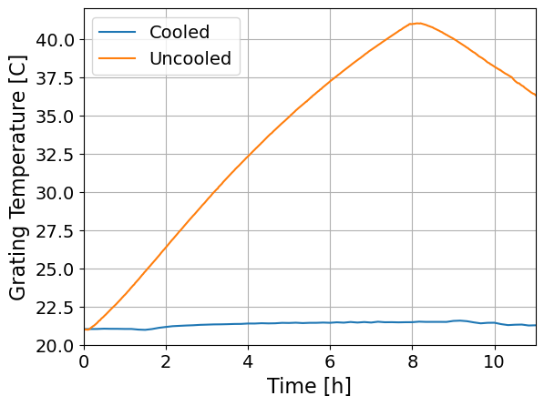
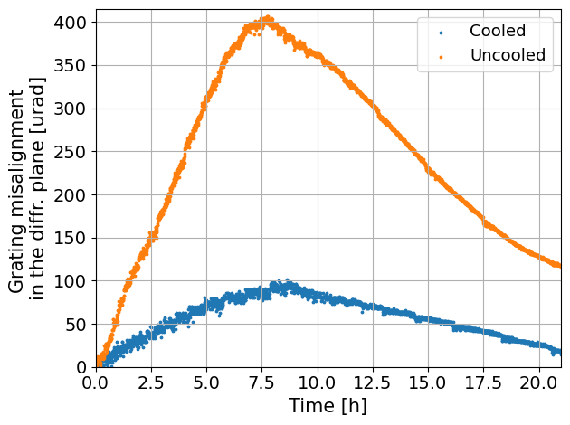
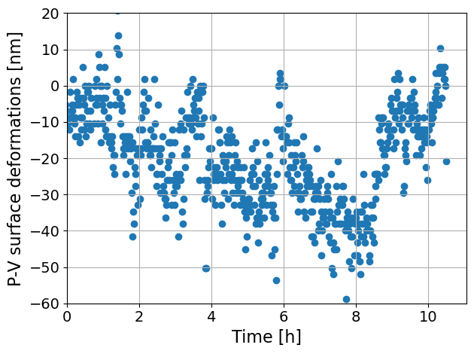
Cooled Grating Results
Uncooled
Pump lasers OFF
Pump lasers OFF
Pump lasers OFF
Cooled
Pump lasers OFF
Uncooled gratings continue to heat up under vacuum >8hrs
Cooling has measurable effect on surface deformation.
Approaching noise limit ± 20nm.
Heat transferred into the mount affects alignment/pointing.
Unexpected absorption: 0.5% ± 1% @ Littrow, 4.4% ± 1% @ normal incidence.
Next steps: modelling of ¼ size grating (Demcon), full-sized prototype design.

Slide 12
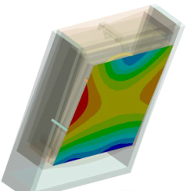
Full Sized Grating Modelling
Gratings tests to date have observed thermal impact of 10Hz, 1PW operations on smaller gold grating setups, which provide partial insight into EPAC full-power performance.
Modelling of the full-sized optic-optomechanical thermal system is required to gain understanding of problems & solutions ahead of 10Hz, 1PW operation attempts.
Clearly differentiated sources of optic deformation:
Deformation Type | P-V Cooled (nm)
Water Pressure Dynamic: Water turbulence, especially at connections in/out of substrate. Static: Substrate pushed outwards from water pressure. | 1 - 3 25
Thermal Expansion Dynamic: Surface Deformation. Direct thermal change of shape of grating substrate. Dynamic: Rigid Body Deformation. Heating and expansion of bezel, frame and mount that exerts mechanical pressure on optic. | 13 67
Gravity Static: Sagging of optic when oriented at 37-degrees from vertical. | TBC (<85nm CLF, 2022)

Slide 13
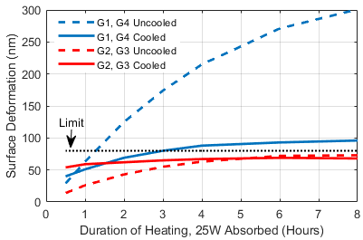
Full Sized Grating Modelling
Rigid body deformation was seen as largest contributor in last round of mount-optic modelling.
G1, G4 uncooled gratings appear unstable @ 10 Hz.
G2, G3 uncooled at EPAC average power may be manageable.
Next round of modelling to consider bezel design & optic clamping in detail.
Minimise rigid body deformation.
Minimise optic sagging under gravity.
To be ready and be used for Day 1 uncooled Au gratings.

Slide 14
Grating Type Summary
 | Uncooled Gold | Multilayer Dielectric (MLD) | Cooled Gold
Max rep. rate to specs | 1Hz | 10Hz | 10Hz
Status | ETA Jan-Mar 2025 | Substates with supplier (PGL), awaiting grating writing order. | Full-sized substrate/grating in planning. Iteration of cooled optic modelling in progress.
Substrate Material | Low CTE ceramic glass Clear Ceram Z | Low CTE ceramic glass ULE 7972. | ULE 7972, not yet purchased.
Diffraction efficiency | >90% (target) | >95% (target) DE wavelength centration resolved | >90%
Laser Induced Damage Threshold (LiDT) | >200 mJ/cm² | 295 mJ/cm² (catastrophic) 195 mJ/cm² (colour, localised) 39 mJ/cm² (colour-mode) | >200 mJ/cm²

Slide 15
Conclusions
Compressor vacuum chamber delivered.
Improved grating mount designed, in manufacture. Optical testing Sep 2024.
Uncooled gold gratings in manufacture (LLNL), delivery Jan-Mar 2025.
Second set of grating substrates ready for MLD grating writing. “Colour-mode” impact on laser performance to be closely examined, including existing MLDs in ATA2 facility.
Greater understanding of expected performance of “Day 1” uncooled Au coated gratings, with further design underway of grating bezel to minimize rigid body deformation and gravitational sagging.
Insightful results from ¼ size water-cooled in-vacuum grating prototype. Preparing design of full-sized cooled G1/G4 grating/substrate test.

Slide 16
Thank you
Extreme Photonics Applications Centre (EPAC)
Science and Technology Facilities Council
@STFC_Matters
Science and Technology Facilities Council
Notes:
The abstract pattern can be removed or repositioned if required. Be careful to ‘Send to Back’ so that it does not obscure any important information.

