Slide 1
EPAC ISTAC
Technical Report
Pump Laser
Jonathan Phillips
Central Laser Facility
May 2024
Notes:
The abstract pattern can be removed or repositioned if required. Be careful to ‘Send to Back’ so that it does not obscure any important information.

Slide 2
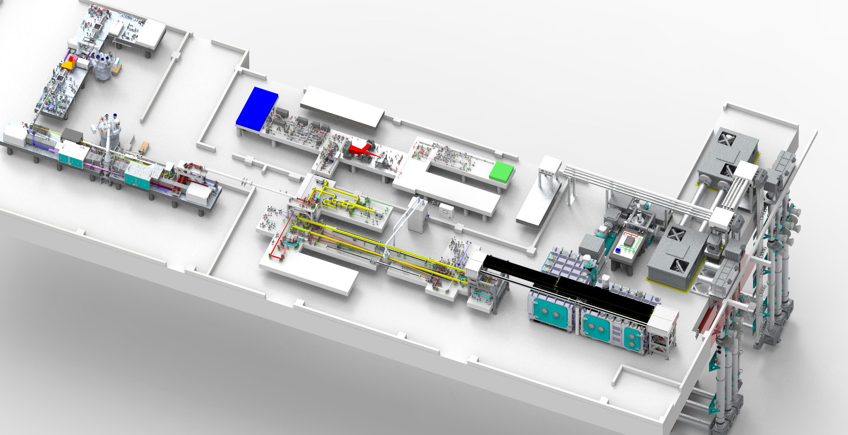
Pump laser layout
Layout of the EPAC Pump Laser and Rack Rooms
Rack Room
Front End
10J Amplifier
120 J Amplifier
Pump Room
Pump Laser Parameter | Design requirement
Pulse energy Day 1 | Day 1 = 120 J with pump A only
Pulse energy Day N | 200 J with pump A & B
Pulse duration FWHM | 15 ns FWHM
Central wavelength | 1030 nm
Repetition rate | 1 Hz and 10 Hz
Notes:
Add slide on FE with pulse shapes?

Slide 3
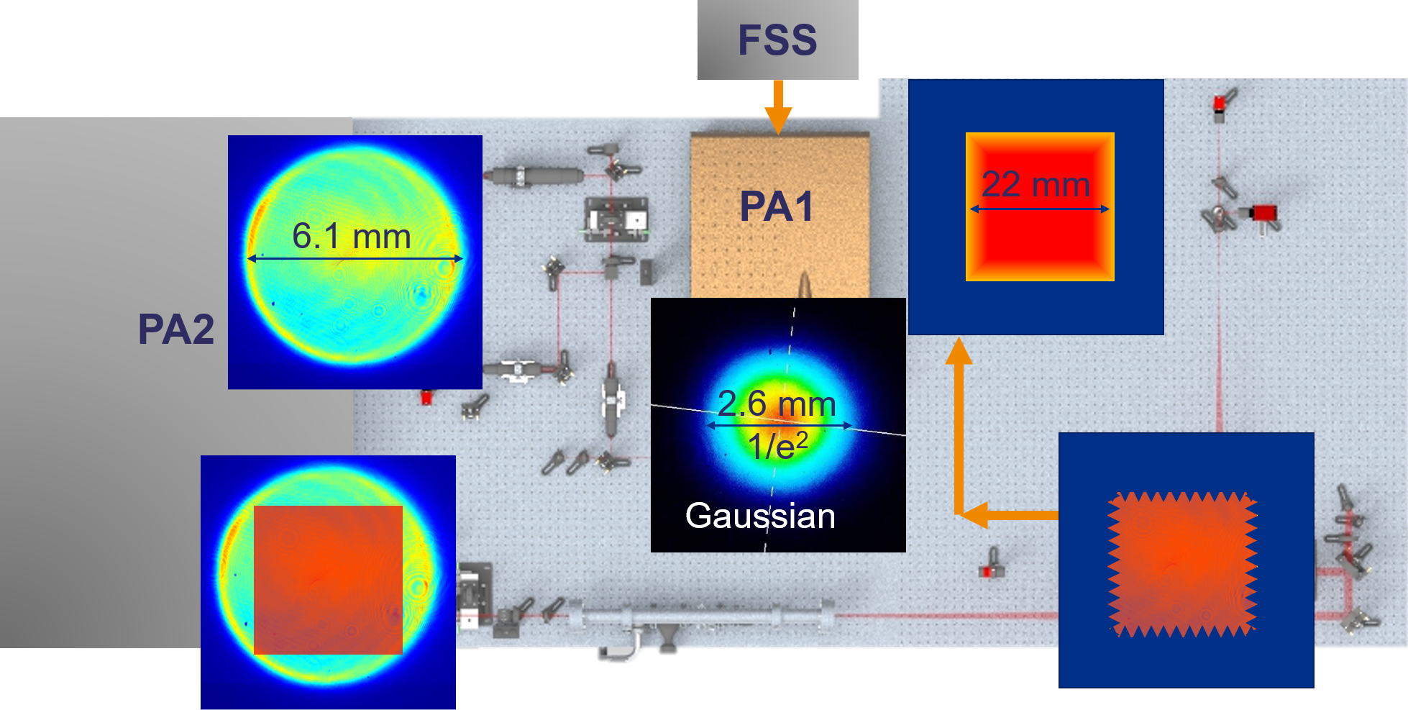
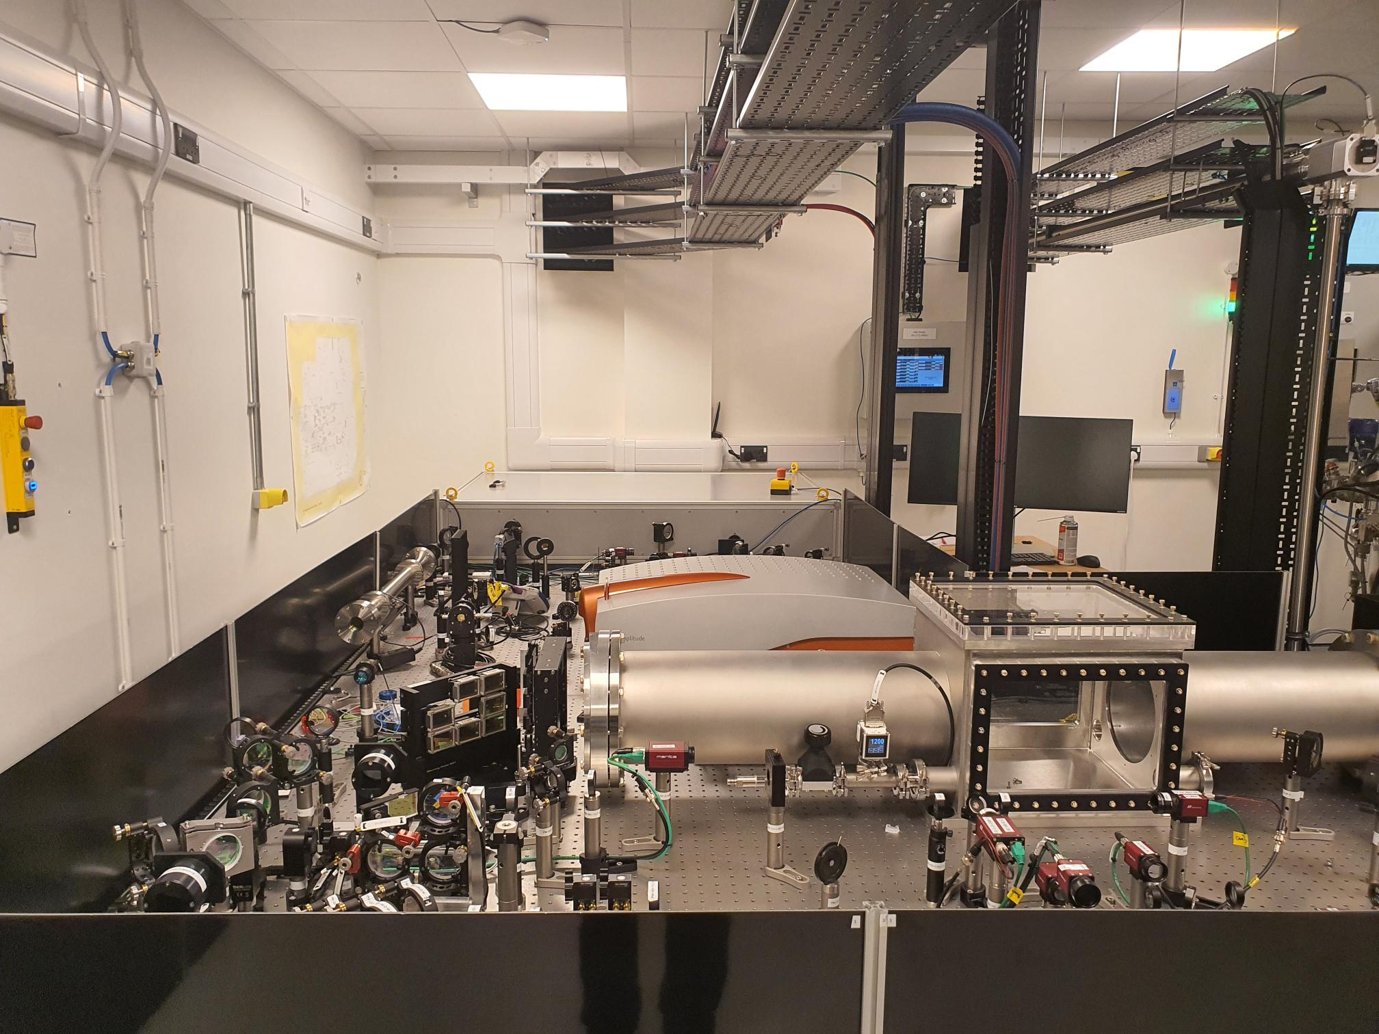
Front End Status
Built and commissioned in EPAC Room201
Fibre seed installed
Pre-amplifier 1 installed
Pre-amplifier 2 installed
Opto-mechanics and optics installed
CW and Pulse beam aligned to 10 J Input
Software Development
Fibre seed – software complete
Pulse shaping software –Software complete
Pre-amplifier 1 – software complete
Pre-amplifier 2 – software complete

Slide 4
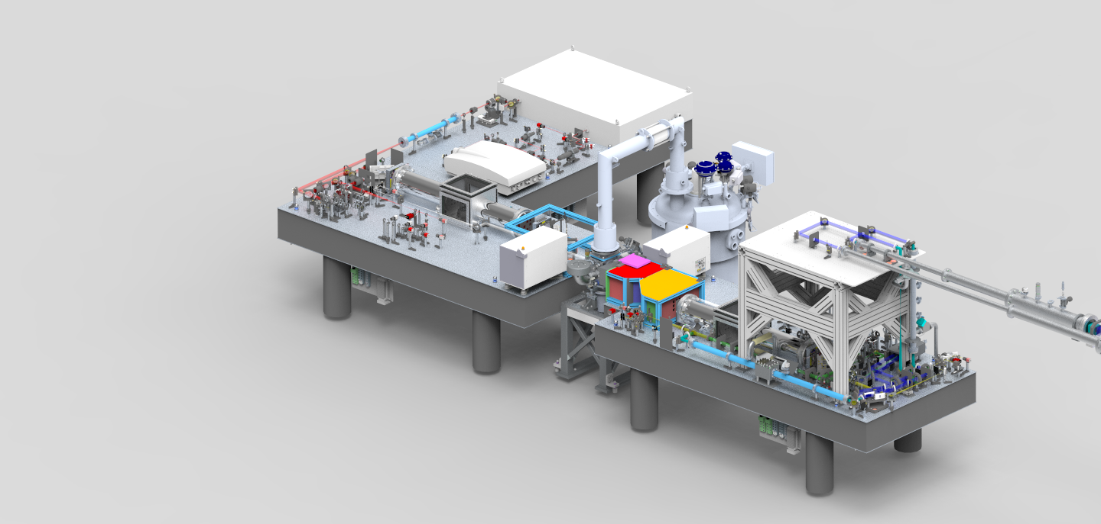
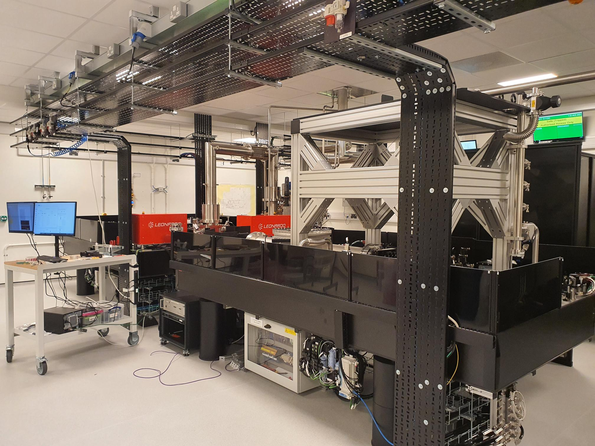
10 J Amplifier Progress
All major optics and opto-mechanics linstalled
10 J Cryostat installed and FAT complete
Pump diodes installed and SAT completed
Debris shield designed and fitted
Support structure installed for Beam transport
All optics installed for BeamTransport
CW Alignment of 10 J to all 7 passes, final adjustment taking palce
CW Alighnment of Beam transport in progress
Notes:
Add image of amp head?

Slide 5
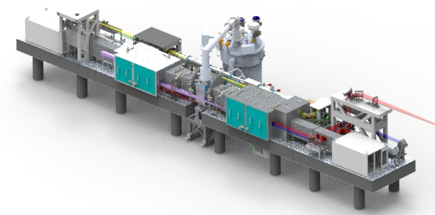
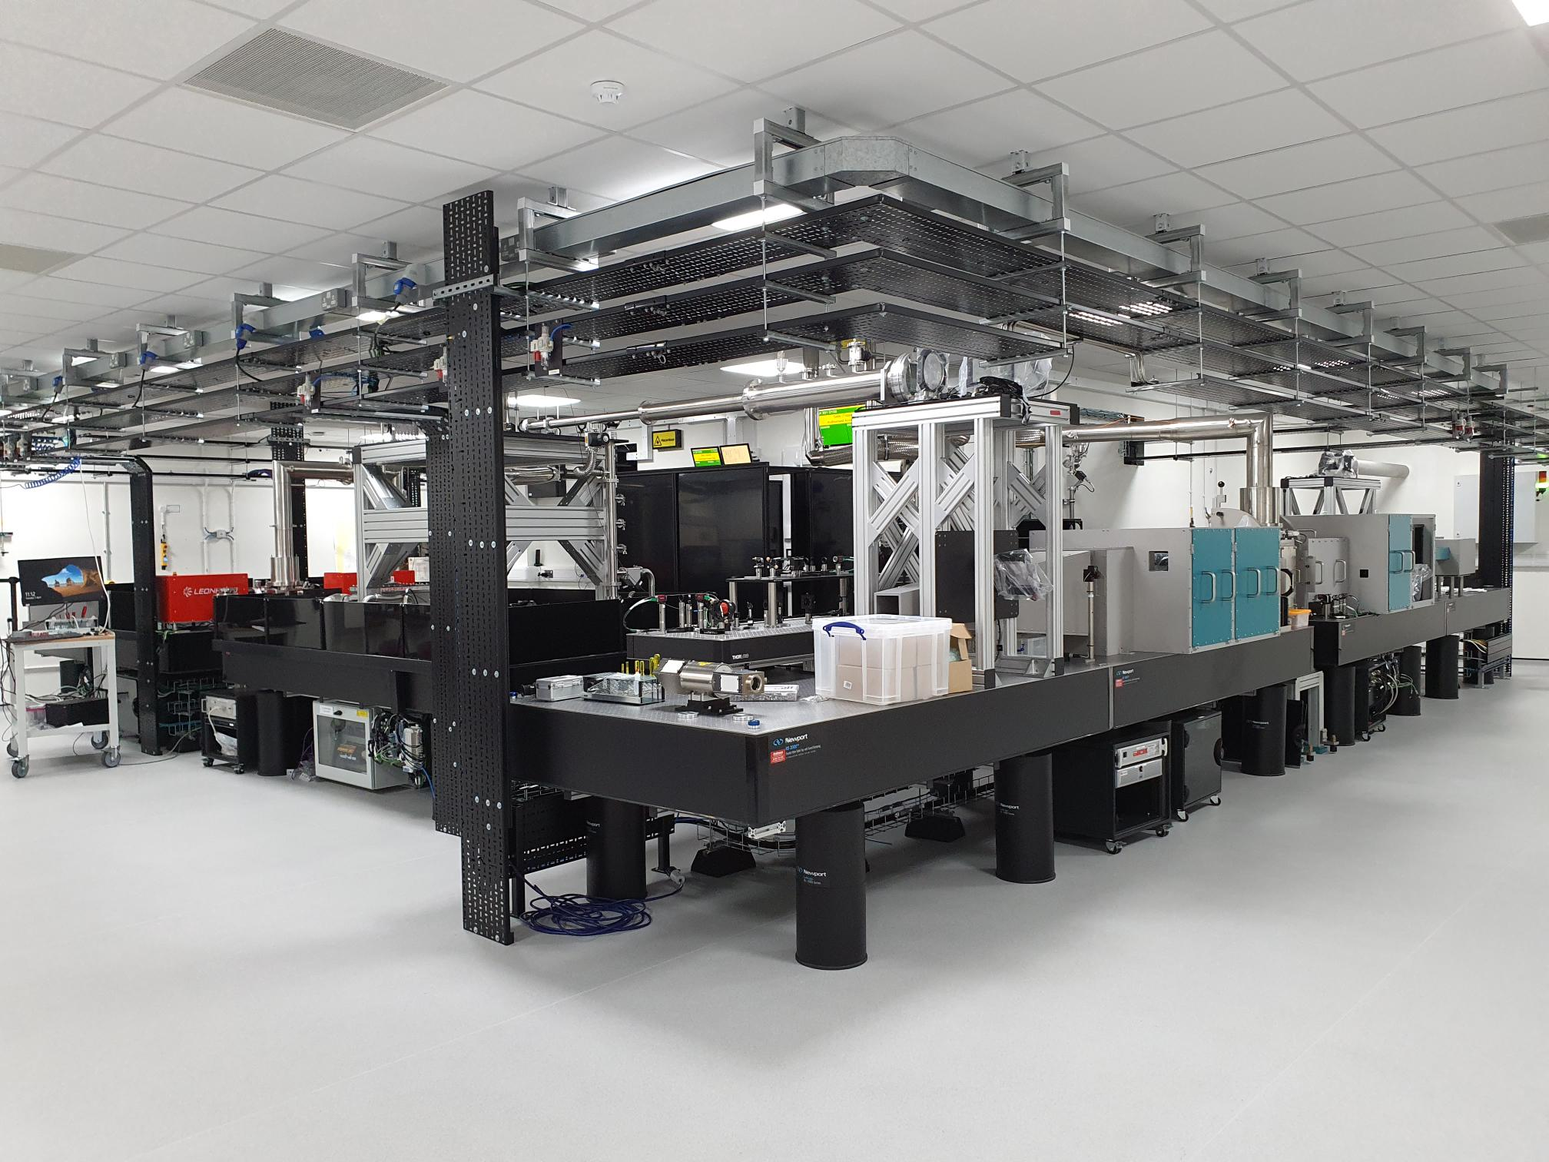
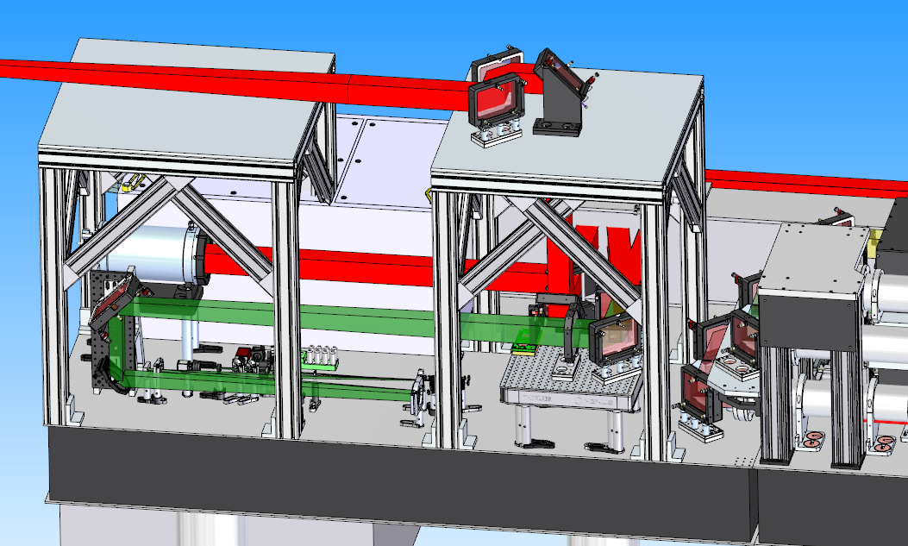
120 J Amplifier
Installation of Opto-Mechanicals
Debris shields installed
All large aperture mirror optics installed
General enclosure design to be finished
Polarisation insensitive diagnostics
Output beam

Slide 6
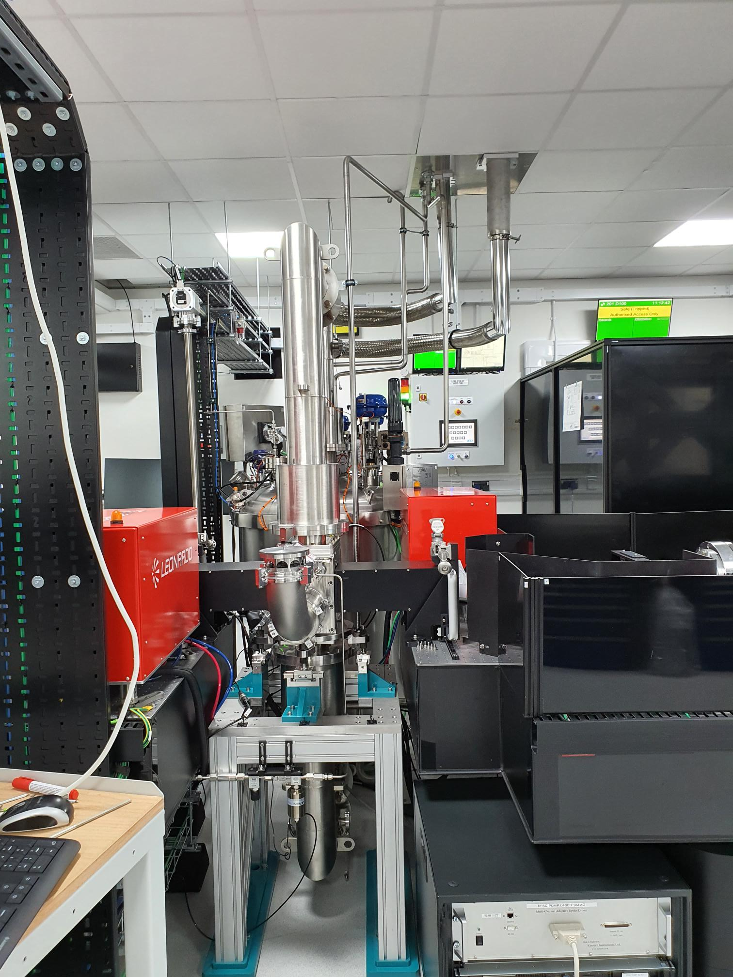
Installation in EPAC
10 J Cryo
Full SAT in EPAC 201 building
Dummy gain media installed for alignment

Slide 7
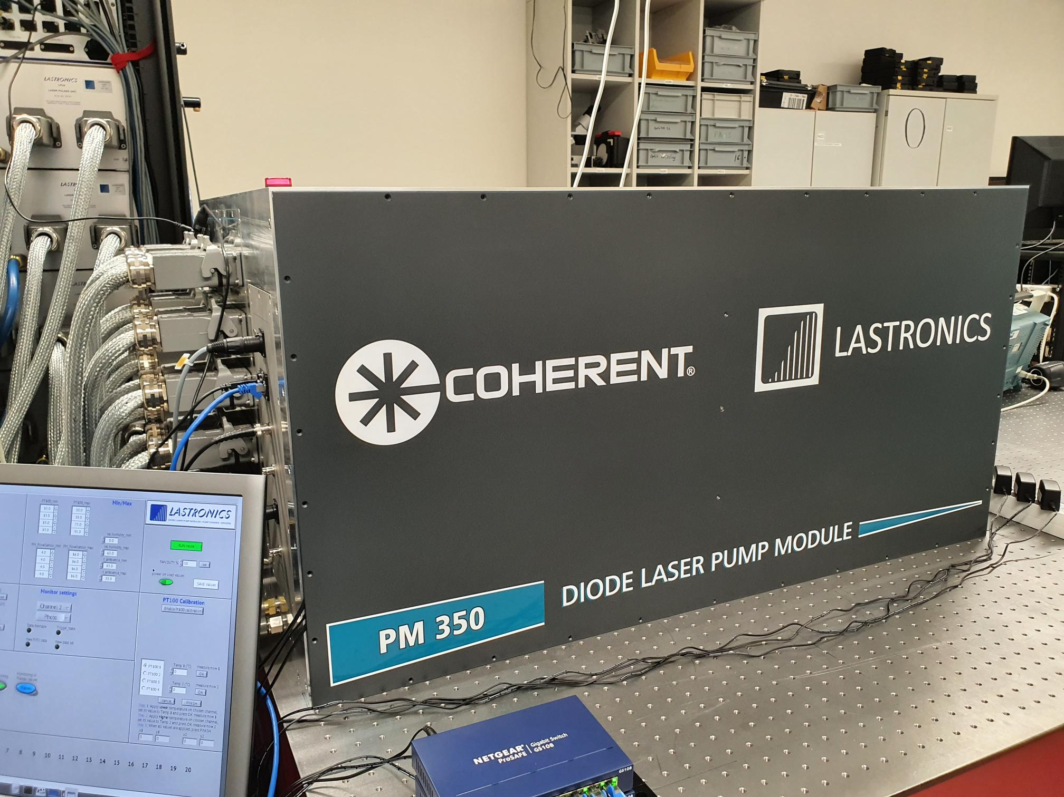
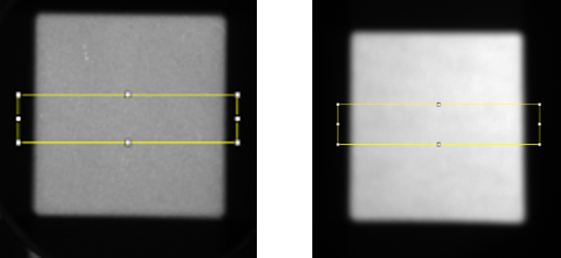
100 J Pumps FAT Complete
Successful completion of FAT
Output energy per Pump 350 J @10 Hz, 1 ms
Delivery in end of April / early May 2024
Installation and SAT in the EPAC Pump room in May 2024
Beam profile of 100 J pumps
PM1
PM2

Slide 8
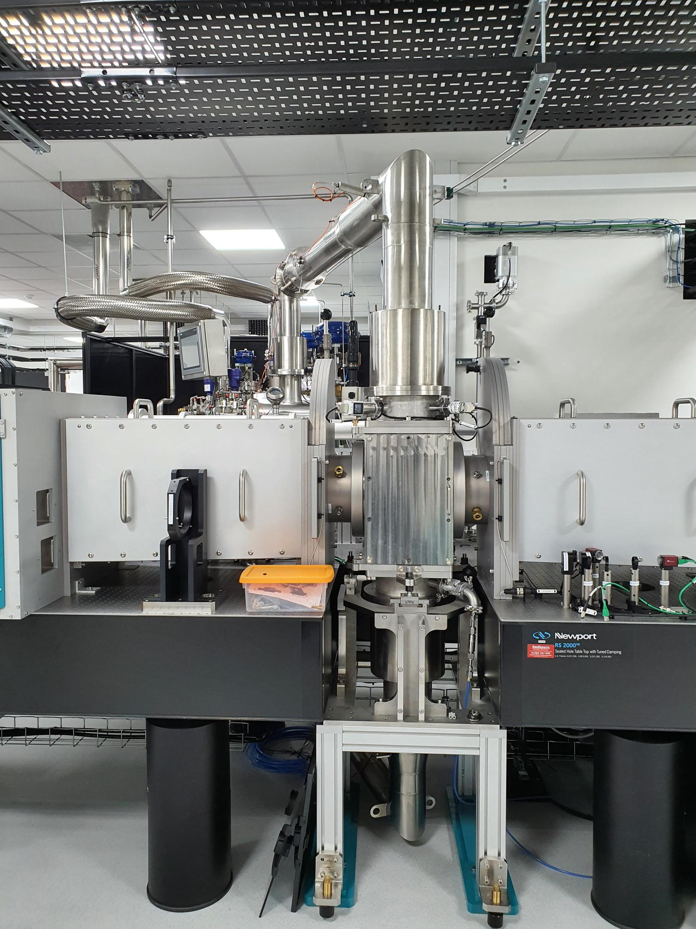
Installation in EPAC
120 J cryo-cooling systems
120 J Cryo-commissioning SAT complete
Dummy gain media installed for alignment

Slide 9
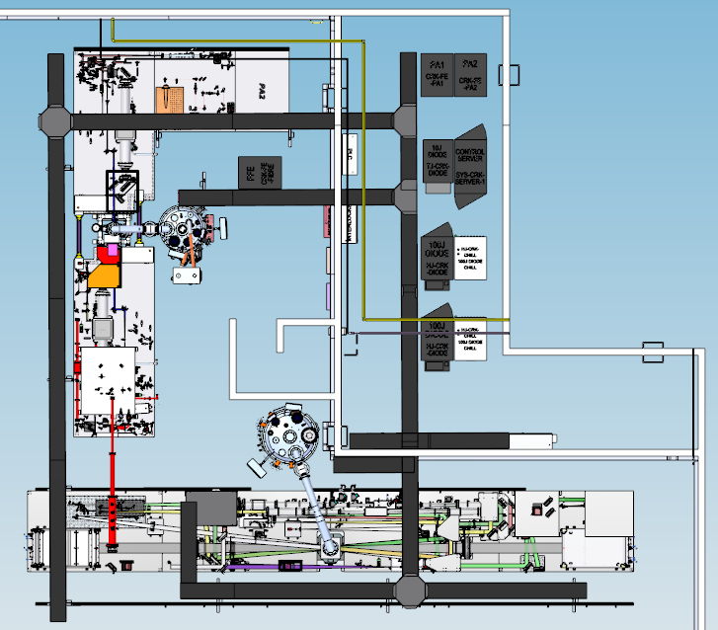
Status of Services
Rack room
Installed
10 J Pump and server
PA1 and PA2 racks
Cryostat racks
Vacuum pumps
Installed in the end of March 24
120 J Pump and server (End of May24)
Pump room
Trunking for services
Distribution control systems
Power
Data
Water
Gas
Turbos backing pump in lab
LN2 feed and exhaust installed
Laser Interlocks
Front Fiber Seed source
PA1
PA2
10 J Pump diodes
CW and Darkfield lasers
All completed

Slide 10
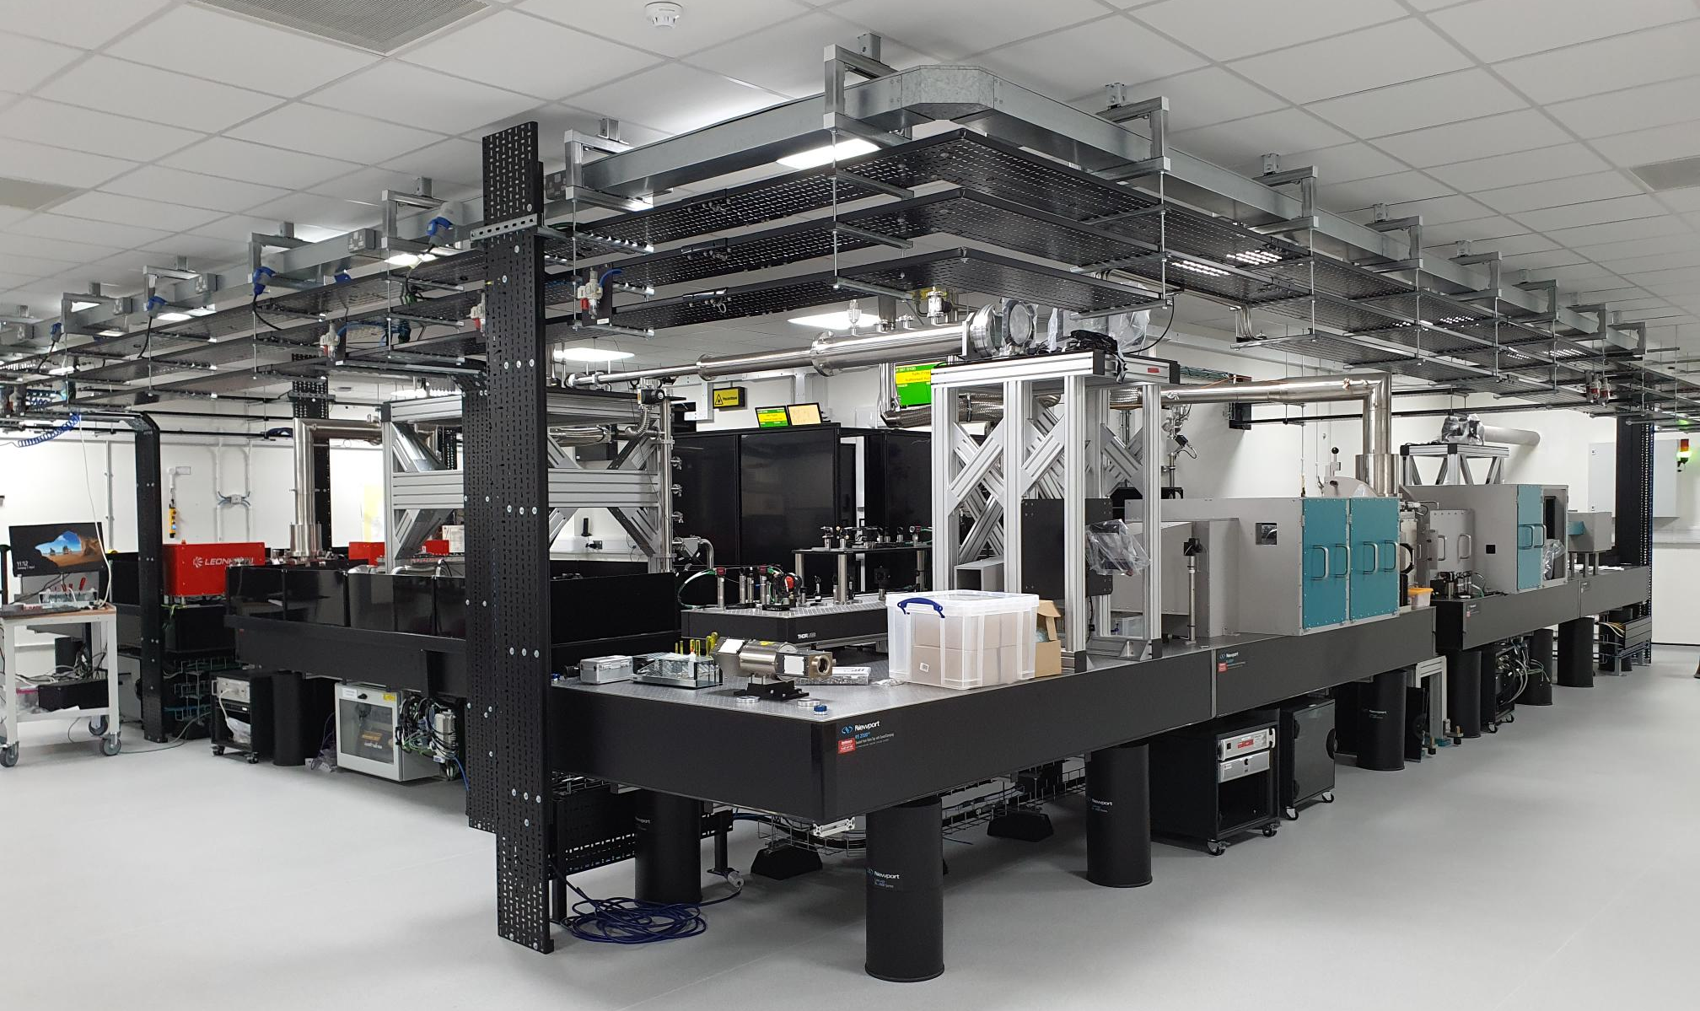
Current status of EPAC Pump Room
Commissioning
FE Optics and table installed
Optics installed in TJ
Large aperture optics installed
Commissioning / Installation overlap started in November 2023

Slide 11
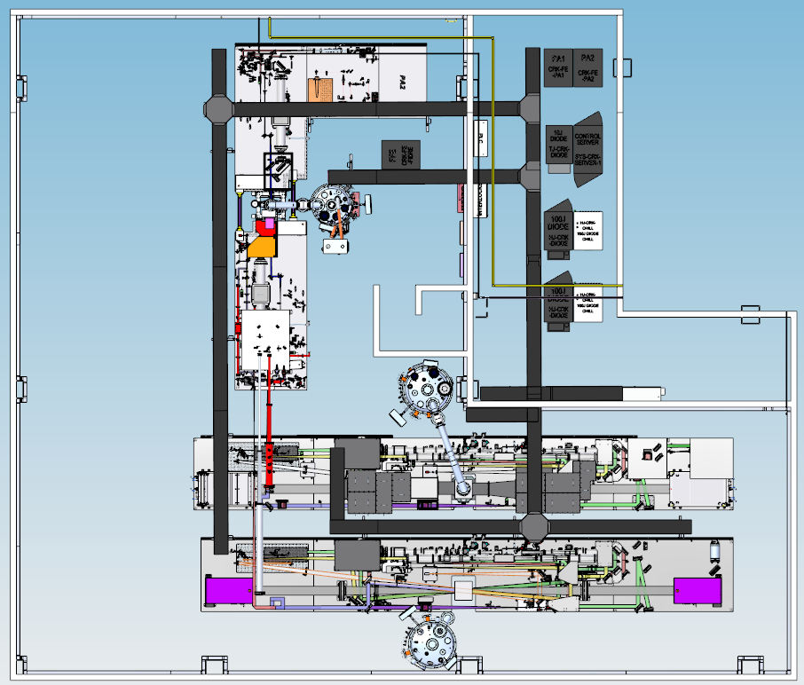
Future provision; two 120J sections
Provision included in services design, space in 209, TJ-HJ-2 beam transport and wall apertures for delivery to Ti:S Room (202)

Slide 12
EPAC Second Pump Update
Funding has been secured to £6m for a second 120 J Amplifier
Currently looking at two options:
Using the current 10 J beam split energy between 120 J amplifiers
A stand alone system with a Front end with an output of ~0.8 J and a 120 J Amplifier head

Slide 13
Thank you
Extreme Photonics Applications Centre (EPAC)
Science and Technology Facilities Council
@STFC_Matters
Science and Technology Facilities Council
Notes:
The abstract pattern can be removed or repositioned if required. Be careful to ‘Send to Back’ so that it does not obscure any important information.

