Slide 1


EPAC ISTAC
Detectors and
Diagnostics
C. D. Armstrong, D. Symes, J. Green
14/05/2024
Notes:
The abstract pattern can be removed or repositioned if required. Be careful to ‘Send to Back’ so that it does not obscure any important information.

Slide 2
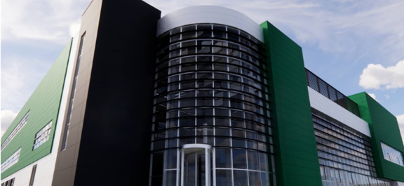
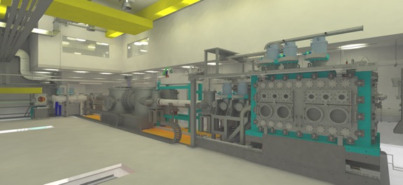
Overview
Overview
Project Scope
Diagnostics for LWFA (EA1)
  Standard experimental requirements
  In-area laser and optical diagnostics
  Electron spectrometer and beamline
  X-ray characterisation
Diagnostics for Solid targets (EA2)
  Standard experimental requirements
  Ion spectral/spatial diagnostics
  X-ray characterisation
  Neutron detectors
Notes:
Outline the scope/challenge of the project and then talk about what the key radiation types we expect from each area in EPAC to give context to the detector designs I’m going to show.
I’ll run through the concepts we’ve come up with for each detector and then run through where our technical risks are and how they’ve changed since last year.
Then to wrap up I’ll show off some of the prototyping results in a few areas and talk about what it means going forward for each design.

Slide 3
Project Scope

Slide 4
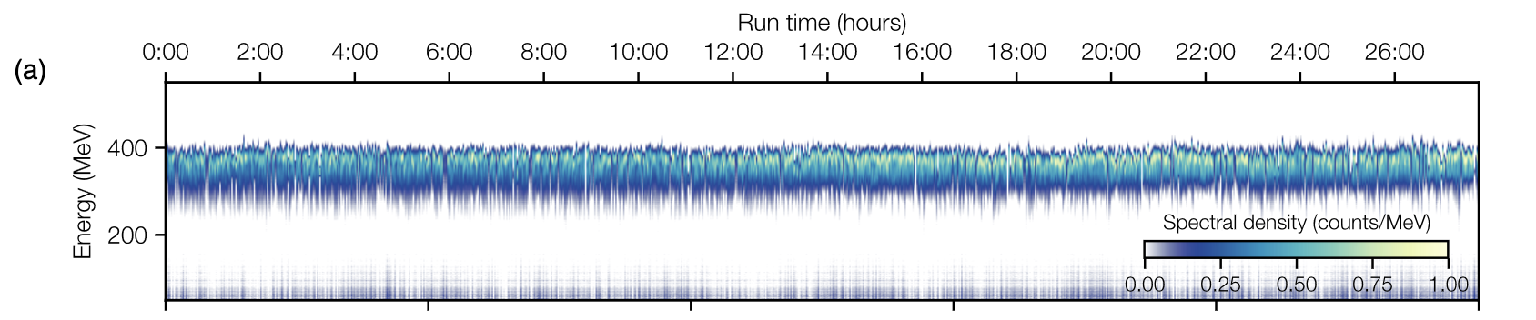
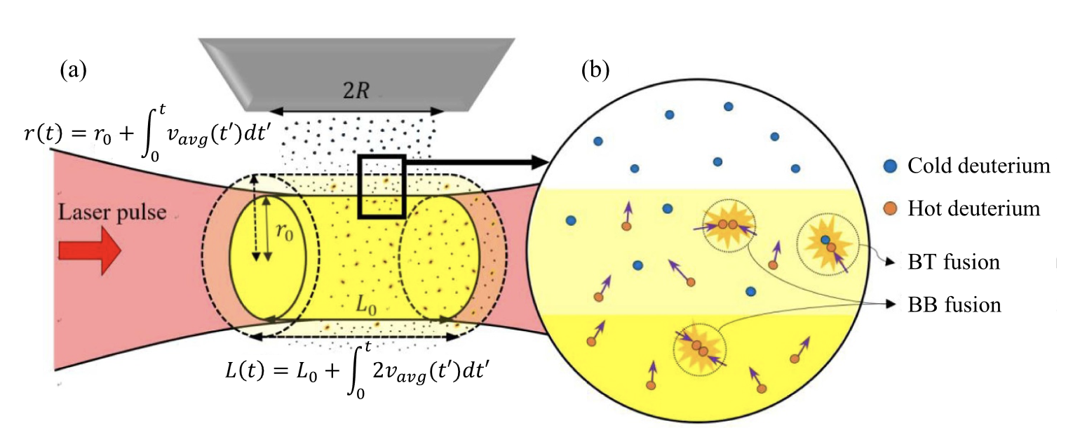
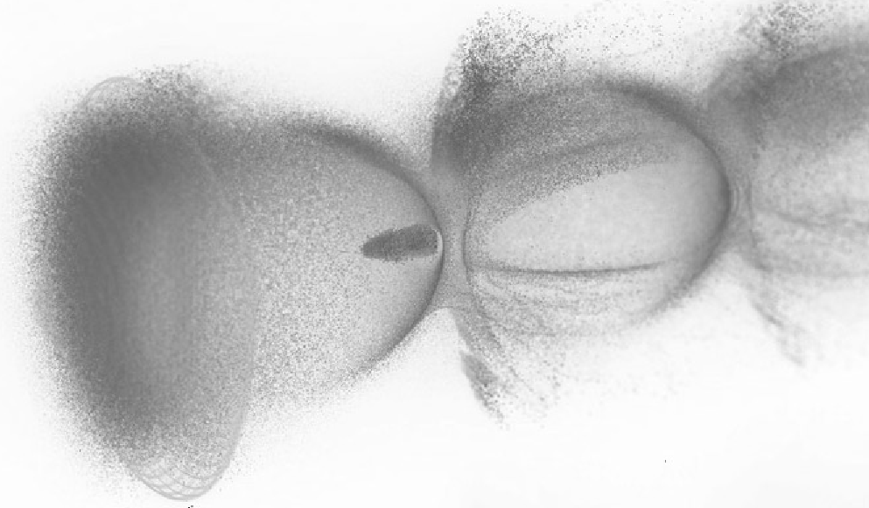
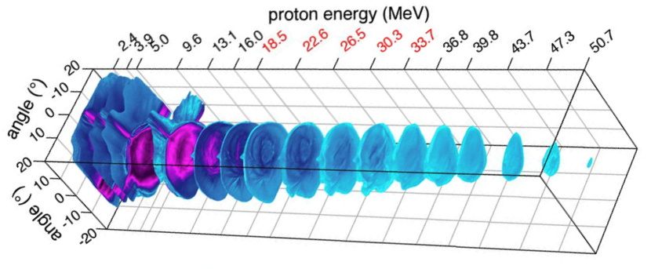
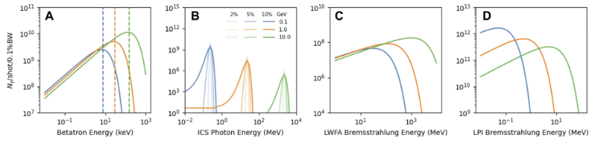
What is required?
A. R. Maier, et al. PRX 10.3 (2020): 031039.
Electrons:
<100 MeV (EA2) to 10 GeV (EA1)
Charge, emissivity, spectral characterisation all required to high quality
Wide angular/spatial information for EA2
J. Won et al. Nucl. Fusion 63 (2023) 066031
Neutrons:
Epithermal to Fast detection
100 ps temporal resolution
Discretion from x-rays
X-rays:
10 keV to 100 MeV detection
Source-limited spatial resolution at 100 keV
Efficient detection at high energies
Protons / Ions:
1 to 100 MeV/u detection
Active replacement for RCF (spectro-spatial imaging)
High dynamic range spectrometer
M. Schollmeier, et al. Rev. Sci. Instrum. 1 April 2014; 85 (4): 043305
C. D. Armstrong, et al. Front. Phys. (11) (2023): 28-30.

Slide 5
What is being delivered?
The critical diagnostics to perform a wide variety of experiments.
Distinction here is a detector is sensitive to the radiation and the diagnostic is a total package.
A baseline suite of detectors and diagnostics able to characterise standard experimental configurations and industrial applications.
* to some degree – resolution limits or energies requirements might not necessarily cover specific applications
This requires sufficient understanding and development to establish.
Protons / Ions:
<100 MeV Thomson spectroscopy
3-Layer spectro-spatial monitor as “active-RCF”
X-rays:
High spatial resolution <100 keV
Wide FOV (>150mm) imaging across energy domains
High efficiency 100 keV imaging
~keV resolution spectroscopy up to 600 keV
Spectral fitting up to 100s MeV
Electrons:
Compact <100 MeV spectroscopy
% level 0.5-10 GeV spectroscopy
Beam pointing/distribution monitors in line
Non-invasive charge measurements
Longitudinal characterisation via CTR
Neutrons:
Time gated imaging with fast CH scintillator
High temporal resolution nTOF

Slide 6
EA1
Underpinning Methodology
Scintillator
Optics
Detector
Magnets
Electron
Electron
Scintillator screens
Permanent double dipole
Non-invasive
charge measurement
Quad emittance
Variable electromagnet
Probe
Exit Mode
Dielectric Streaker
Transverse
Whole beam
Exit Mode
Longitudinal
Wavefront
Transmission laser spectroscopy
Imaging
Spectroscopy

Slide 7
EA2
Underpinning Methodology
Scintillator
Optics
Detector
Magnets
Protons / Ions
Protons / Ions
Scintillator screens
Active Thomson parabola
Three colour splitting system
Isolated chamber
Compact design
Electrons
Optical
Optical
Compact active e-spec
Laser harmonics
Transverse probe
Transmission/reflection
Imaging
Spectroscopy

Slide 8
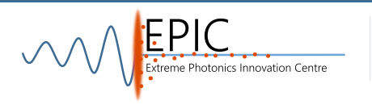
Detectors
Underpinning Methodology
Scintillator
Optics
Detector
Betatron
Hard X-ray
Neutron
X-ray
Particle
THz
Bayer Ross-Pair
N-/P-
Shaped
Scintillators
Sub-micron
imager
MeV+ Imager
Interferometer CTR
Linear Spectrometer
Fast Decay
High Flux CZT
Splitting Spectrometer
Directly coupled
Electron Cherenkov
Multi-Modal
High Rep-Activation
2D Active Thomson
Large area panel
Low noise system
Imaging
Spectroscopy

Slide 9
Experimental Requirements for EA1
Predominantly gas targets with long focal length parabolas. Narrow emission angle limits opportunity for simultaneous measurements. Requires characterisation of ultra-relativistic electron beam, large energy spread of x-rays, and high resolution spatial profiles.

Slide 10
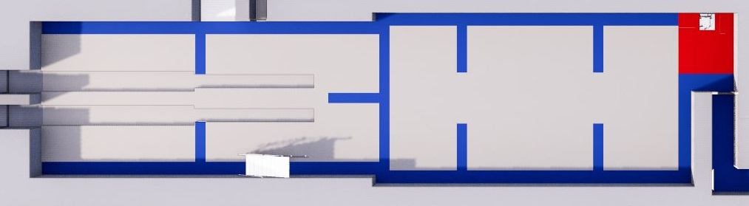
EA1 Examples Experimental Layout
Experiment description:
Gas jet / cell interaction with long focus
Sustained 10 Hz operation with variable gas density
Investigating the coupling of laser-energy into the wakefield
Expected variation from wavefront and gas-density/structure
Collimated emission area with predominately electron and x-ray emission
Diagnostic Areas:
Laser input conditions
Laser-plasma coupling characterisation
Plasma density
Emitted electron beam characteristics
keV to MeV x-ray emission

Slide 11
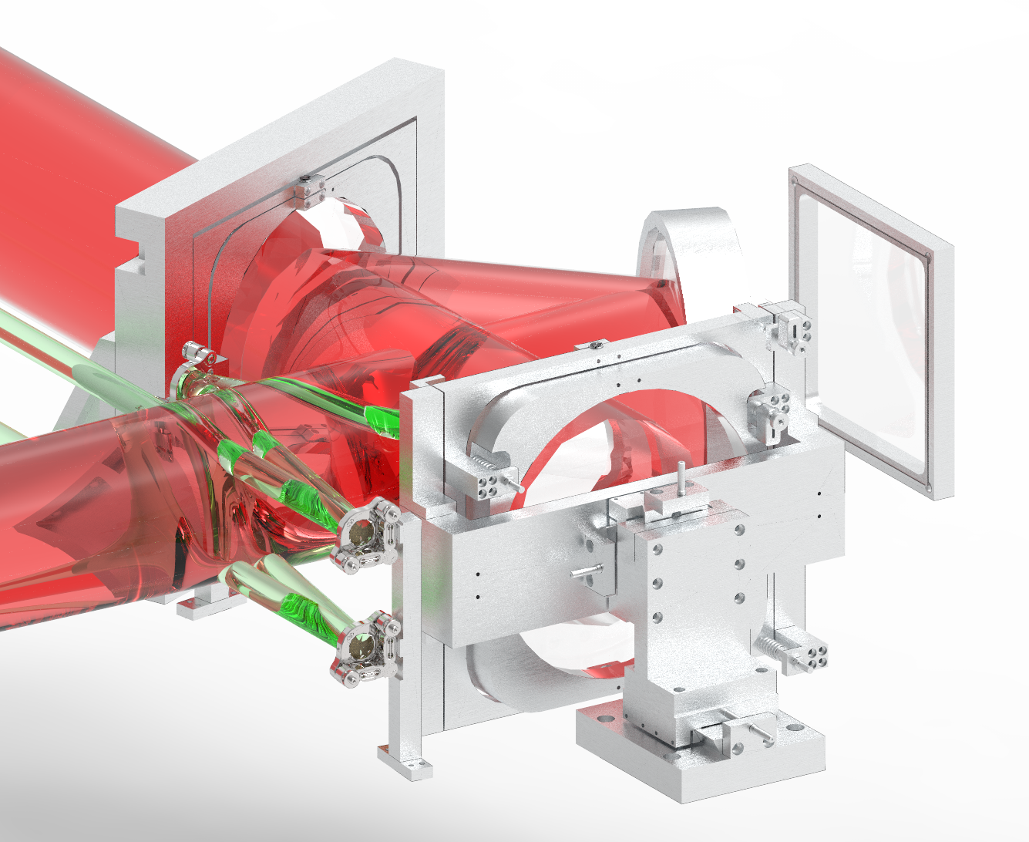
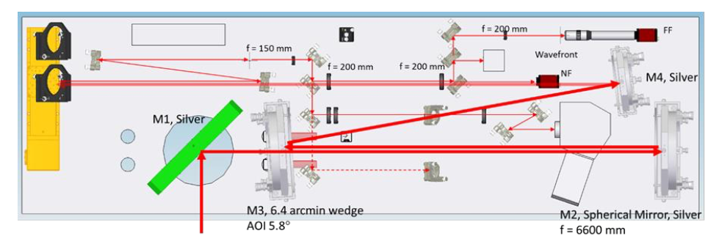
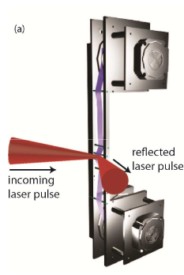
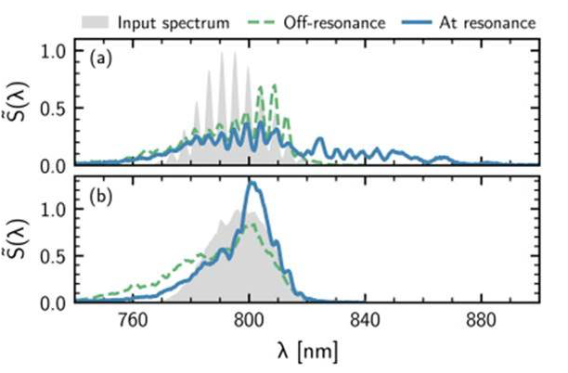
Direct
Exit mode characterisation
Indirect
Provide the users with on-shot:
Transmitted energy fraction (NF integral)
Spectral modulation (Shamrock)
Pointing/Hosing (FF centroid)
Wavefront (Zernike modes)
Develop towards:
SW-/MW- Infrared Spectroscopy
Indirect plasma mirror operation for compact exit mode configuraitons
T. Sokollik, et al., AIP Conf. Proc. 1299, 233 (2010).
A.J. Ross et al. https://arxiv.org/pdf/2310.05097

Slide 12
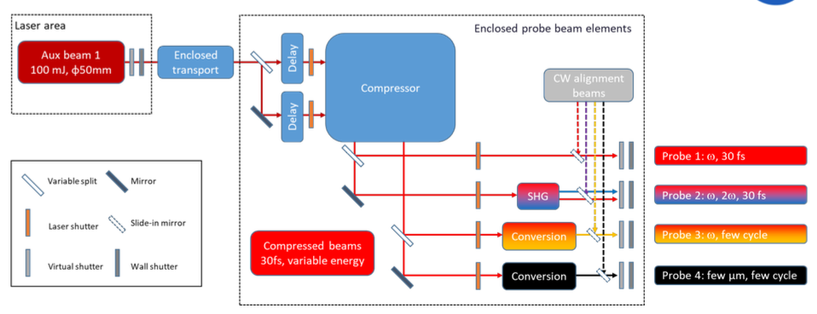
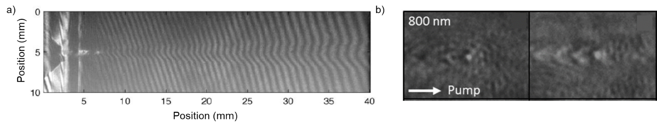
Target density and profile
Detailed design ongoing
Provide the users with on-shot:
Interferometry of time-integrated plasma channels across mm- and um- scales
30 fs probe at 1st and 2nd harmonic
Analysis platform matured to “gui-interface” of probe density reconstruction
Develop towards:
Sub-10fs probes to open up wakefield structure directly
SW-/MW- IR probe to reduce the plasma density characterisation below 10¹⁷
Chirped co-linear probe increases sensitivity to lower average plasma density
Increasing complexity
Transverse probe
Schwab et al PRAB 23, 032802 (2020)

Slide 13
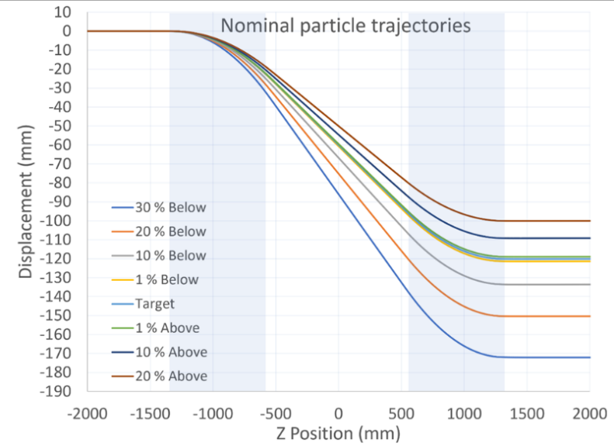
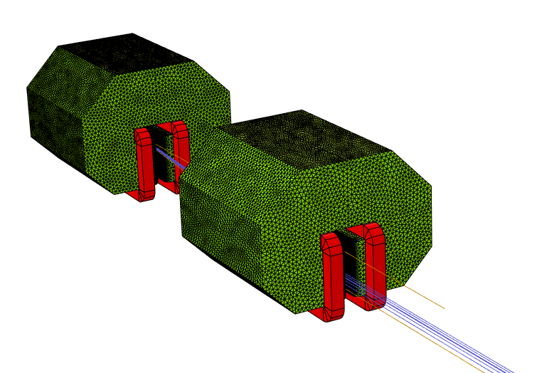
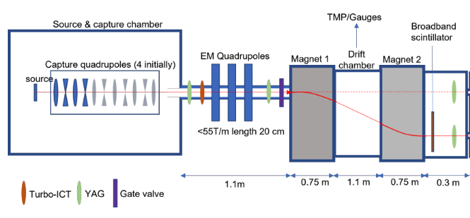
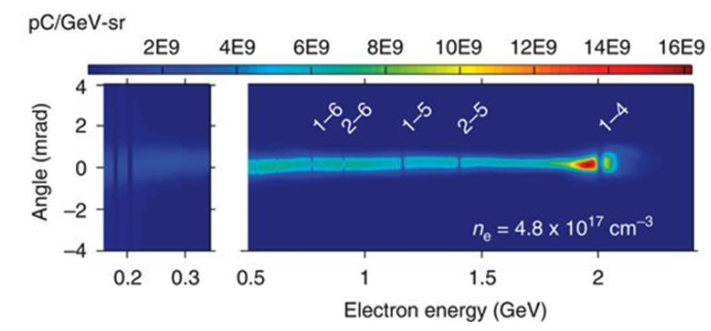
Electron beam emission - Spectra
Double variable strength dipole for flexible operation
Provide the users with:
Calibrated and variable dipole for electron characterisation.
Target electron energies returned to consistent position and nominally colinear propagation below axis.
Develop towards:
Calibrated and variable dipole for electron characterisation.
Target electron energies returned to consistent position and nominally colinear propagation below axis.

Slide 14
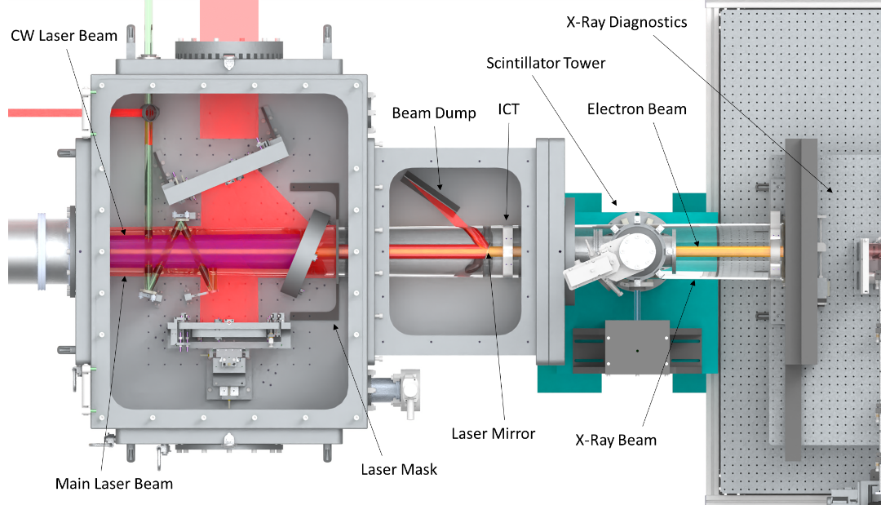
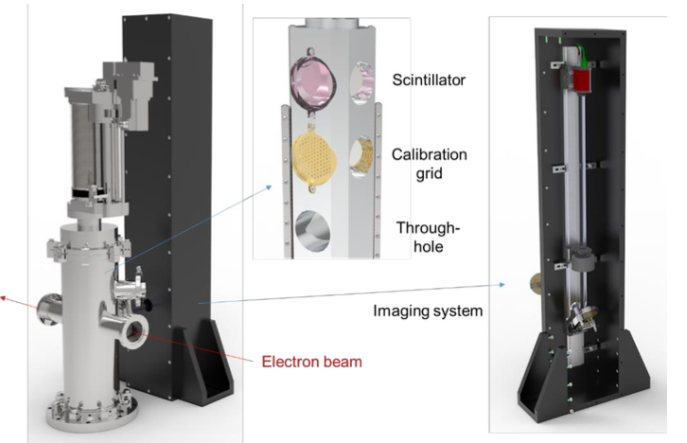
Electron beam emission – Spatial
Develop towards:
Non-invasive measurements for passive characterisation / stability monitor
High resolution scanning system (requires source stability)
Thinfilm optical CTR characterisation to minimise in-beam material
Provide the users with on-shot:
Spatial profile of electron beam emission at fixed distances from target
Invasive measurement with scintillator
Multiple units to provide degree of emissivity measurements

Slide 15
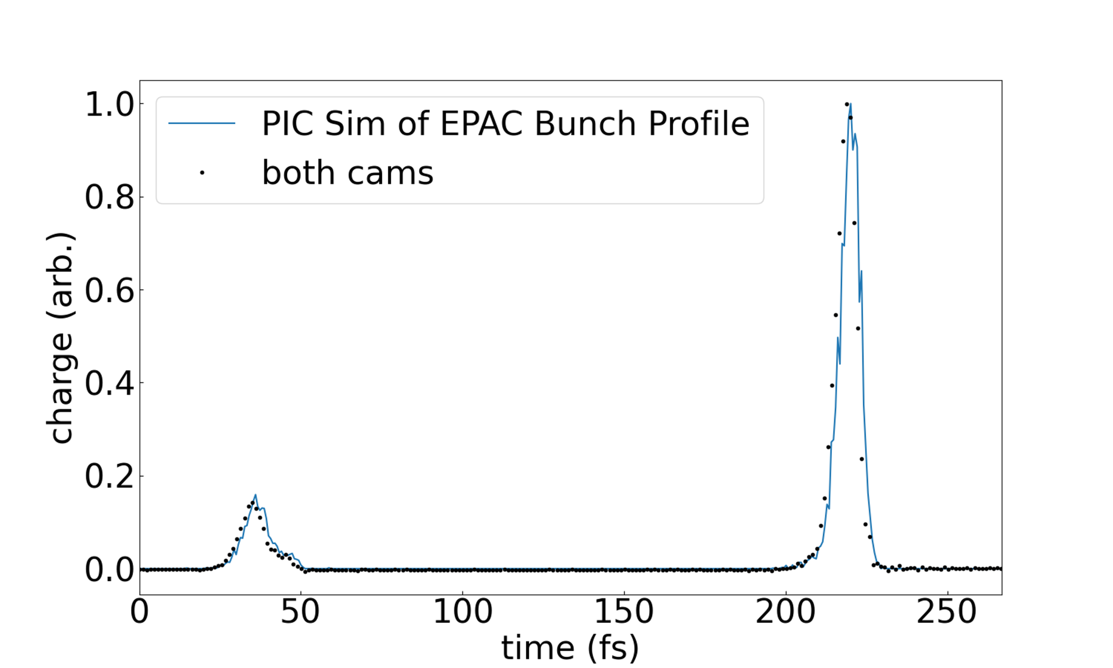
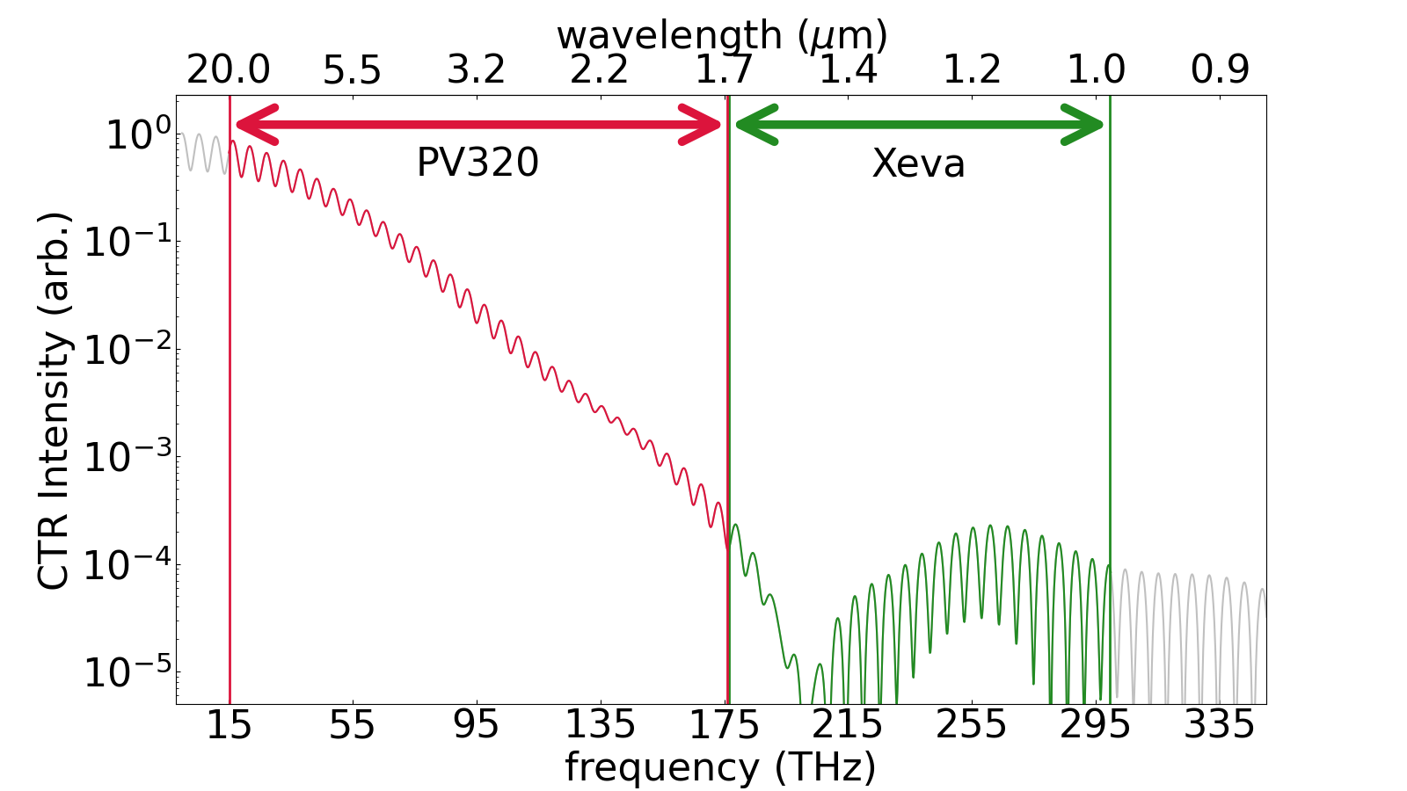
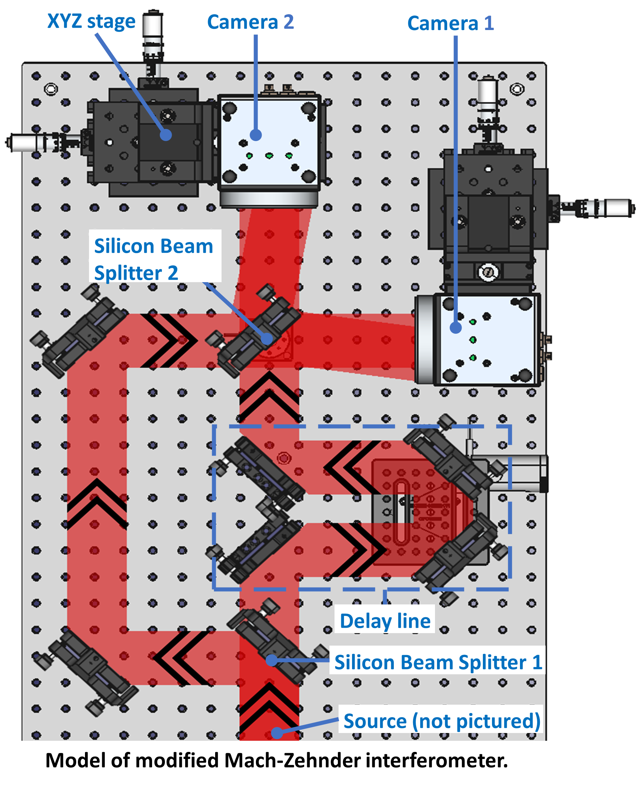
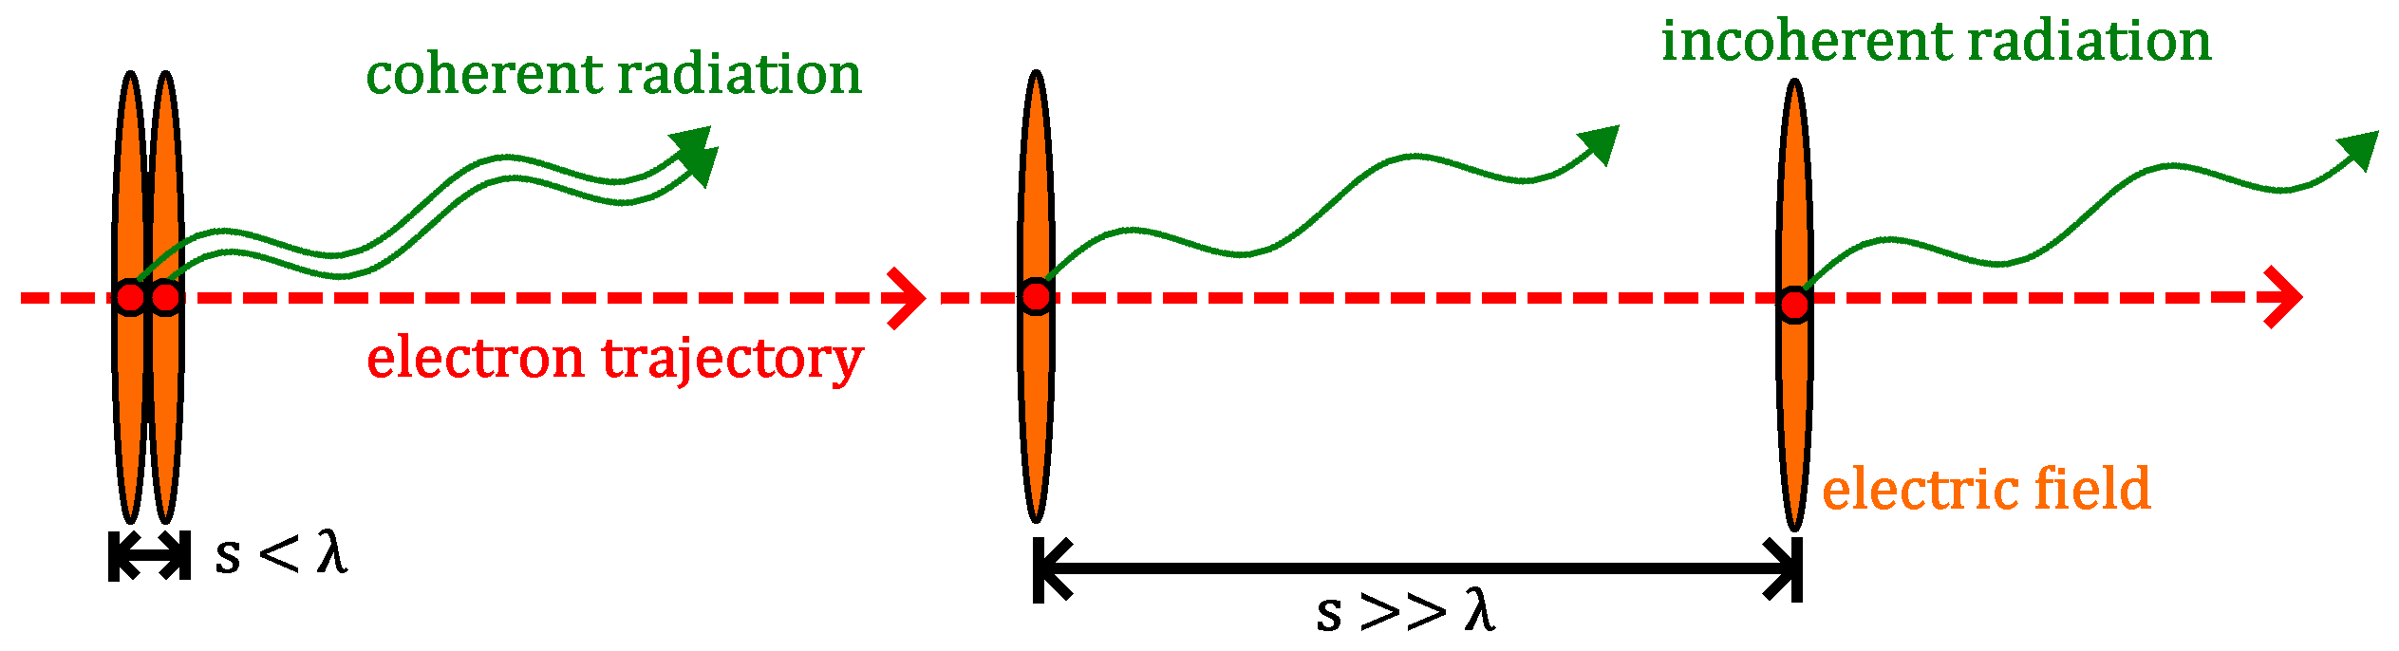
See poster tomorrow!
Electron beam emission – Longitudinal
Provide the users with THz CTR emission:
Interferometry across 1-30 um with dual view
Temporal FOV out to ~400fs in single frame
Form-factor pulse reconstruction of complex profiles
Broadband THz spectroscopy
Develop towards:
Ultra-high sensitivity single pixel detectors
Compressed sensing algorithms to enhance reconstruction of low signal

Slide 16
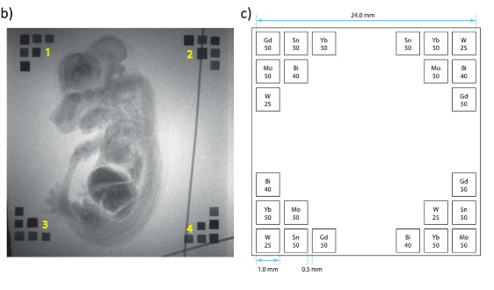
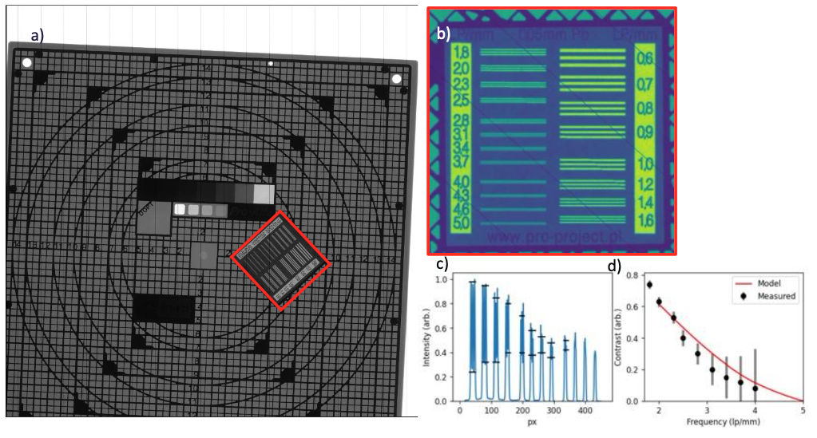
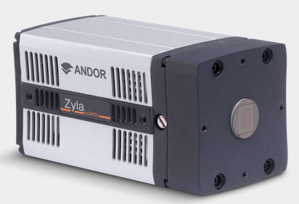
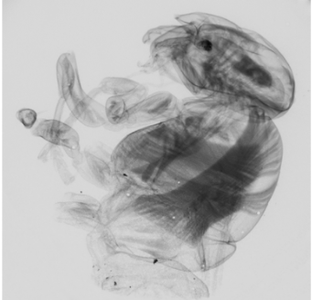
X-ray Characterisation – HE Spatial (10-300 keV)
Large Area: 300x300 mm at ~400 um resolution
J. Wood, ‘Betatron radiation from laser wakefield accelerators and its applications’, Sep. 2016, doi: 10.25560/58282
High resolution: 16 x 14 mm at ~50 um resolution
Provide the users with on-shot:
Highly efficiency detection of <100 keV x-ray.
Blurring PSF equivalent to 20um at the scintillator plane
Masking techniques to provide on-shot / in-image spectral reconstruction

Slide 17
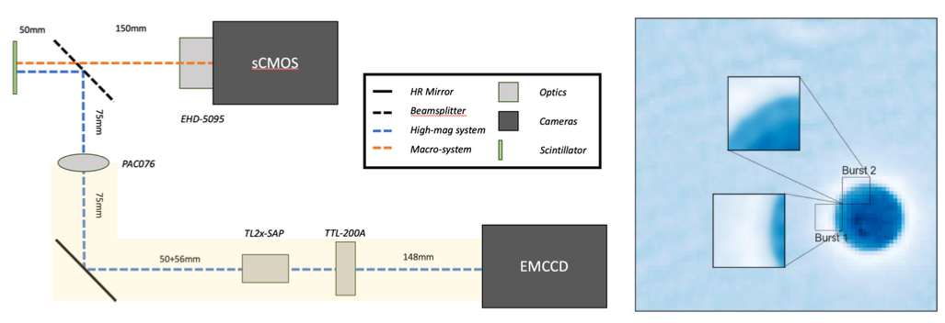
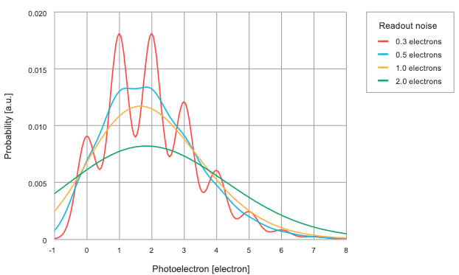
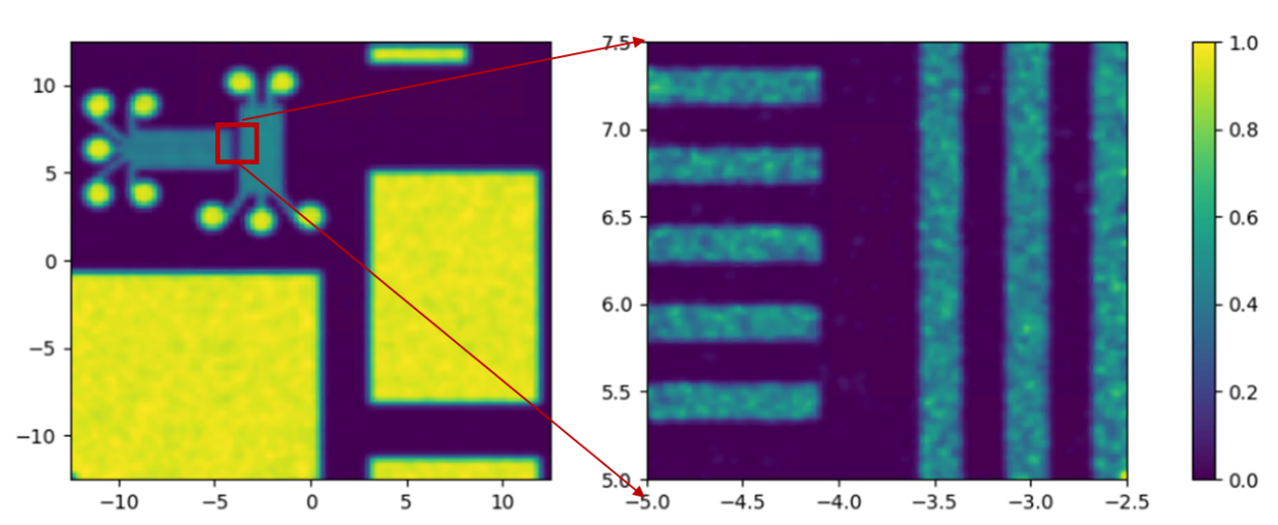
X-ray Characterisation – HR Spatial (10-300 keV)
Provide the users with on-shot:
Dual view at both ~50 and ~4 um plane resolution limits
Macro-view acts as a viewfinder for operation a mitigates any shot-shot instability.
Micro-view under few-x geometric magnification hits sub-micron resolving power of x-rays up to 100 keV.
Macro View
Micro View
Develop towards:
High repetition scanning of micro-view arm
Variable scintillator options
Larger FOV, lower noise.
Simulated radiograph

Slide 18
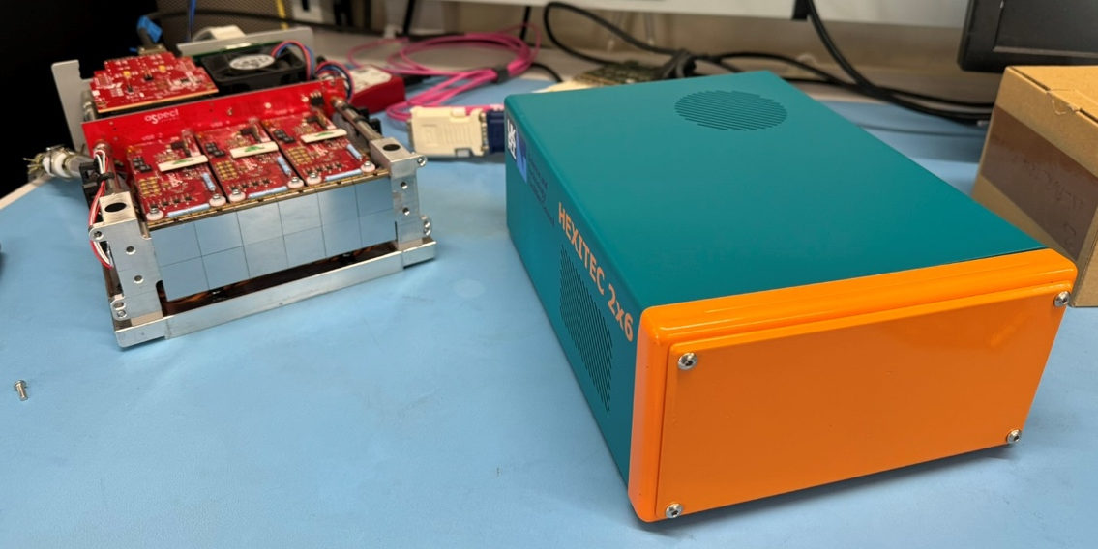
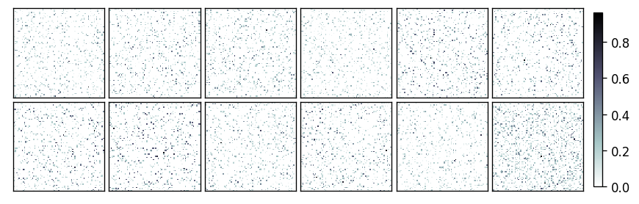
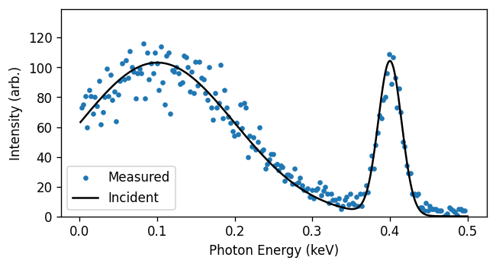
See poster tomorrow!
Veale, M. C., Seller, P., Wilson, M., & Liotti, E. (2018). Synchrotron Radiation News, 31(6), 28–32. https://doi.org/10.1080/08940886.2018.1528431
X-ray Characterisation – Spectral (10-600 keV)
Provide the users with on-shot:
76k px x-ray spectrometer with ~keV resolution to 600 keV
Target operation at 15% population to provide onshot characterisation of the full spectra.
Indirect/scattering methods to reduce flux and retain spectral information
Develop towards:
Spatial spectral techniques using multi-pinhole arrangements (multiple shots)
Diffractive measurements using combination of displacement and energy
High energy calibrations for Compton backscatter

Slide 19
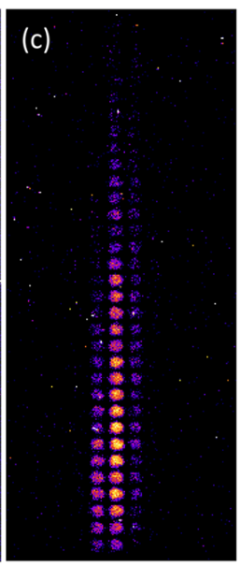
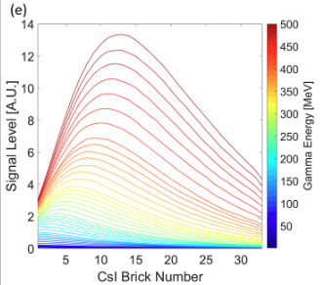
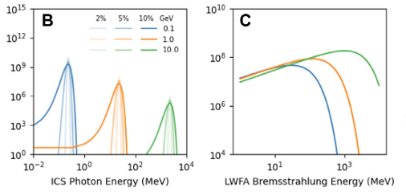
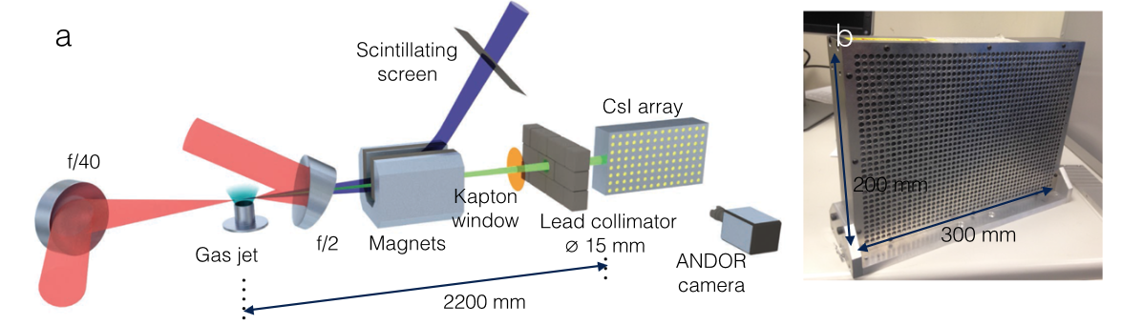


X-ray Characterisation – Spectral (0.3-300 MeV)
Inverse Compton Scatter
LWFA Bremsstrahlung
K. Behm et al. Rev. Sci. Instrum. 89, 113303 (2018)
$$θ$$
$$∝E$$
Broadband spectral characterisation:
For higher energies we need significantly more attenuation
Past users have used ~300mm of CsI (4g/cc)
Applied a similar reconstruction process to before iteratively fitting the expected shape with the response matrix

Slide 20
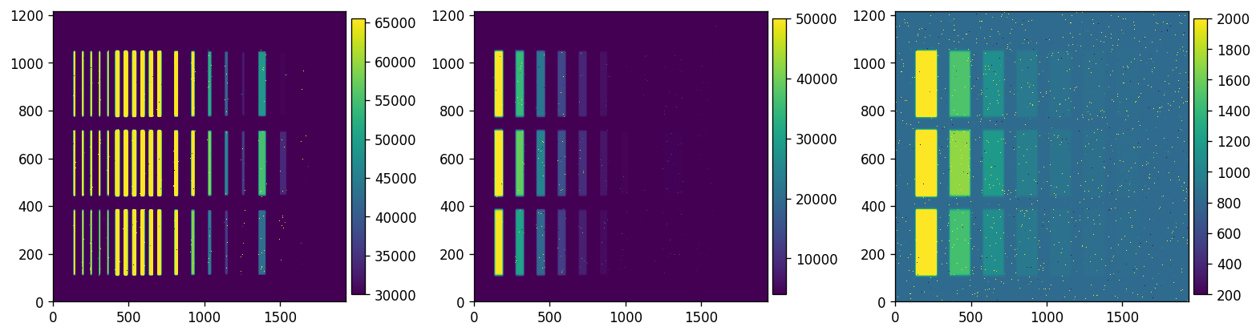
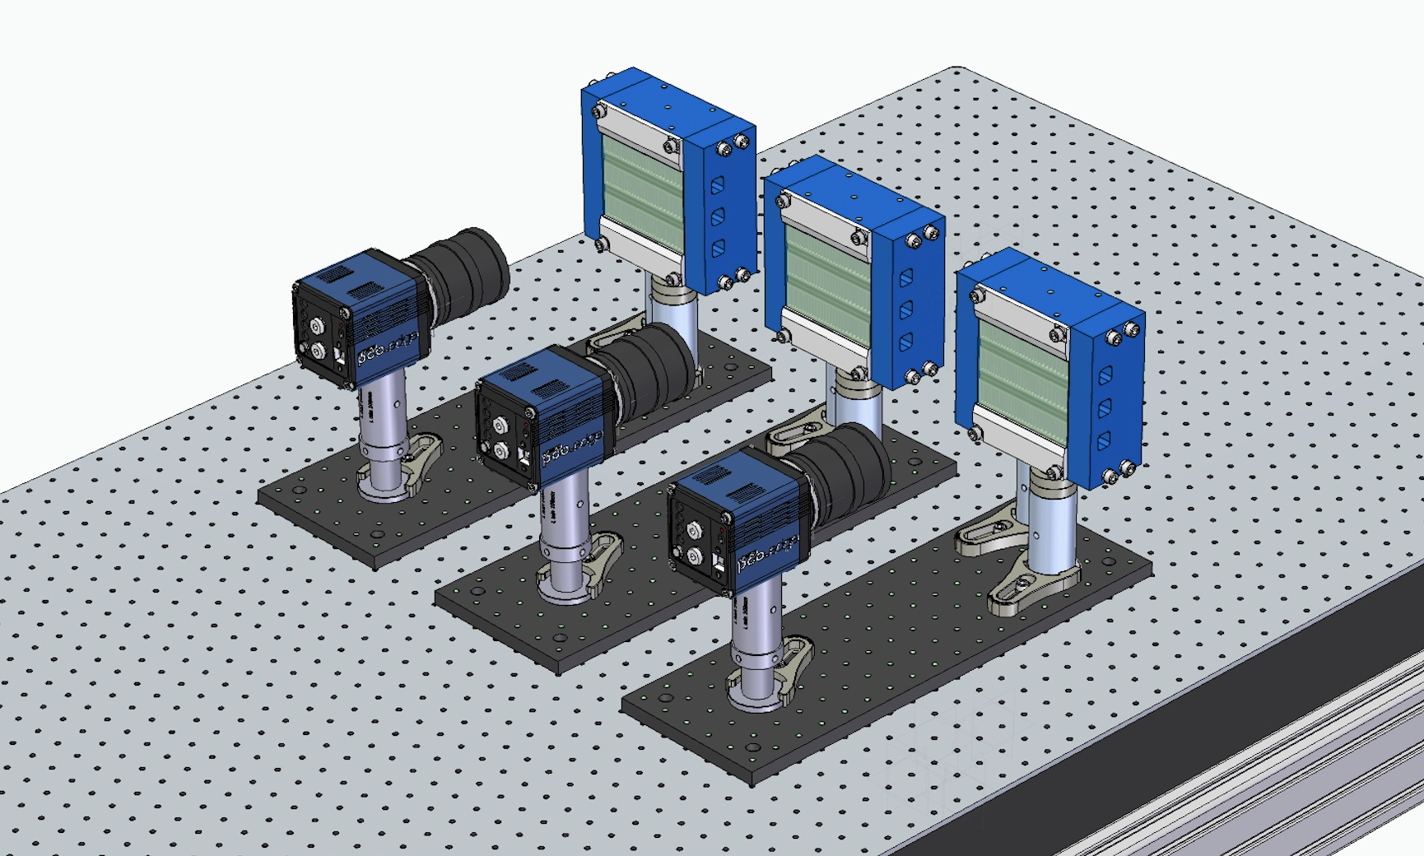
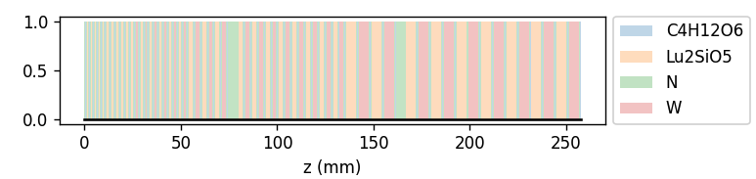
X-ray Characterisation – Spectral (0.3-300 MeV)
Inverse Compton Scatter
LWFA Bremsstrahlung
Camera 1
Camera 2
$$∝E$$
Broadband spectral characterisation:
For higher energies we need significantly more attenuation
Past users have used ~300mm of CsI (4g/cc)
Applied a similar reconstruction process to before iteratively fitting the expected shape with the response matrix
EPAC version is ~250 mm of LYSO (7g/cc) split across 3 camera systems with independent gain and lens systems to maximise dynamic range
Camera 3

Slide 21
Experimental Requirements for EA2
Predominantly solid targets with short focal length parabolas. Requires characterisation of emitted particle and photon radiation, emission is simultaneous/co-linear so isolation methods must be considered.

Slide 22
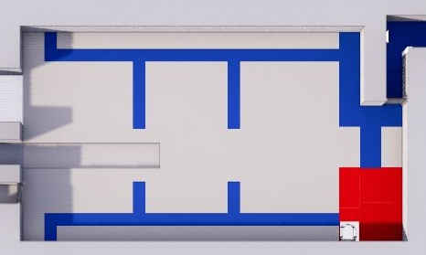
EA2 Examples Experimental Layout
Experiment description:
Solid target interaction using short focal length parabola at high intensity
Structured tape targets spooled at 1 Hz operation
Investigating the coupling of laser-energy into the accelerated electrons and secondary radiation
Expected variation from focus, pre-plasma formation, laser/target parameters
Large emission area with mix of radiation types
Diagnostic Areas:
Laser input conditions
Laser-plasma coupling characterisation
Target evolution
Emitted proton/ion radiation
X-ray radiation
Neutrons from secondary converter (ion/x-ray source)

Slide 23
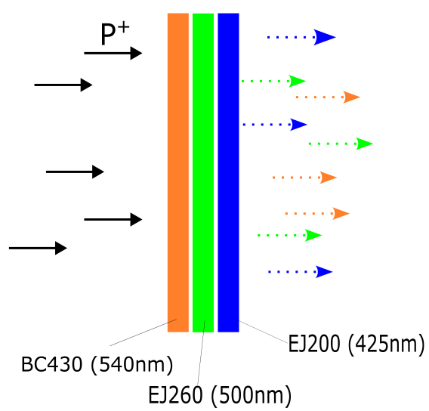
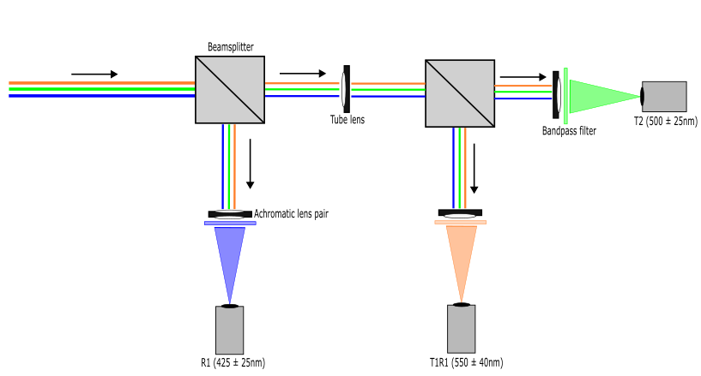
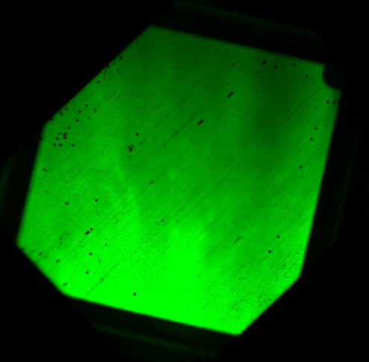
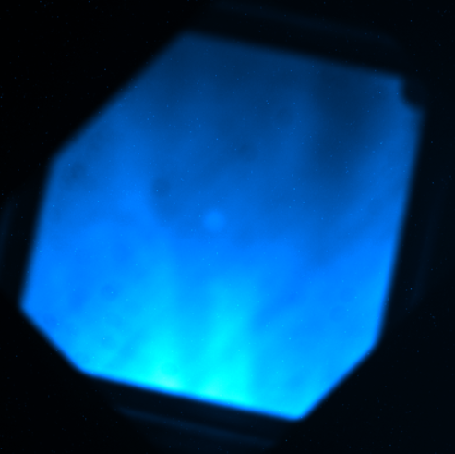
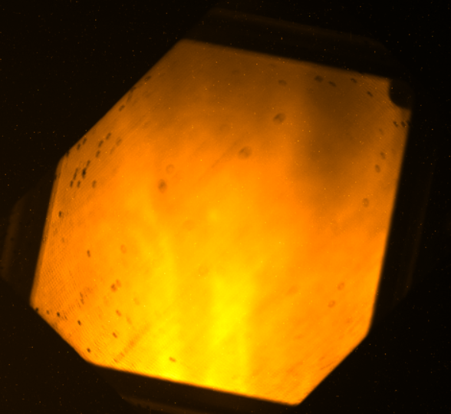
Emitted proton/ion distribution - spatial
Provide the users:
Few energy-bin system for inspecting spatial proton/ion emission
RCF-like at 10 Hz
“Probies” style mask to provide further attenuation regions
Provide the users with on-shot:
9.1 MeV
Develop towards:
11.3MeV
5.8 MeV

Slide 24
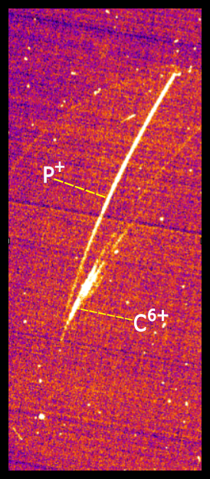
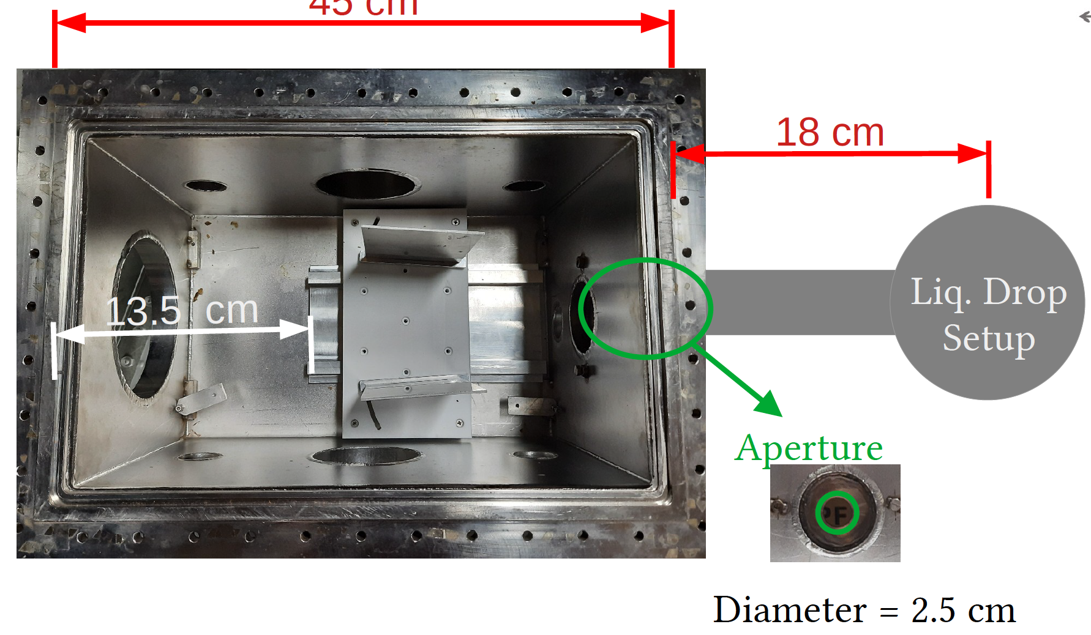

Emitted proton/ion distribution - spectral
Source
Provide the users with on-shot:
2x dedicated Thomson parabola angles
Characterised ”TAP” style active Thomson with high brightness phosphor screen
Proton/ion distinction with variable e-field
Source
Develop towards:
2D array pinhole development for ~degree resolution proton characterisation

Slide 25


Emitted neutron distribution - spatial
Armstrong et al. Submitted to Review of Scientific Instruments, (2024)
Provide the users:
2-4x 10 ns gated images of fast scintillator system
Spatially resolving isolated neutron energies up to 100 MeV
Gamma-discretion through time rather than PSD
Develop towards:

Slide 26



Emitted neutron distribution - spectral
Temporal response
High sensitivity response
Blackened surfaces only permit direct light to PMT
Kills “whispering gallery”
~100ps response material limited
Hyperbolic shape redirects signal to PMT
High reflectivity coating to maintain intensity
<ns response, volume limited
Current version
Pushing to faster responses
Provide the users:
~200 ps temporal resolution of arriving signal
Neutron and proton sensitivity
3x channels to provide multiple angles of sampling
Scintillator
PMT
Develop towards:
<100 ps temporal resolution
In-vacuum mounting for p-TOF response

Slide 27




X-ray characterisation - spatial
Provide the users with on-shot:
100-400 um resolution over 150 x 150 mm² active FOV
~10% absorbed energy at 10 MeV (for 5 mm thick system)
1 mm thick system equivalent sensitivity to commercial FOP with approximately 3x better resolution
5 mm thick system approximately an order of magnitude higher sensitivity (E>1 MeV) with equivalent resolution

Slide 28


Summary
Protons / Ions:
<100 MeV Thomson spectroscopy
3-Layer spectro-spatial monitor as “active-RCF”
Providing a comprehensive suite of detectors and diagnostics to cover base needs from the user/industrial community
Laser input conditions, plasma/target evolution, and emitted radiation diagnostics.
Highlights:
  Sub-micron system for 100 keV betatron
  <200 um system for 1-10 MeV x-rays
  Longitudinal and emissivity diagnostics for electron optimisation
Neutrons:
Time gated imaging with fast CH scintillator
High temporal resolution nTOF
X-rays:
High spatial resolution <100 keV
Wide FOV (>150mm) imaging across energy domains
High efficiency 100 keV imaging
~keV resolution spectroscopy up to 600 keV
Spectral fitting up to 100s MeV
Electrons:
Compact <100 MeV spectroscopy
% level 0.5-10 GeV spectroscopy
Beam pointing/distribution monitors in line
Electron beamline optics
Non-invasive charge measurements
Longitudinal characterisation via CTR

Slide 29
Extra Slides

Slide 30

X-ray sources
DLA Induced X-rays
T. Wang, Phys. Rev. Applied 13, 054024 (2020)
Positron Annihilation
R. J., Murphy, et al. Astrophys. Journal Supp. Series 161.2 (2005)
2^{ndary} Nuclear Emissions
M.M Günther, et al. Nat Commun 13, 170 (2022).
F Mackenroth, et al. Physical Review E 99.3 (2019): 033205.
ICS
H-E Tsai, et al. Physics of Plasmas 22.2 (2015).
S. Cipiccia, et al. Journal of Applied Physics 111.6 (2012).
Bremsstrahlung
R. D. Edwards, et al. Applied Physics Letters 80.12 (2002)
Transition lines (k-$α$..)
P. Neumayer, et al. Physics of plasmas 17.10 (2010).
Betatron Emission
F. Albert, and A. G. R. Thomas. Plasma Physics and Controlled Fusion 58.10 (2016)
HHG
T. Popmintchev, et al. Science 336.6086 (2012)
Notes:
The abstract pattern can be removed or repositioned if required. Be careful to ‘Send to Back’ so that it does not obscure any important information.

Slide 31
X-ray Characterisation – Spectral Techniques
Cascade Detection
R. J. Protheroe, MNRAS 221.4 (1986): 769-788
Compton Recoil
Kojima et al. Rev. Sci. Instrum. 87, 043502 (2016)
Single Hit Spectroscopy
Activation
Rakowski et al. Scientific REPORTS | 7: 16603 (2017)
M. I. K. Santala, et al. APL 78.1 (2001)
Rusby, D. R., et al. RSI 89.7 (2018).
Transmission/Absorption Spectroscopy
Chen, C. D., et al. RSI 79.10 (2008).
Behm, K. T., et al. RSI 89.11 (2018).
Maddox, B. R., et al. RSI 82.2 (2011).
Ross-Pair Differential Spectroscopy
Transmissive
J Seely. RSI. 93, 093529 (2022)
Bragg Crystal Refraction
K. W. Hill et al. RSI. 87, 11E344 (2016)
Reflective
C. Svetina, et al. Opt. Lett. 44, 574-577 (2019)
Talbot/Fresnel Grating Spectroscopy
Photo-electric
Compton Scattering
Pair Production
Notes:
The abstract pattern can be removed or repositioned if required. Be careful to ‘Send to Back’ so that it does not obscure any important information.

Slide 32



X-ray Characterisation – Spectral (10-300 keV)
Broadband spectral characterisation:
Triple axis linear absorption spectrometer
High efficiency measure of incident radiation with minor angle ($θ_{LAS}$) between each carriage.
Either:
  Angular variation from fixed pattern offset
  Spectral region change when $θ_{x}≫θ_{LAS}$
Provide the users with on-shot:
Spectral characterisation between ~10 keV and 500 keV critical energy
<% resolution (for betatron spectral shape) across energy range
”At-rep” analysis routine for incident single temperature
~Hz level analysis routine for complex spectral shapes
180 keV
Develop towards:
”At-rep” analysis routine for incident complex spectra
“Anomaly” detection for “unknown” spectral features
ML-reconstruction
Optimised scintillator patterns
200 keV
180 keV
Synthetic data

Slide 33

From upstairs:
Pulse duration (SPIDER)
  Pick off reference to whole beam characterisation
SOD, TOD terms
Laser characterisation diagnostics
NF/FF for stabilisation/ pilot beam
Spectrometer
Wavefront monitor and NF/FF for main beam
Highly reflective for CW and alignment
Provide the users with on-shot:
Laser energy (NF integral)
Beam footprint (NF uniformity)
Pointing (FF centroid)
Wavefront (Zernike modes)
AR coating at 800 for full power
Laser monitor via leaked through final turning mirror
Wedge to minimise ghosts/secondary surface reflections

Slide 34




Electron beam emission – Emissivity
Quad (1)
Monitor (2)
Provide the users with ability to:
Vary quadrupole position and monitor impact on the spatial profile of the beam
Floor dictated by plasma mirror
Permanent high-field quadrupole to capture/control electron beam
Develop towards:
Active methods for focus and emissivity scanning of quadrupoles as routine.
10x permanent quad set for long-distance focus

Slide 35
Laser characterisation diagnostics
Wedge to minimise ghosts/secondary surface reflections
Provide the users with on-shot:
Laser energy (NF integral)
Beam footprint (NF uniformity)
Pointing (FF centroid)
Wavefront (Zernike modes)
Laser monitor via leaked through final turning mirror
AR coating at 800 for full power
Highly reflective for CW and alignment
Spectrometer
NF/FF for stabilisation/ pilot beam
Wavefront monitor and NF/FF for main beam

Slide 36




Escaping electron distribution
Active compact e-spec design:
Field-tested design with configurations up to 50 MeV
Small-throw, double-magnet, reduced field versions tested with community.
Provide the users:
3-4x chassis with variable internals
Calibrated and known configurations to work up to 100 MeV
Develop towards:
Spectro-spatial developments with coded-aperture/complex pinhole

Slide 37
See poster tomorrow!
Veale, M. C., Seller, P., Wilson, M., & Liotti, E. (2018). Synchrotron Radiation News, 31(6), 28–32. https://doi.org/10.1080/08940886.2018.1528431
X-ray Characterisation – Spectral (10-600 keV)
Provide the users with on-shot:
76k px x-ray spectrometer with ~keV resolution to 600 keV
Target operation at 15% population to provide onshot characterisation of the full spectra.
Indirect/scattering methods to reduce flux and retain spectral information
Develop towards:
Spatial spectral techniques using multi-pinhole arrangements (multiple shots)
Diffractive measurements using combination of displacement and energy
High energy calibrations for Compton backscatter

Slide 38

X-ray Characterisation – Spectral (0.3-10 MeV)
Broadband spectral characterisation:
  Triple axis linear absorption spectrometer
  High efficiency measure of incident radiation with minor angle ($θ_{LAS}$) between each carriage.
  Either:
    Angular variation from fixed pattern offset
    Spectral region change when $θ_{x}≫θ_{LAS}$
Provide the users with on-shot:
Spectral characterisation between ~100 keV and 10 MeV Boltzmann temperatures
<5% resolution across energy range
”At-rep” analysis routine for incident single temperature
~Hz level analysis routine for complex spectral shapes
180 keV
Develop towards:
”At-rep” analysis routine for incident complex spectra
“Anomaly” detection for “unknown” spectral features
ML-reconstruction
Optimised scintillator patterns
200 keV
180 keV
Synthetic data

Slide 39
Status at 2021 ISTAC
Concept
Design
Prototyping
Procurement
Characterisation
Commissioning
Sub-micron,
<100 keV x-ray
Imaging
MeV Imager,
MeV x-ray
Multi-modal,
>100 keV x-ray, N
Bayer Mask
<100 keV x-ray
LAS,
MeV x-ray
Spectroscopy
nTOF
< 100 MeV Neutron
THz
0.1-50 Thz
Development

Slide 40
Status at 2022 ISTAC
Concept
Design
Prototyping
Procurement
Characterisation
Commissioning
Sub-micron,
<100 keV x-ray
Imaging
MeV Imager,
MeV x-ray
Multi-modal,
>100 keV x-ray, N
Large Area Panel,
High sensitivity
Bayer Mask
<100 keV x-ray
LAS,
MeV x-ray
Spectroscopy
nTOF
< 100 MeV Neutron
THz
0.1-50 Thz
Development

Slide 41
Status at 2022 ISTAC
Concept
Design
Prototyping
Procurement
Characterisation
Commissioning
Sub-micron,
<100 keV x-ray
Imaging
MeV Imager,
MeV x-ray
Multi-modal,
>100 keV x-ray, N
Large Area Panel,
High sensitivity
Direct Coupled,
Efficient/Resolution, x
Bayer Mask
<100 keV x-ray
LAS, (3 versions)
MeV x-ray
Spectroscopy
nTOF
< 100 MeV Neutron
THz
0.1-50 THz
Hexitec
10-600 keV x-ray
Development

