Slide 1



EPAC
Experimental Area 2
James Green
EPAC International Scientific and Technical Committee meeting
14th May 2024

Slide 2
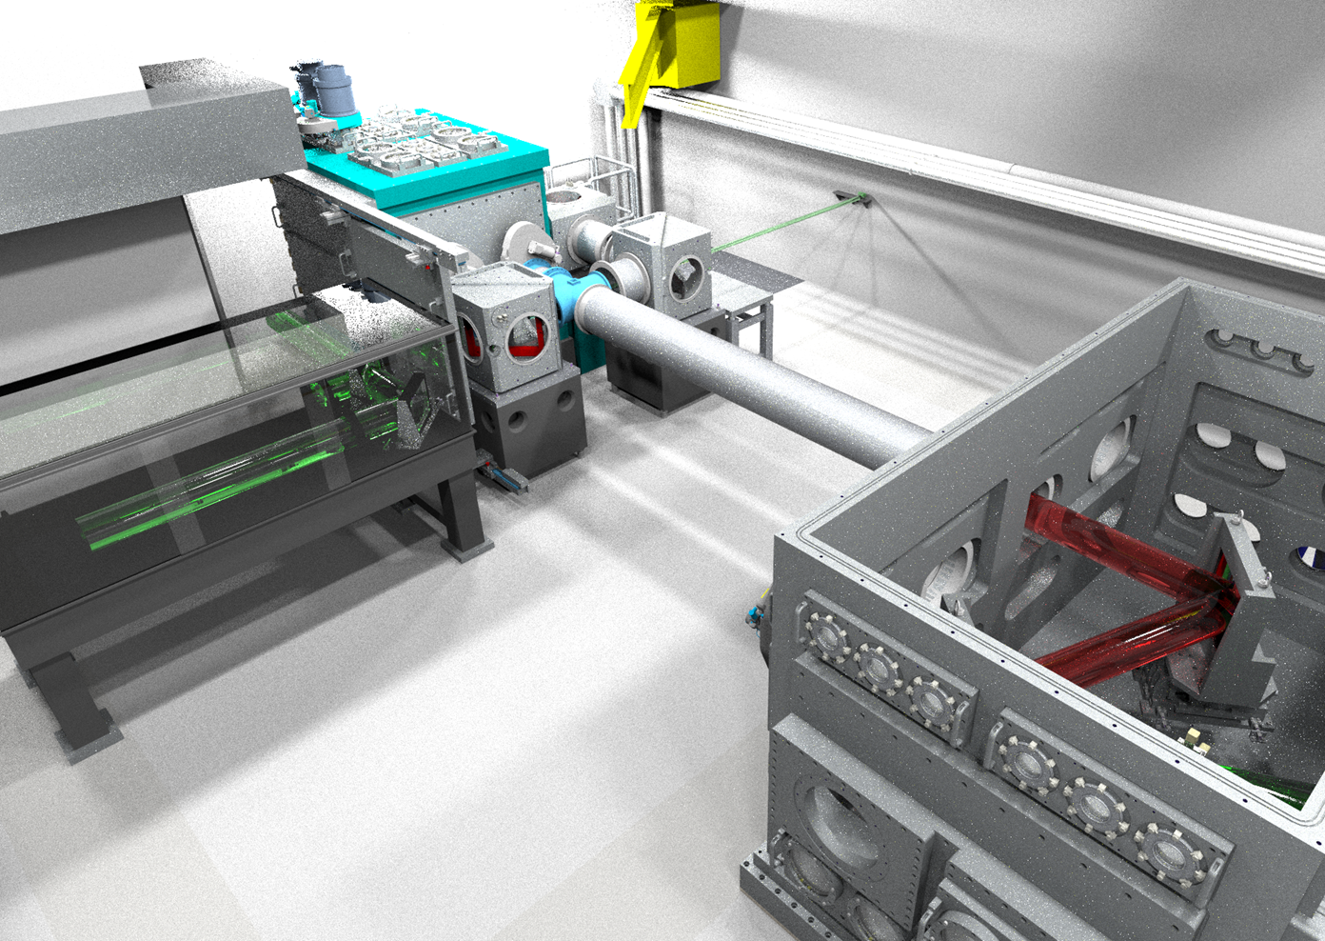

Experimental Area 2
Flexible experimental area for broad range of interaction geometries
Primary focus on high density laser-matter interactions for optimisation of secondary sources and fundamental science
Initial project scope (2020)
Full design of an experimental area capable of delivering short and long focus experiments
Procurement and installation of large-scale engineering infrastructure for beam delivery
Budget of ~£1.5m

Slide 3
EA2 Budget uplift
Additional MOD funding secured in 2023 to bring EA2 online much sooner.
Budget increased to ~£3.5m to realise the following revised objectives:
Procurement of main beamline large optics and opto-mechanics to enable first light with a focused intensity of > 1x10²¹ Wcm⁻² in short focus configuration (f/3).
Installation of mechanical and electrical services for the experimental area
Procurement of laser diagnostic suite (pre-interaction) to monitor key beam parameters and stability
Installation of all required beam transport, optics and key area components to permit internal alignment
Initial commissioning program to enable delivery of external CW and low power beams to target

Slide 4
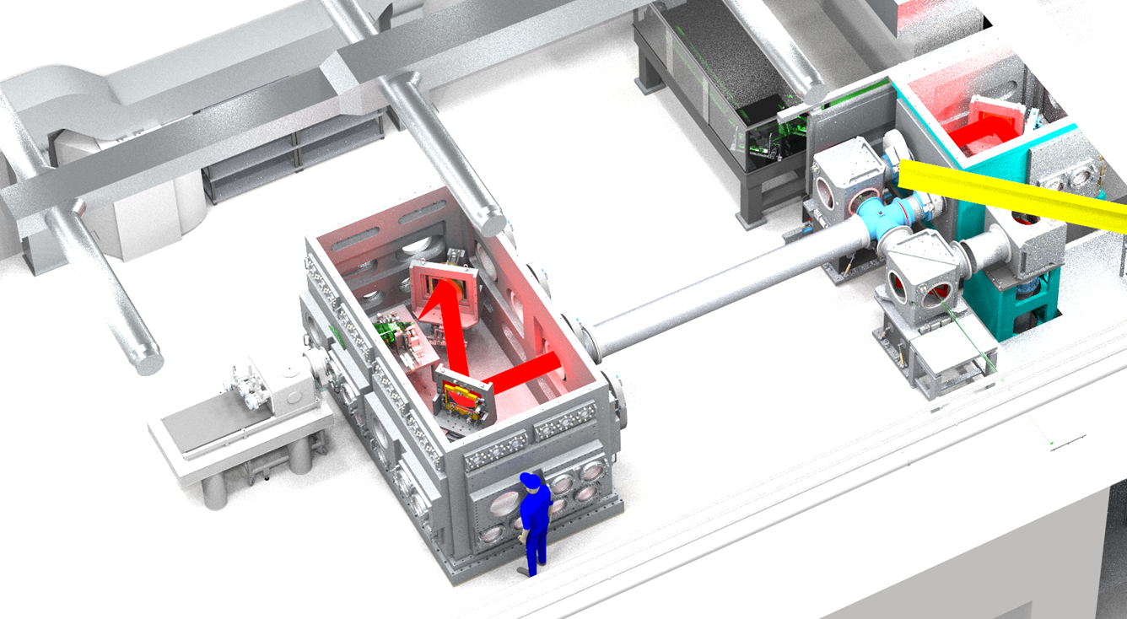
EA2 – Overview and timeline
AO Chamber
Beam diagnostics
Interaction Chamber
Beam entry from pit
Forward directed diagnostic area
CW beam input
Timeline:
2024-2025 – Delivery and installation of large-scale infrastructure
Q4 2025 – Area completion and Commissioning
Q2 2026 – First source optimisation experiments

Slide 5
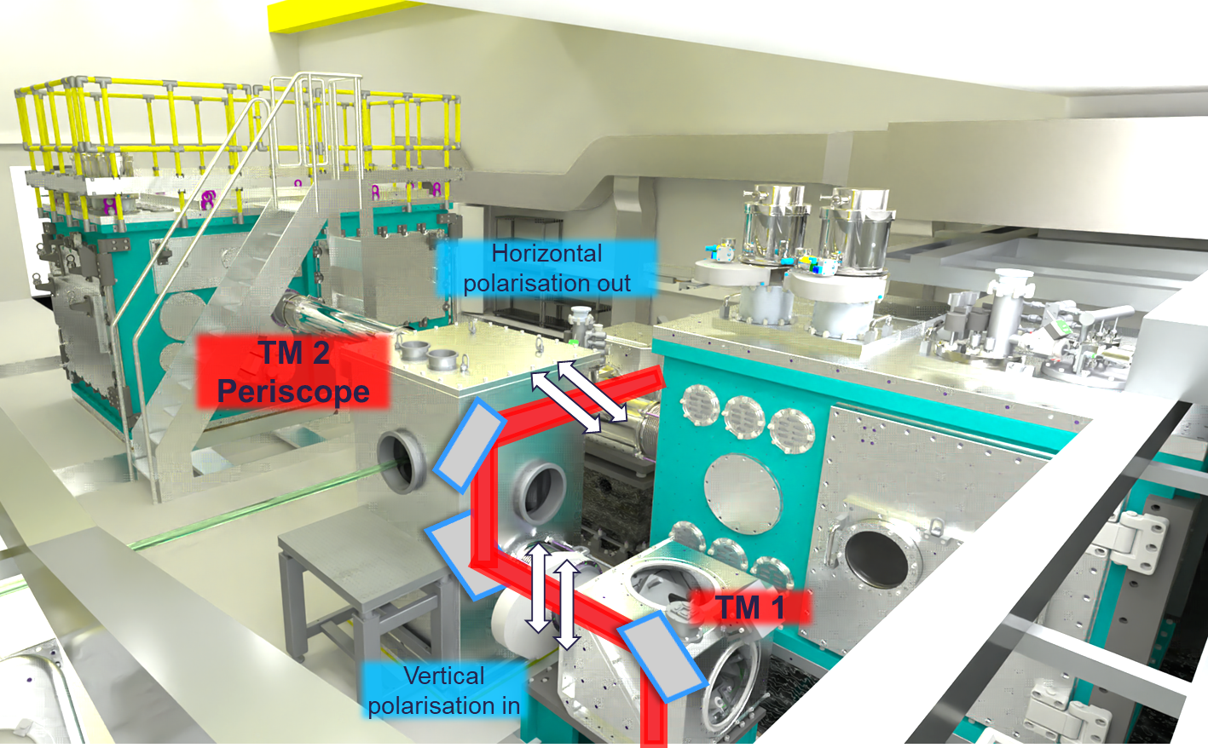
EA2 – Polarisation switch

Slide 6
EA2 – Current activities and timeline
Design work and installation:
2024
  AO chamber tender - Awarded
  Delivery of large optics mounts – Assembly underway
  Completion of design work for Interaction Chamber
  Completion of remaining beam transport design
2025
  Installation of AO and Interaction Chambers
  Other beam transport, services install
  Delivery of f/3 parabola
  Commissioning begins (Q4)
2026
  Source optimisation experiments begin
  Additional capabilities begin installation (TBC)
Research and Development:
2024
  Working to finalise design for ion diagnostics
  Off-line and in-situ testing of liquid jet / liquid crystal targetry systems
  Procurement of solid targetry array
  Data collection and analysis of debris creation, damage testing, pellicle tests
2025
  Testing of solid targetry array system
  Full experimental testing of liquid jet system
  2nd harmonic crystal testing for high contrast operations

Slide 7
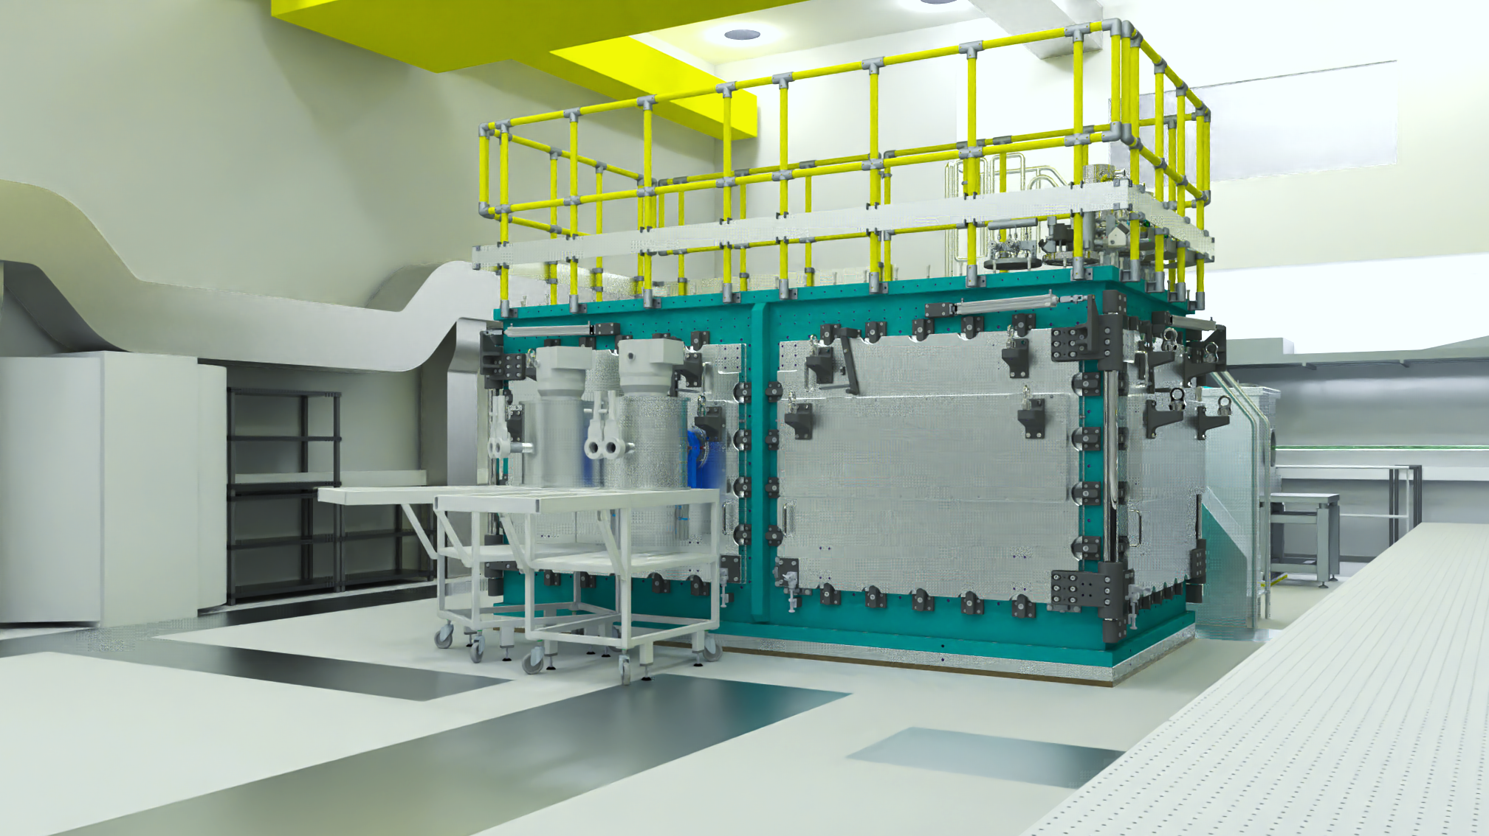
EA2 - Interaction chamber
Design work nearing completion
Aiming tender launch in Q3 2024
Delivery in Q4 2025 – Q1 2026

Slide 8
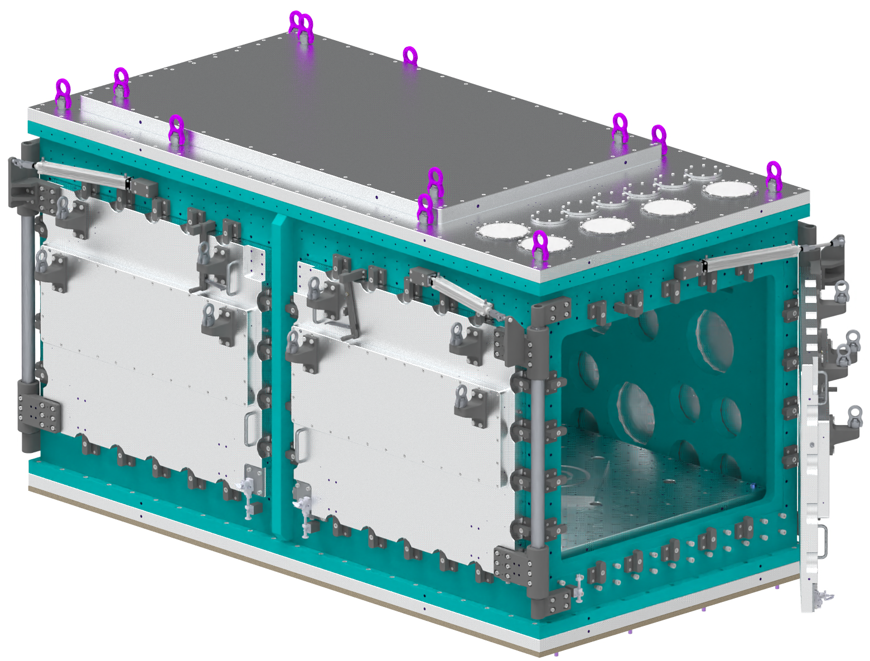
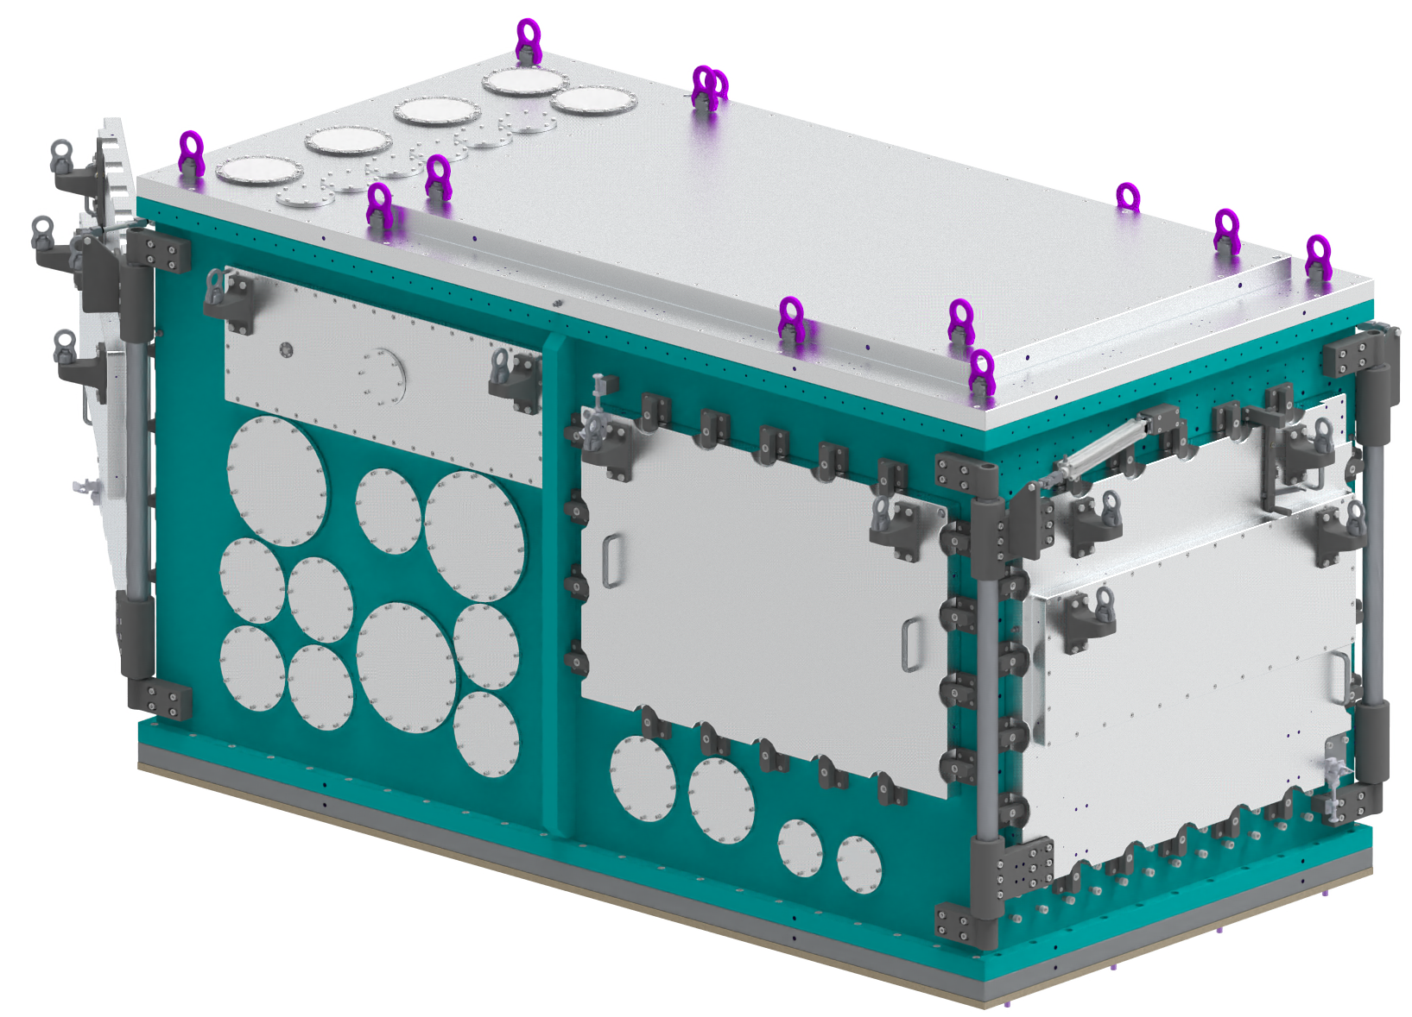
Interaction chamber
Permanent ports for vacuum and probe / long pulse input
4900 mm
Removable roof section
Diagnostic / Rear side
Beam input side
2370 mm
2700 mm
Notes:
Design work ongoing in 2024 and installation work for 2025
- Further details on commissioning on next slide
R&D:
- Goals for 2024 and 2025

Slide 9
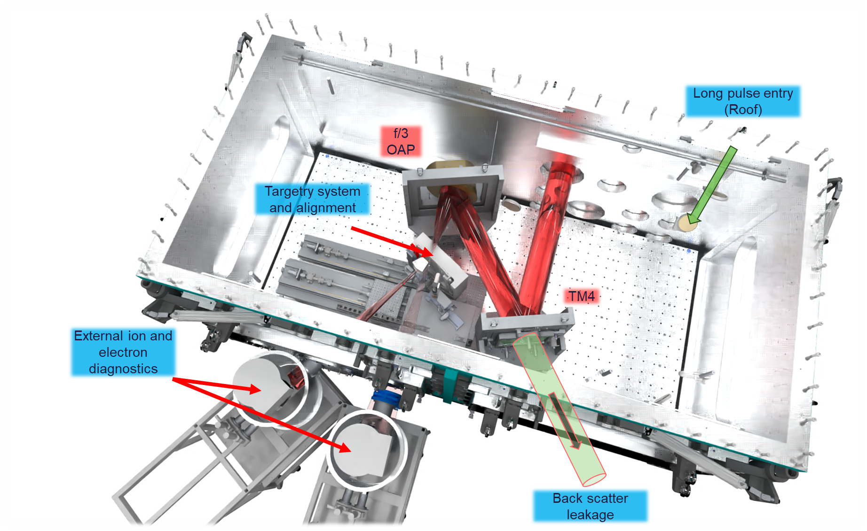
EA2 – f/3 layout for Day 1

Slide 10
Commissioning to User experiments
Area commissioning
Source optimisation
User experiments
(2025-)
(2026)
(2026-)
Testing of engineering systems e.g. vacuum, motion control
Target systems and alignment
Laser diagnostics and stability
Laser energy (and rep-rate) ramp to full power @ 1Hz:
  Radiological commissioning
  Plasma and particle diagnostics
  Ion / electron scalings
  Debris and EMP
  Laser contrast
(1) Demonstration of stable ion acceleration in TNSA regime at 1 Hz
(2) Production of bright x-ray Bremsstrahlung source
Feedback systems on laser and targets
Tape drive or liquid targetry
Verification of debris mitigation, data acquisition at 1 Hz
User group(s) involvement!
1st call for experiments, user-driven aligned to facility priorities
Operation in configured access mode
Commissioning of additional source diagnostics
Other laser and focusing capabilities come online

Slide 11
Day 1 capabilities
Targetry
Solid targetry array – Commissioning
Tape drive - Commissioning
Liquid jet – (Phase 2 of source optimisation)
Relevant to Source Optimisation and first experiments
EPAC PW beam (800 nm):
Single shot – 1Hz
20J maximum
30 fs
f/3 ~2x10²¹ Wcm⁻²
AOI to target >30 degrees
Diagnostics
Thomson parabolas
High resolution 2D ion beam profiler
Electron spectrometers
X-ray Linear Absorption Spectrometers (WP8)
X-ray MeV Tiler Imager (WP8)
X-ray Large Area X-ray Panel (WP8)
Laser reflectivity / backscatter
EMP diagnostics
Optical Transmission Radiation
Transverse / reflective optical probes (TBC for Day 1)
Laser-related systems
Adaptive Optic
Full power laser diagnostics
Internal CW for set-up
Automated control and optimisation

Slide 12
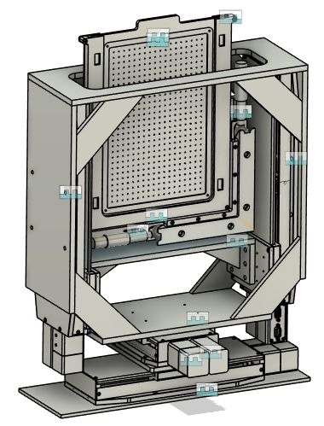
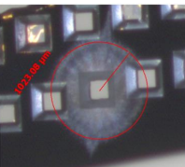
Solid targetry for EA2
Solid target array
Critical for ultra-thin targets, more complex assemblies
Investigating limitations on rep-rate, damage resistance, alignment
Will hold ~ 400 targets plus alignment references
Looking at array-based system as well as High Accuracy Microtarget Supply (HAMS)
Parallel research into supporting technology of rapid manufacture and assembly
  Deep Reactive Ion Etcher (DRIE)
  Robotic pick and place system
HAMS targetry testing @ CLF
Solid targetry array

Slide 13
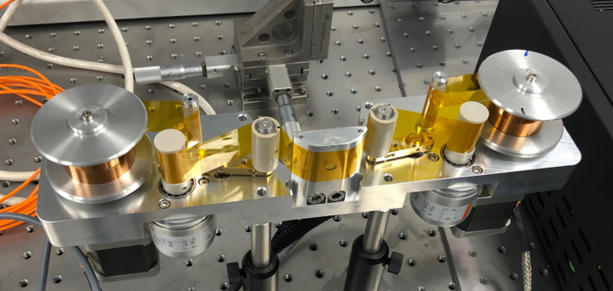
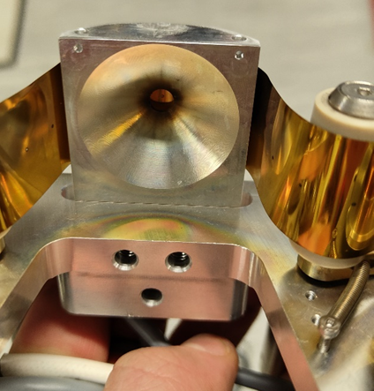
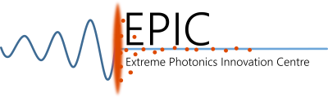
CLF Tape drive
CLF Tape drive continues to be fielded on user experiments at CLF and internationally
Current R&D focuses on extra improvements with extra shielding for EMP, X-rays and Debris
New version to allow shooting at wider angles, and to permit access for focal spot camera
EPIC collaboration working on coating system to deport metallic dots onto tape and then characterisations
CLF-based coating system will be capable of coating 250m tape in 8 hours (similar to 1Hz shot rate)
An extended tape drive for off axis shots
Cu debris

Slide 14

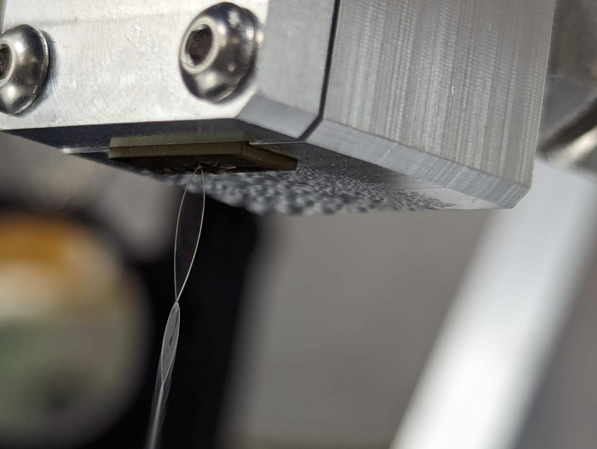


Liquid jet and Liquid crystal targetry
Liquid jet
New collaboration between SLAC, CLF and QUB following on from Gemini testing
Lab operational in EPAC for testing
Prototyping new nozzles including 3D printed to test multiple designs along with simulations.
Working with QUB on diagnosing performance
Liquid crystal
Primary application for high rep-rate plasma mirror
Working with UKRI legal on agreement to permit CLF testing and developments
Liquid jet testing at the CLF
(April 2023)

Slide 15
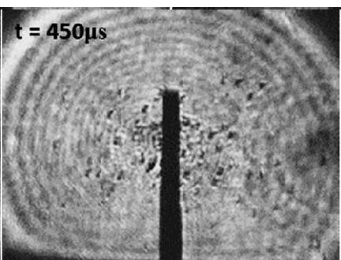
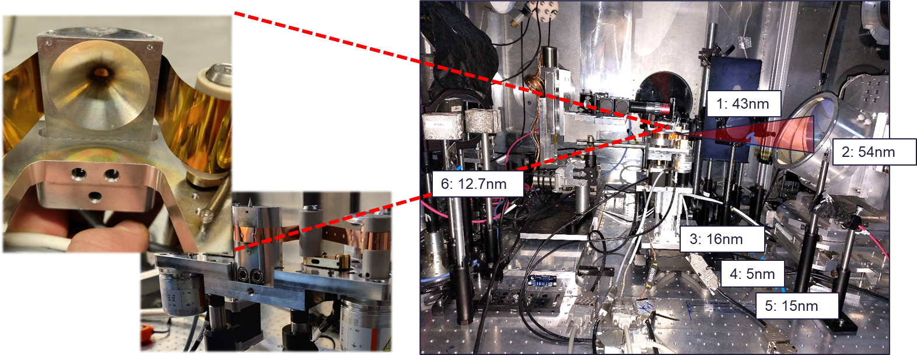
Debris mitigation
We are continuing to study debris emission from a range of experiment types
Quantitative data from Gemini on debris build up.
New high-speed camera now being prepared for several experiments
High speed imaging of debris emission
Debris measurements from Gemini

Slide 16
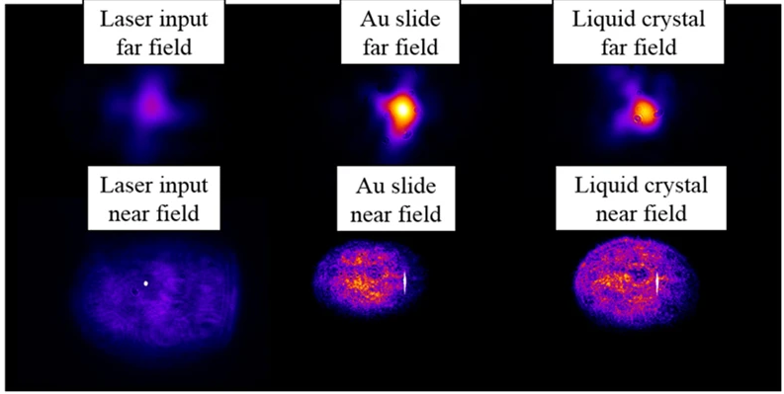
Future capability - High contrast
Initial source optimisation and user experiments will be with native laser contrast
Initial contrast levels can be characterised as EA1 comes online
R&D underway looking at contrast improvement solutions if required. Most likely candidates:
  Liquid-crystal plasma mirror system
  Frequency doubling (800 nm -> 400 nm)
Target fab looking will be building own liquid crystal system in collaboration with Ohio State University
Looking at viability of buying thin KDP for testing 400nm operations in Gemini
Liquid crystal plasma mirrors (P.L. Poole et al. Sci. Rep. 2016)

Slide 17
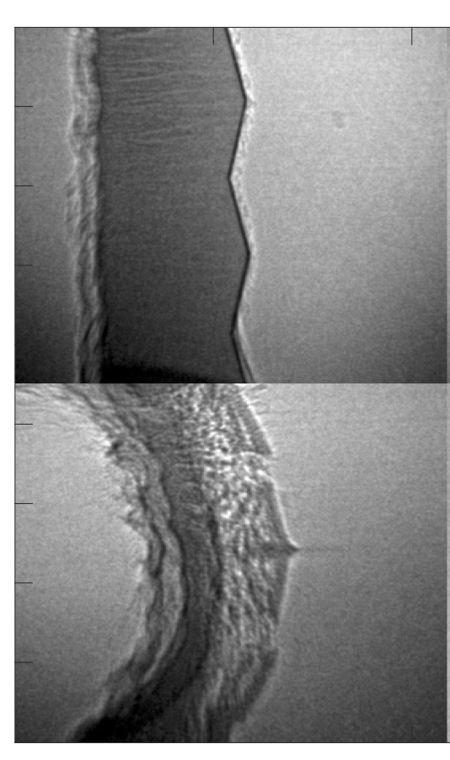
Future capability - Long pulse beams
A new additional DiPOLE pump laser purchased for EPAC could be propagated down to experimental areas
Would enable pump-probe geometries for a range of science areas, e.g.
Time-resolved probing of shock propagation
Astrophysical plasmas and large magnetic fields
Tailored pre-plasma formation on front surface for laser absorption and acceleration
Cold
50μm
80ns
Proton probing astrophysical plasmas L. Romagnani
Betatron imaging shocked Al –
J Wood (Imperial College)
Long pulse beam parameters (TBC!)
~100-150 J in IR, upto 10 Hz
Could be frequency doubled to ~60J in Green (in EA)
Pulse length of 2-15ns with pulse shaping
Focal spots from 50 µm to 100’s µm with phase plates
EA1 and/or EA2?
Might be delivered to one area first depending on compatibility

Slide 18
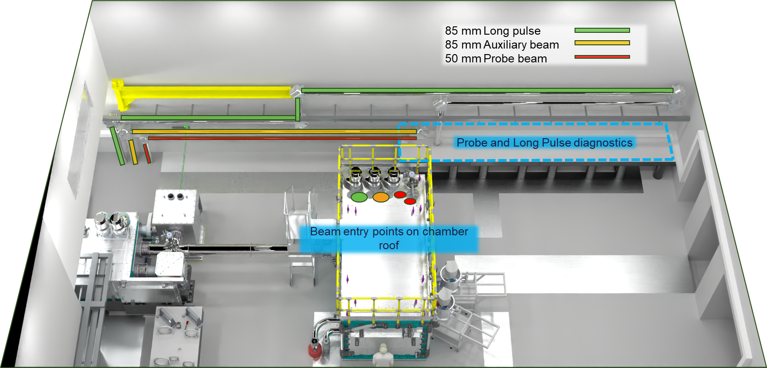
EA2 – Probe and Long pulse beams
Notes:
Example of probe and long pulse propagation for EA2
Large diagnostic area at the back of the room against the wall for probe beam and long pulse beam diagnostics and frequency conversion.
Aim to propagate each to roof of Interaction chamber to keep main doors free.

Slide 19
EA2 Summary
EA2 design work progressing well, with procurement of large-scale infrastructure underway. Expect commissioning from Q4 2025 onwards
Additional budget has allowed us to accelerate procurement of beamline infrastructure, services and large optics.
Working towards Day 1 capability to field high repetition rate ion acceleration experiments.
R&D continues on high repetition rate ion diagnostics, targetry systems and debris mitigation
Consultations underway on future capabilities including a long pulse beam, high contrast operations and longer focusing geometries

Slide 20



Thank you
Extreme Photonics Applications Centre (EPAC)
Notes:
The abstract pattern can be removed or repositioned if required. Be careful to ‘Send to Back’ so that it does not obscure any important information.

Slide 21
Additional slides

Slide 22
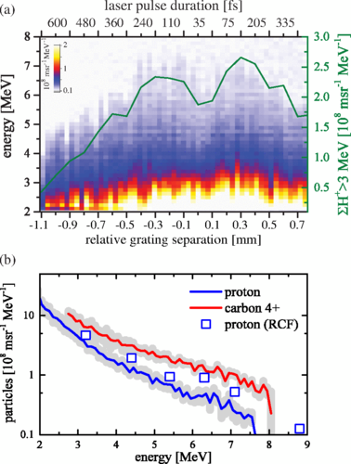
Other focusing geometries
EA2 has capability to field other focusing geometries for the 10Hz PW beam
We could field f/7 - f/35 with additional funding
  2x10¹⁹ - 2x10²⁰ Wcm⁻²
  High flux, low energy ion beam source
  Betatron source for pump-probe work
  Offset focus from normal position inside Interaction Chamber
Could operate with with an in-chamber plasma mirror if didn’t require ultra-high intensities
How much of a priority is this once we are operational with f/3?
Long focus ion acceleration on BELLA
Phys. Rev. Accel. Beams 23, 021302 (2020)

Slide 23
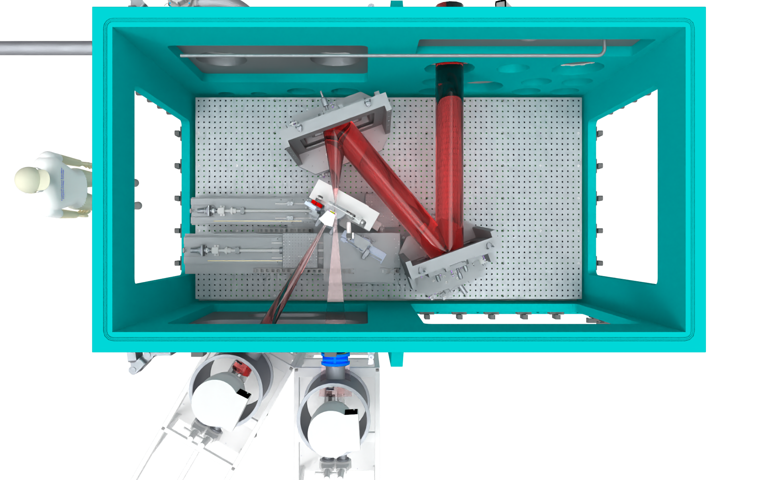

EA2 – ‘medium’ focusing
f/10 for scale
Medium focus
~2x10²⁰ Wcm⁻² a0 ≈ 14
TNSA Ion acceleration
Bremsstrahlung
Thermal neutron production
Turning mirror
Could be implemented in a number of ways depending on ultimate application
Currently low priority unless specific need

Slide 24
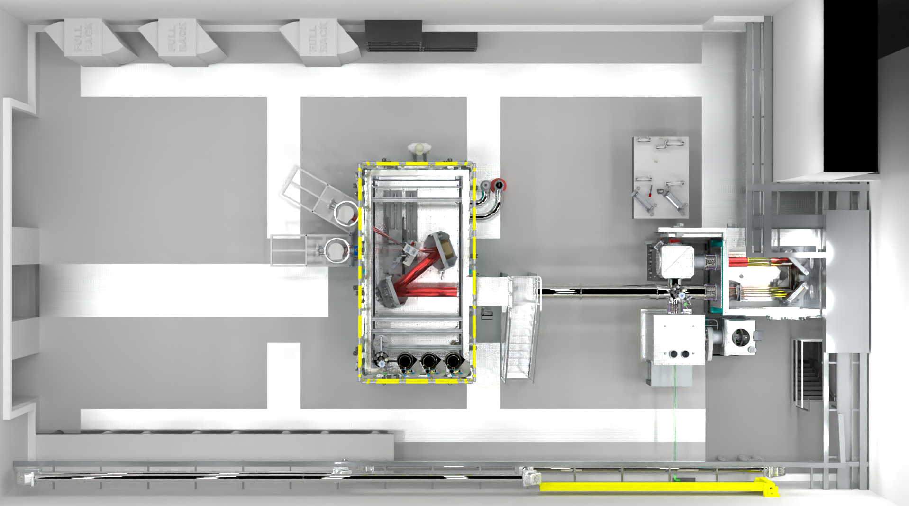
EA2 – f/35 focusing
f/35 Long focus
~2x10¹⁹ Wcm⁻² a0 ≈ 3
Interaction Chamber
AO Chamber
f/35 focus region
AO
TM3
f/35
OAP
TM2 / Periscope
TM 1
Probe and Long Pulse diagnostics

