Slide 1



EPAC
Experimental Area 1
Daniel Symes
Central Laser Facility
Rutherford Appleton Laboratory
EPAC ISTAC meeting 14 May 2024
Notes:
The abstract pattern can be removed or repositioned if required. Be careful to ‘Send to Back’ so that it does not obscure any important information.

Slide 2


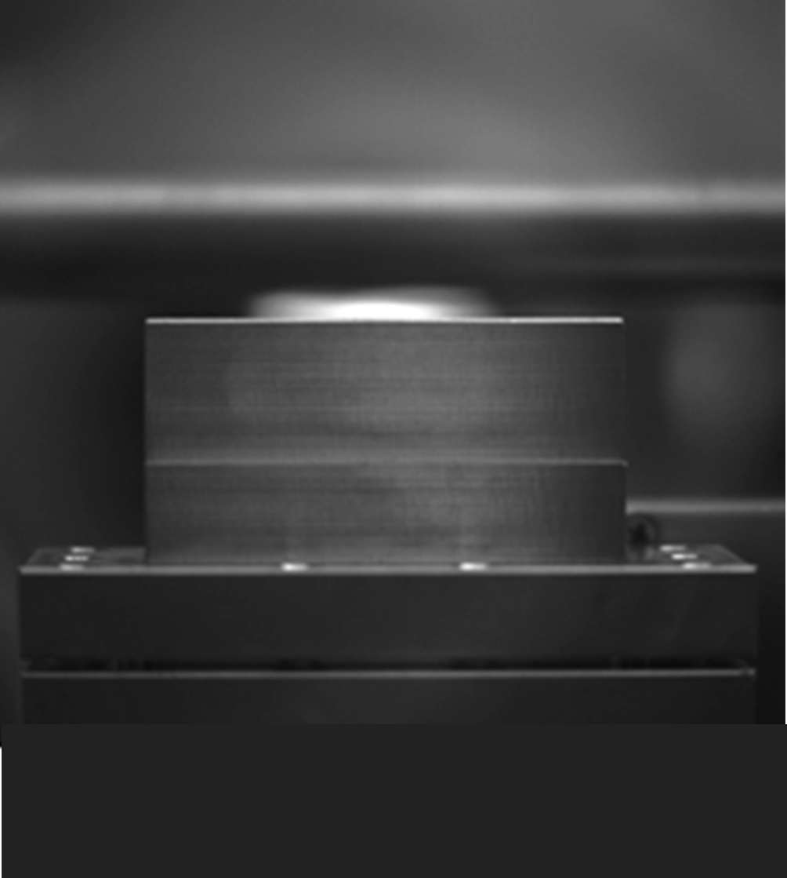
Outline
1 EA1 status
2 Beamline simulations
3 First LWFA experiments
4 TA2 LWFA test beamline
Notes:
Delete boxes as required

Slide 3
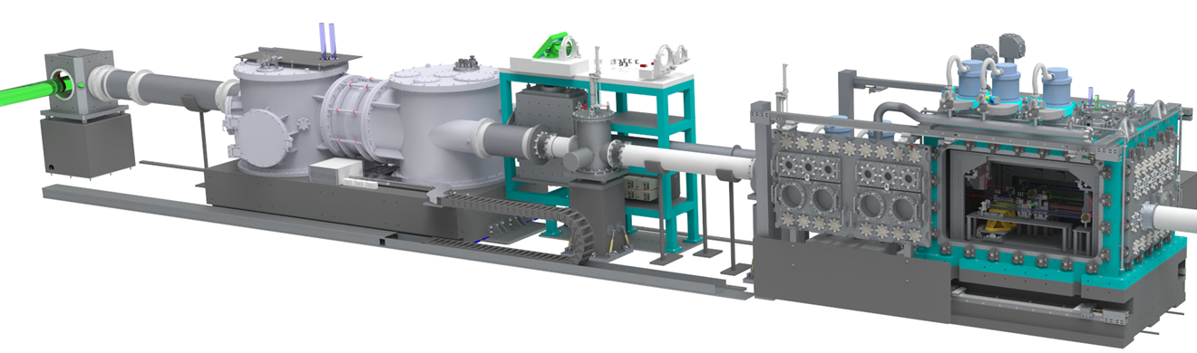
EPAC EA1 houses a laser wakefield electron accelerator
Turning chamber
Beam focusing
Interaction chamber
Off-axis parabola: focal length 6 m (f / 27) – 14.5 m (f / 65)
Intensity ~ 8 x 10¹⁸ W cm⁻² (a₀ ~ 2)
Adaptive optic for focal spot control
20 x 9 m area for flexible applications beamlines
Notes:
Replace this guidance text with your own bullet pointed content.
For further guidance please see https://www.bdadyslexia.org.uk/advice/employers/creating-a-dyslexia-friendly-workplace/dyslexia-friendly-style-guide

Slide 4
EA1
Project Status
Notes:
The abstract pattern can be removed or repositioned if required. Be careful to ‘Send to Back’ so that it does not obscure any important information.

Slide 5
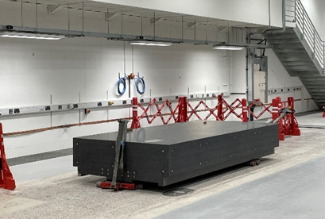
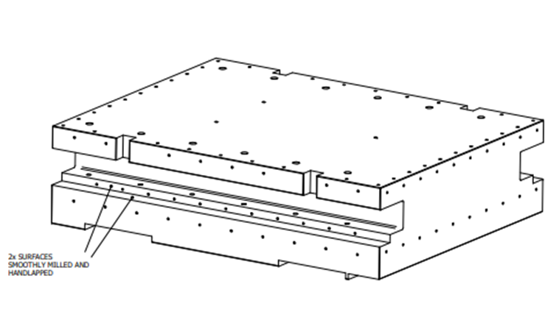
Granite support blocks
Granite for focusing chamber and alignment rigs has been delivered
Translation of support block with air skates has been tested
Target chamber granite on order – expected delivery in July 2024
Focusing chamber
Target chamber
Alignment chambers
Notes:
Replace this guidance text with your own bullet pointed content.
For further guidance please see https://www.bdadyslexia.org.uk/advice/employers/creating-a-dyslexia-friendly-workplace/dyslexia-friendly-style-guide

Slide 6
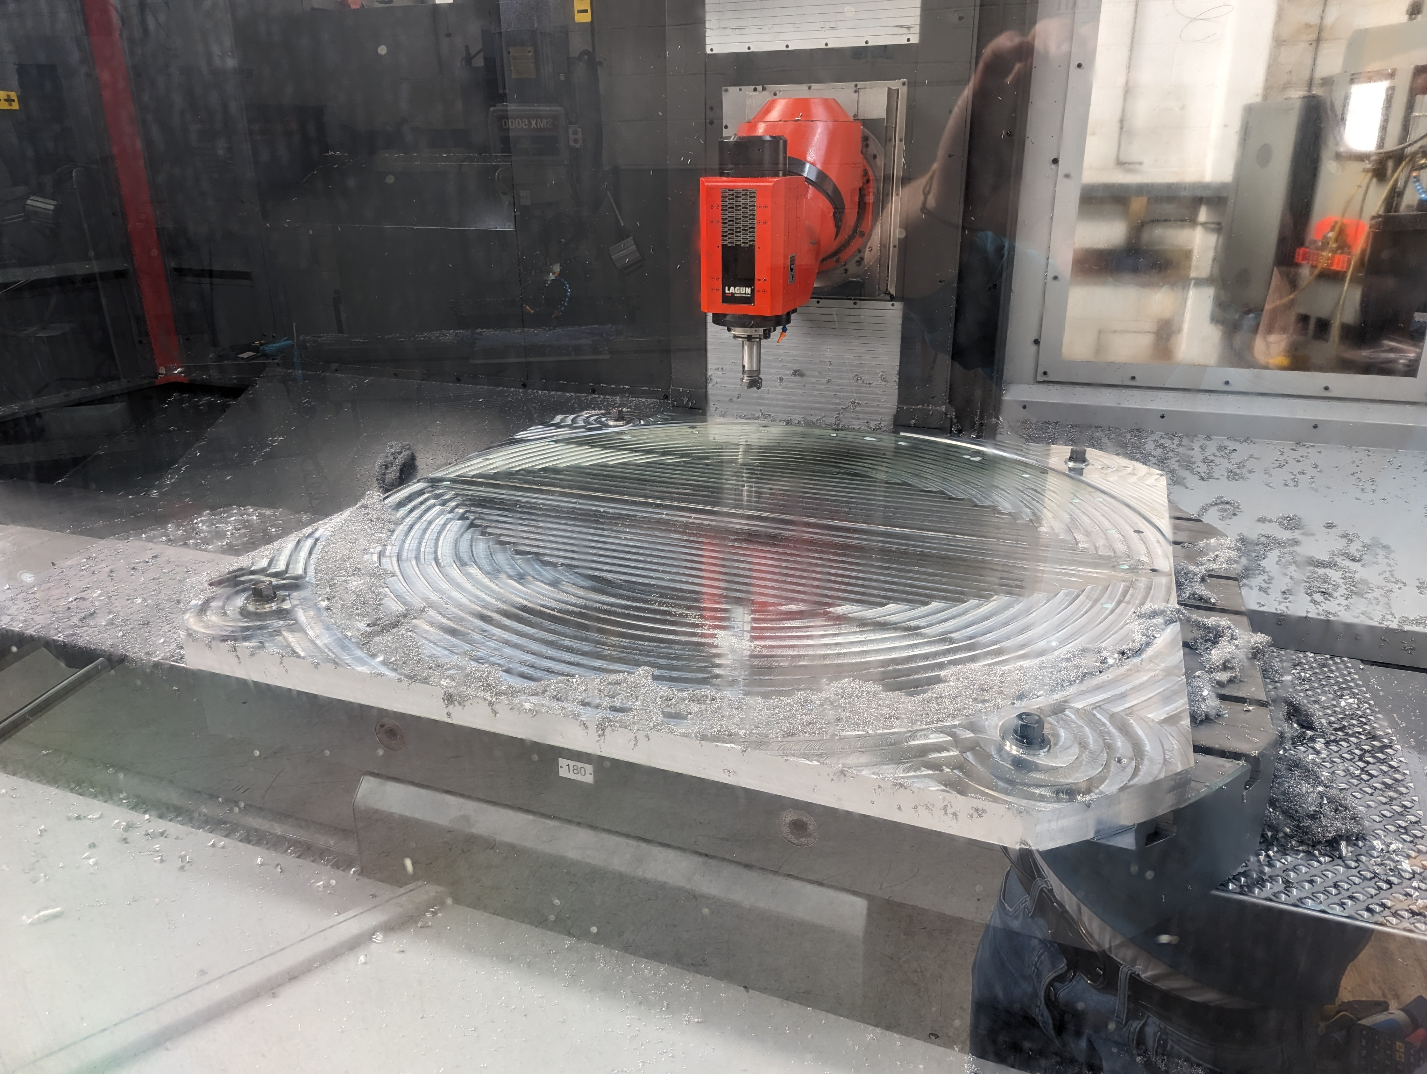
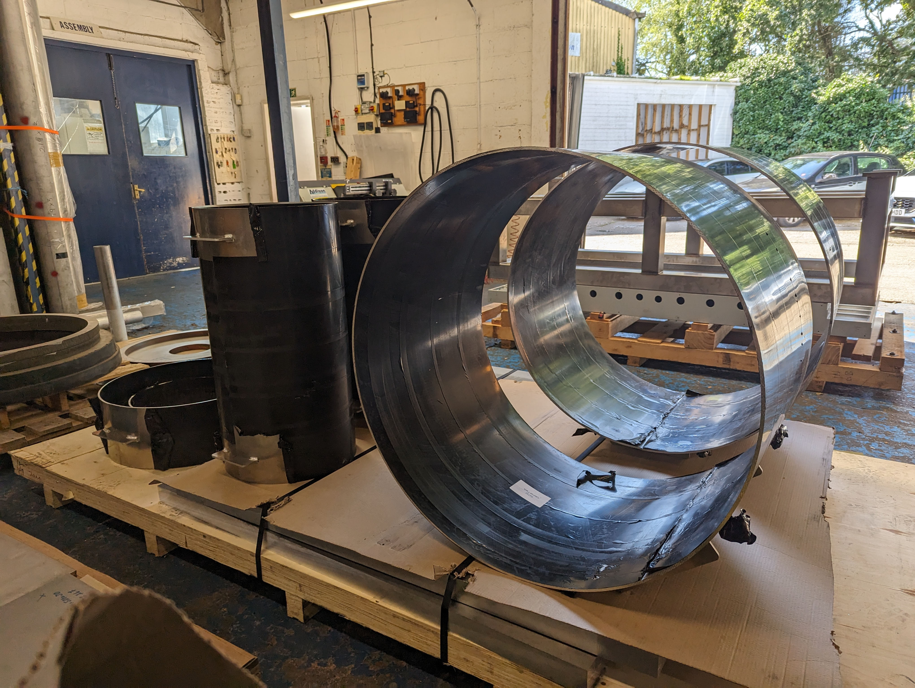
Focusing chamber
Focusing chamber in manufacture with HiVac
Problems with welding are delaying completion
Hope to be delivered by summer 2024
Notes:
Replace this guidance text with your own bullet pointed content.
For further guidance please see https://www.bdadyslexia.org.uk/advice/employers/creating-a-dyslexia-friendly-workplace/dyslexia-friendly-style-guide

Slide 7
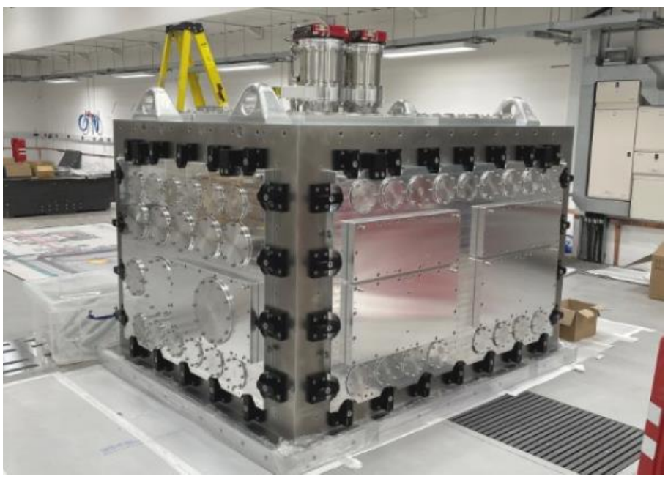
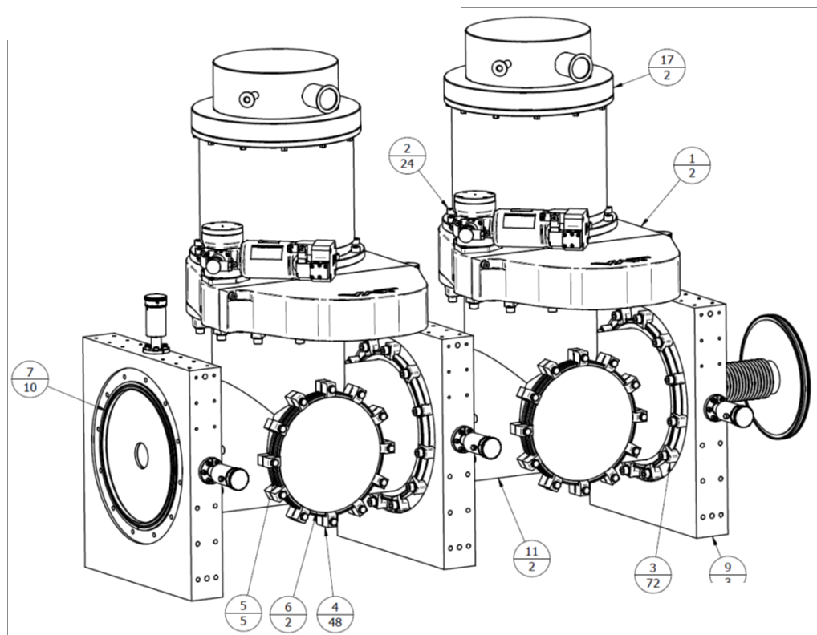
Interaction chamber
Has been delivered and SAT complete
Most kit for differential pumping has been delivered
Notes:
Replace this guidance text with your own bullet pointed content.
For further guidance please see https://www.bdadyslexia.org.uk/advice/employers/creating-a-dyslexia-friendly-workplace/dyslexia-friendly-style-guide

Slide 8
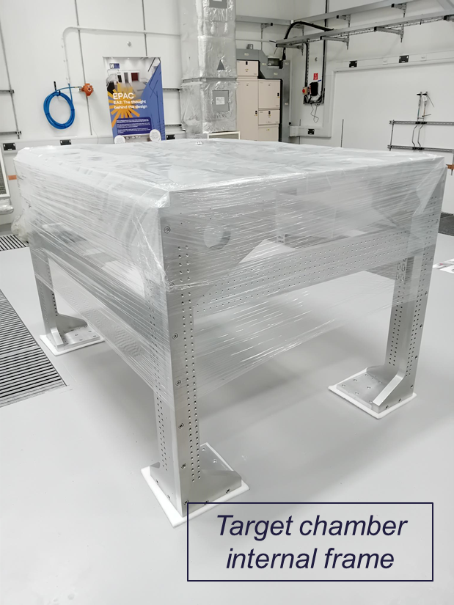
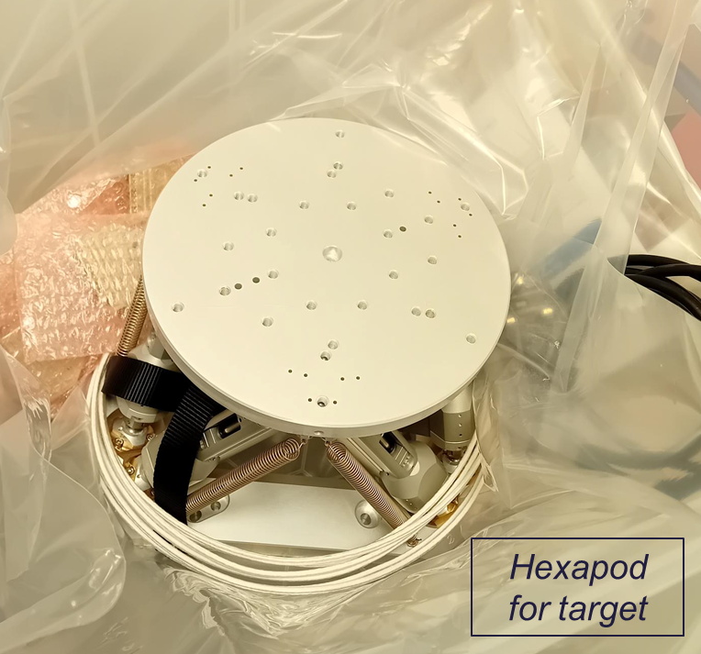
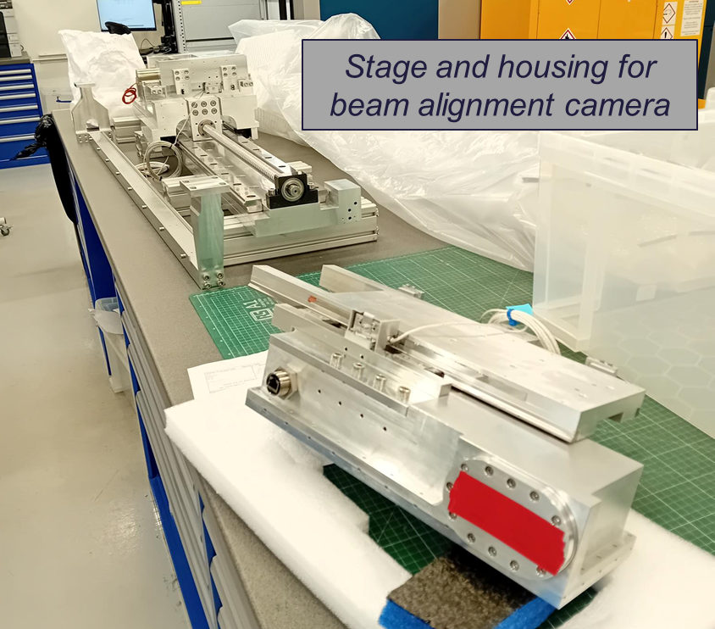
Interaction chamber internal equipment
Internal framework is complete
Hexapod has been delivered
Stage and housing for beamline camera being assembled
Notes:
Replace this guidance text with your own bullet pointed content.
For further guidance please see https://www.bdadyslexia.org.uk/advice/employers/creating-a-dyslexia-friendly-workplace/dyslexia-friendly-style-guide

Slide 9
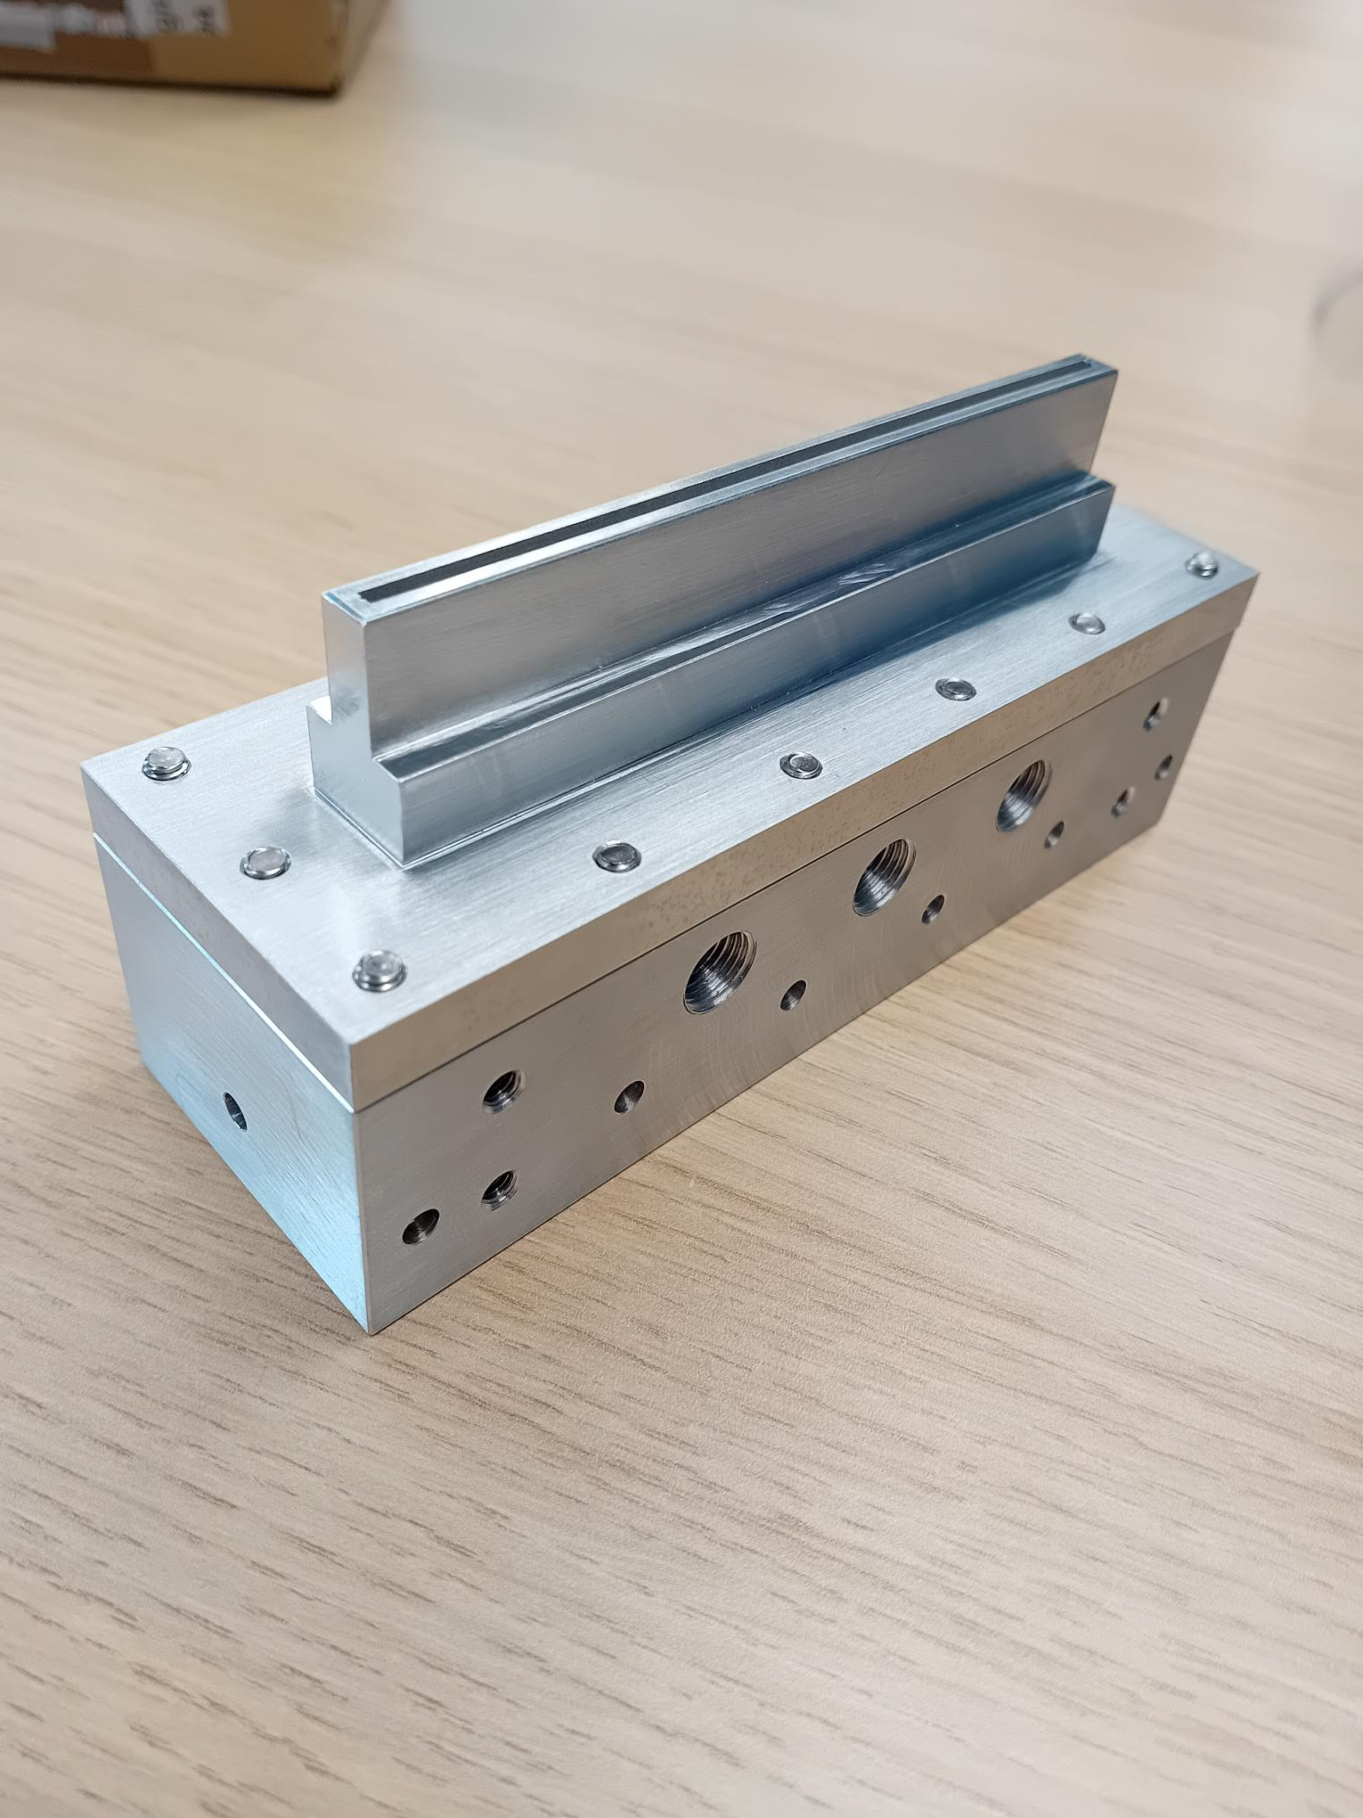
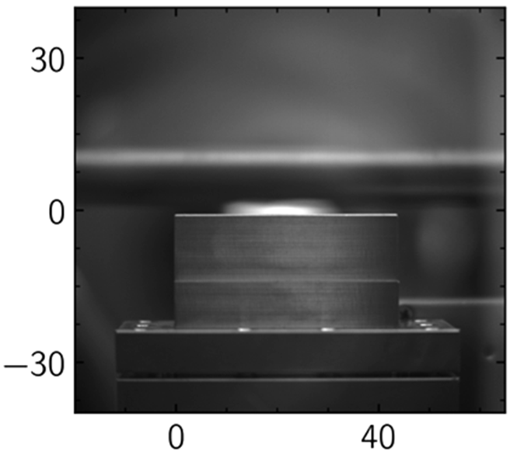
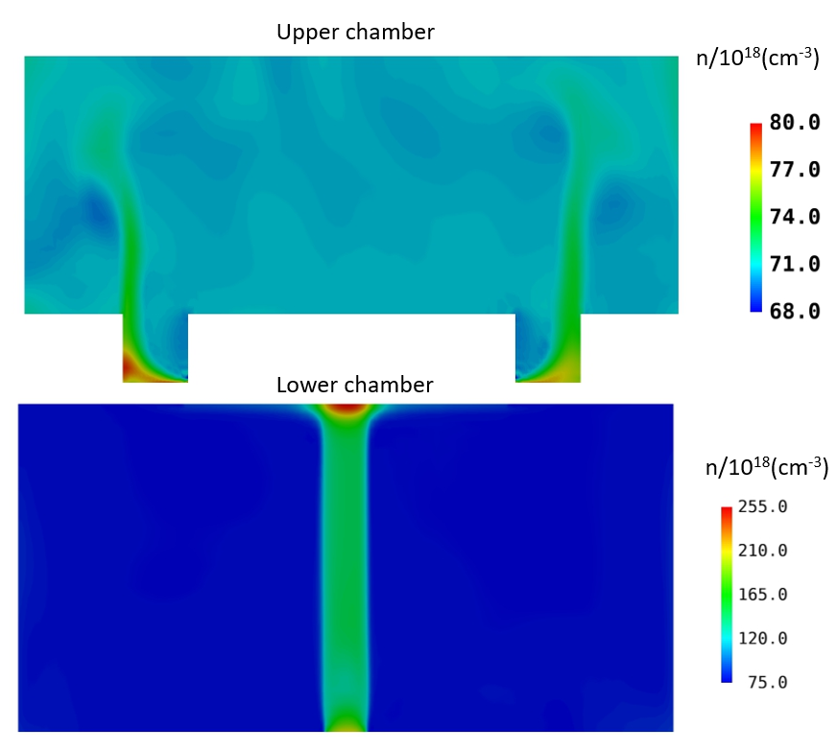
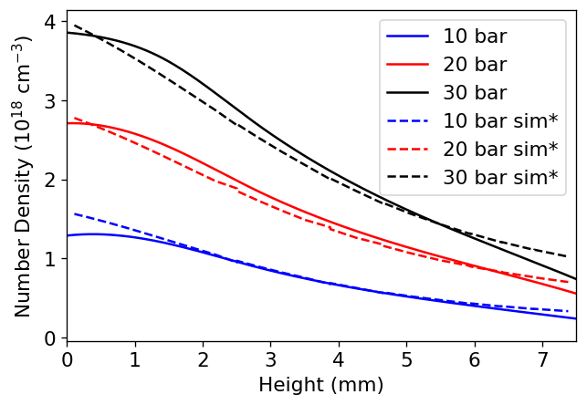
LWFA gas jet targets
Precision engineered slot nozzles
300 μm throat width, 2 mm exit width
20, 30, and 40 mm nozzles used on experiments by user groups
100 mm nozzle delivered
Characterised with interferometry at RAL and plasma fluorescence at OPAL
Fluid simulations by SCD
Notes:
Replace this guidance text with your own bullet pointed content.
For further guidance please see https://www.bdadyslexia.org.uk/advice/employers/creating-a-dyslexia-friendly-workplace/dyslexia-friendly-style-guide

Slide 10
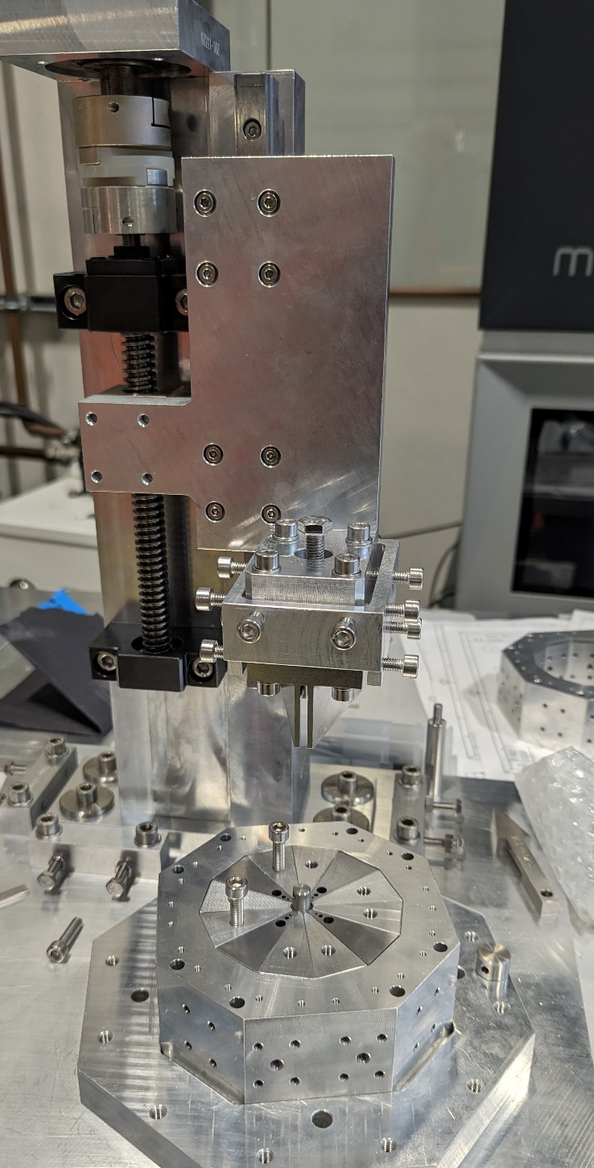
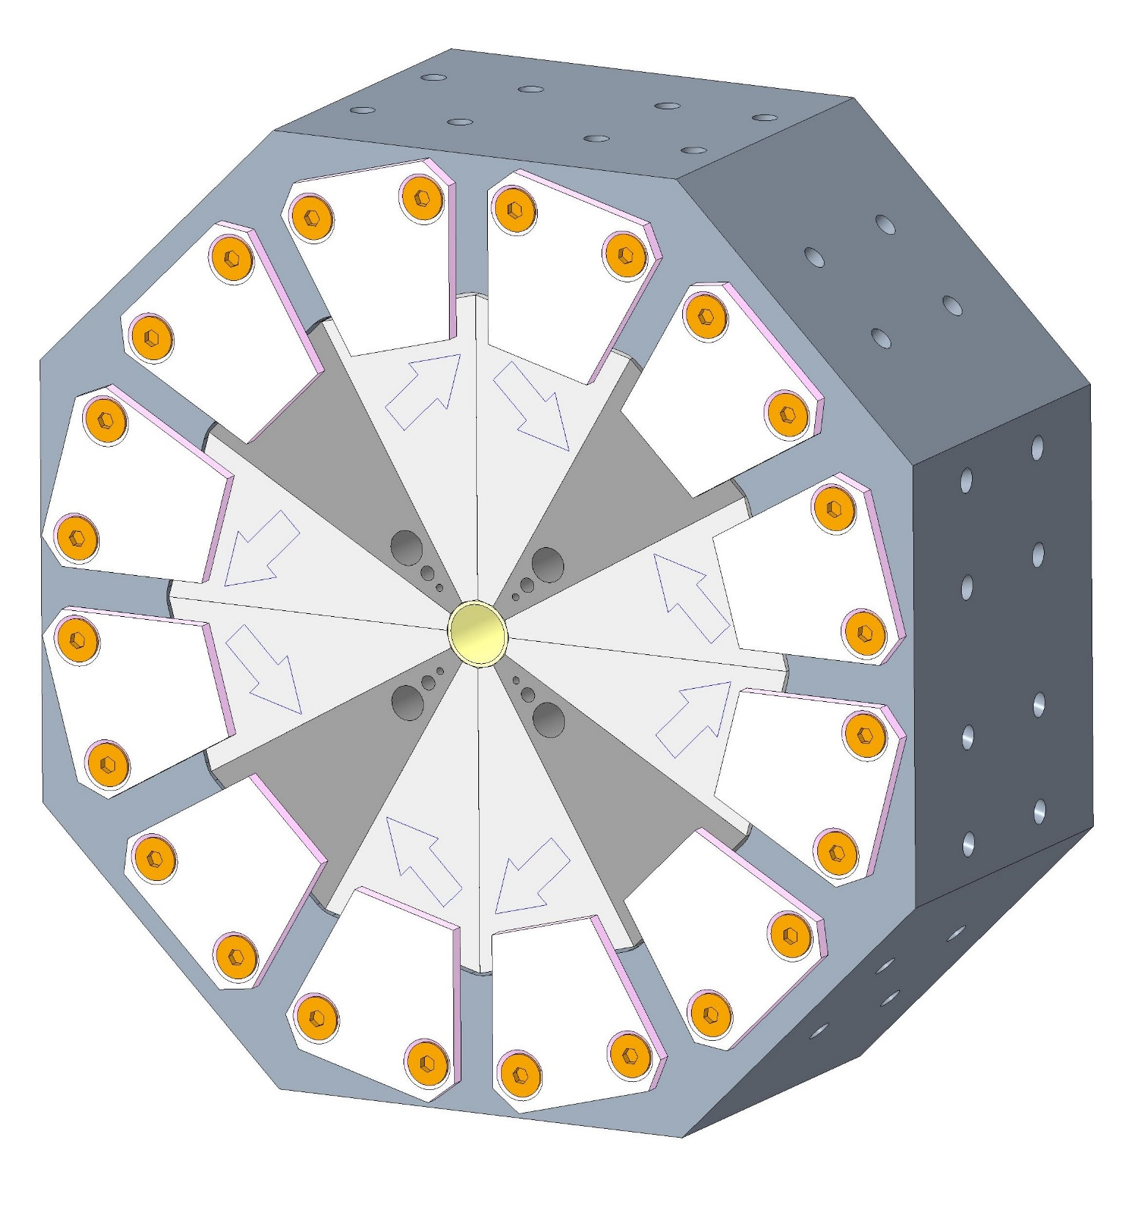
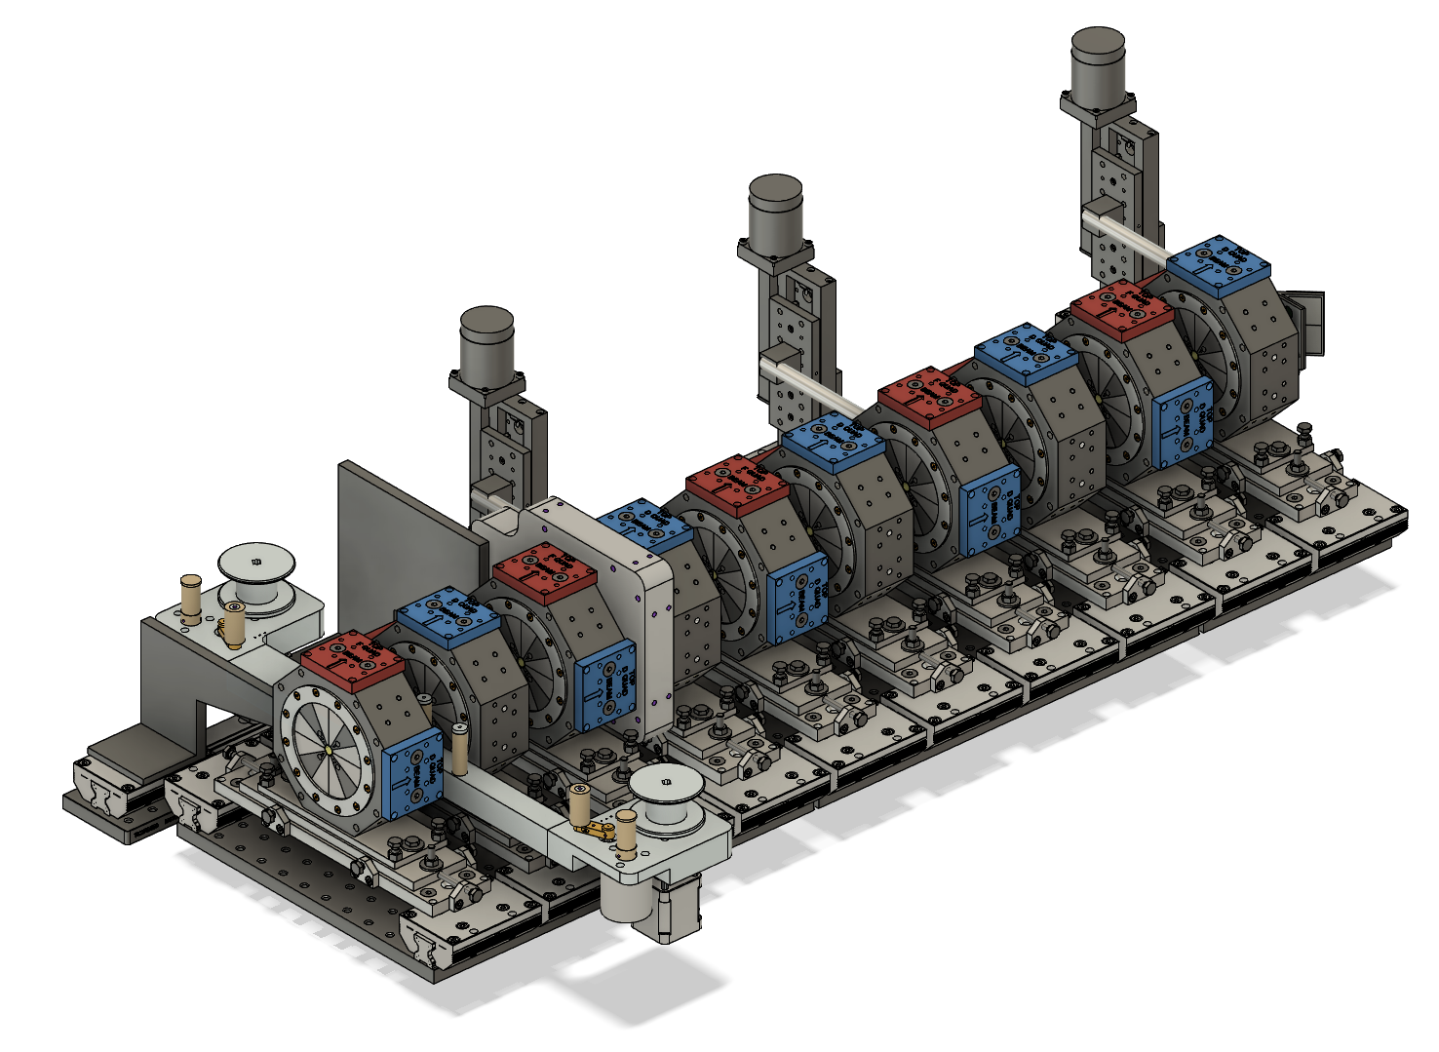
Electron beam focusing
~ 500 Tm⁻¹
Magnet blocks from Vacuumschmelze GmbH
Permanent magnet quadrupoles used for beam capture at LWFA exit
In-vacuum & low maintenance
Magnet blocks commercial, assembly at STFC-DL
Modular assemblies for 100 MeV, 1 GeV, 5 GeV
Plasma mirrors and beam diagnostics inserted between PMQs
Notes:
Replace this guidance text with your own bullet pointed content.
For further guidance please see https://www.bdadyslexia.org.uk/advice/employers/creating-a-dyslexia-friendly-workplace/dyslexia-friendly-style-guide

Slide 11
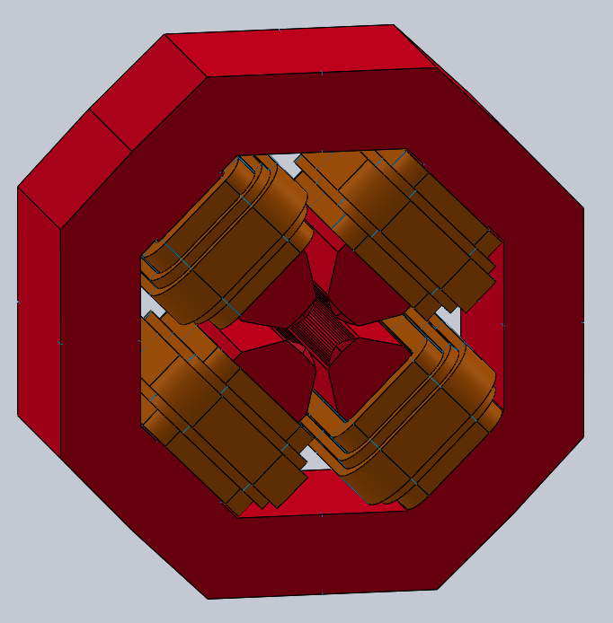
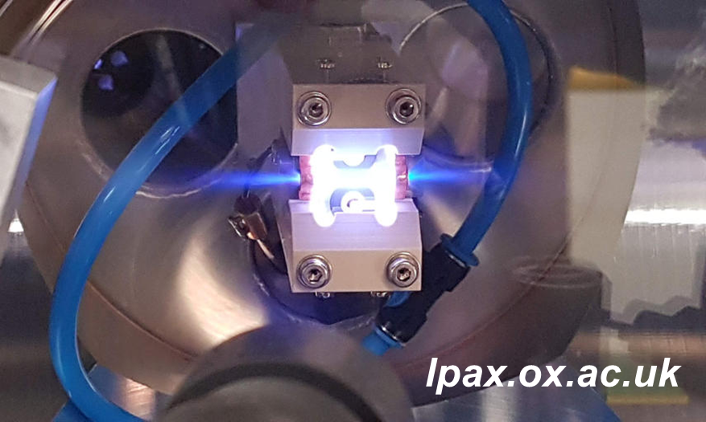
Electron beam focusing
~ 3000 Tm⁻¹
~ 40 Tm⁻¹
Electromagnet quadrupoles for tunable beam focusing
Outside vacuum, commercial products
Active plasma lenses
In vacuum, very strong fields
Needed for short focus at high energy
Notes:
Replace this guidance text with your own bullet pointed content.
For further guidance please see https://www.bdadyslexia.org.uk/advice/employers/creating-a-dyslexia-friendly-workplace/dyslexia-friendly-style-guide

Slide 12
EA1 Beamline Simulations
Notes:
The abstract pattern can be removed or repositioned if required. Be careful to ‘Send to Back’ so that it does not obscure any important information.

Slide 13
PIC simulation working group
Co-ordinating simulation effort toward first EPAC beams
All groups using the same input laser parameters
Targeting 3 different regimes:
Self-guided optimised energy (< 1% spread)
Self-guided optimised charge (broad spectrum, > nC)
Guided optimised beam quality (<1% spread, > 5 GeV)
Laser parameter | Design spec | Day one spec
Pulse energy | 30 J | 20 J
Pulse duration | 30 fs | 30 fs
Peak power | 1 PW | 0.67 PW
Focal spot radius | 54 μm | 38 μm
Peak intensity | 6.5 x 10¹⁸ Wcm⁻² | 8.8 x 10¹⁸ Wcm⁻²
Aim to agree expected LWFA beam parameters through PWASC
Notes:
Replace this guidance text with your own bullet pointed content.
For further guidance please see https://www.bdadyslexia.org.uk/advice/employers/creating-a-dyslexia-friendly-workplace/dyslexia-friendly-style-guide

Slide 14
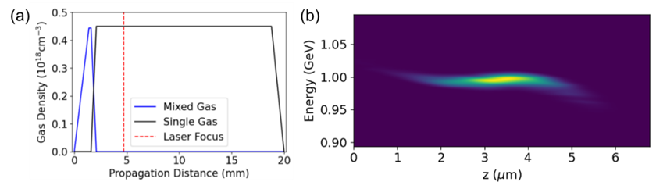
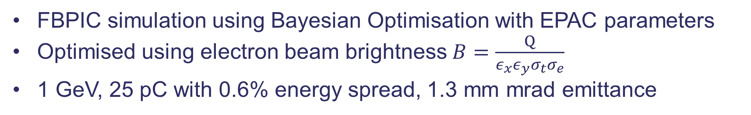
Machine learning optimisation
FBPIC simulation using Bayesian Optimisation with EPAC parameters
Optimised using electron beam brightness $B=\frac{Q}{ε_{x}{ε_{y}σ_{t}σ}_{e}}$
1 GeV, 25 pC with 0.6% energy spread, 1.3 mm mrad emittance
Notes:
Replace this guidance text with your own bullet pointed content.
For further guidance please see https://www.bdadyslexia.org.uk/advice/employers/creating-a-dyslexia-friendly-workplace/dyslexia-friendly-style-guide

Slide 15

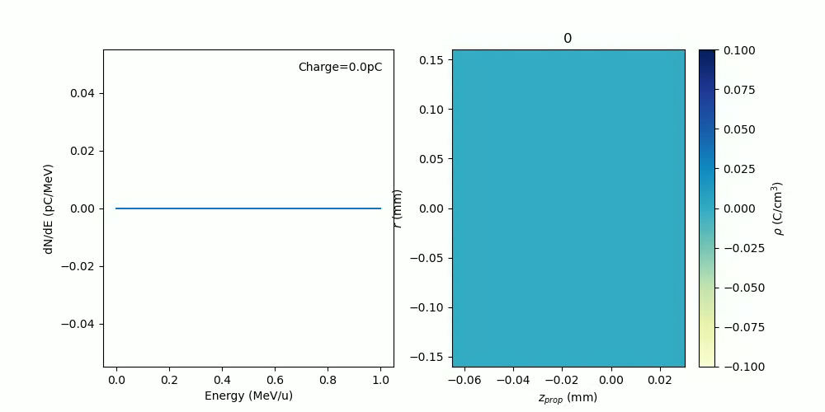
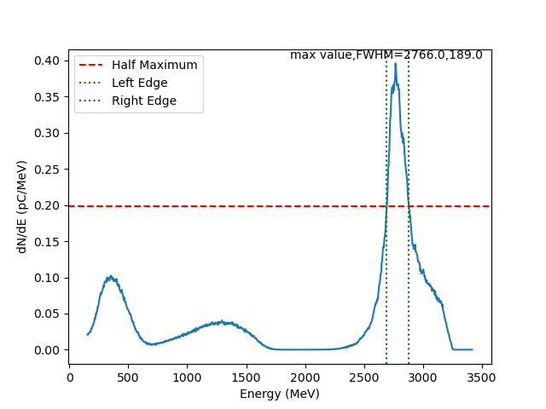
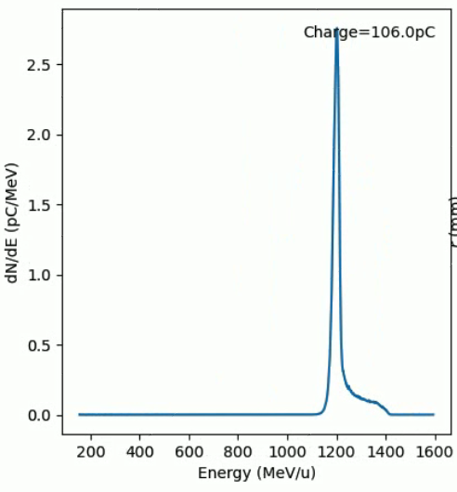
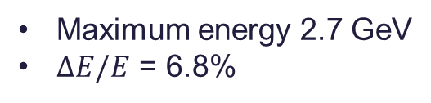
Higher energy LWFA
Maximum energy 2.7 GeV
$ΔE/E$ = 6.8%
Simulations by QUB group show limits of self-focused LWFA
Good quality beam at ~ 1 GeV
With 50 mm target, energy is higher but spread increases
Notes:
Replace this guidance text with your own bullet pointed content.
For further guidance please see https://www.bdadyslexia.org.uk/advice/employers/creating-a-dyslexia-friendly-workplace/dyslexia-friendly-style-guide

Slide 16

Guided LWFA
HOFI channels
Shalloo et al, PRAB 22, 041302 (2019)
LBNL reached 8 GeV in 200 mm capillary waveguides
Simulations in HOFI channels by Oxford group predict 5 – 10 GeV electron energies on EPAC
Need second beam for channel formation
Notes:
Replace this guidance text with your own bullet pointed content.
For further guidance please see https://www.bdadyslexia.org.uk/advice/employers/creating-a-dyslexia-friendly-workplace/dyslexia-friendly-style-guide

Slide 17
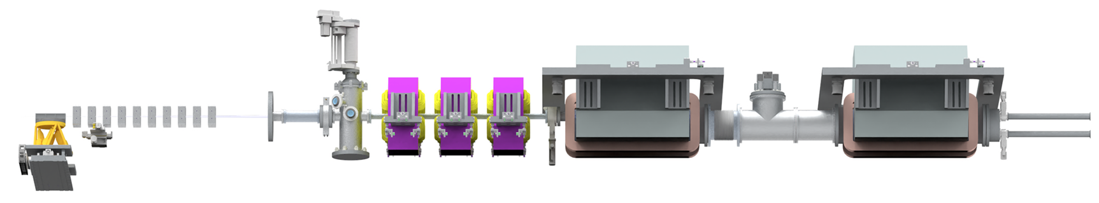
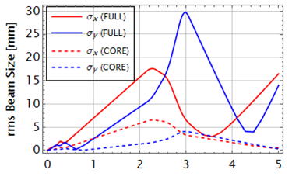
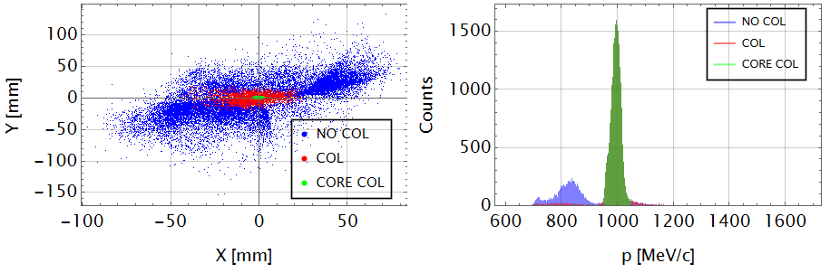
1 GeV electron beamline
Start-to-end simulations
FBPIC simulation output fed into magnet tracking code
4 x PMQ + 3 x EMQ
The core of the electron beam at 1 GeV forms a < 1 mm spot at 5 m
Notes:
Replace this guidance text with your own bullet pointed content.
For further guidance please see https://www.bdadyslexia.org.uk/advice/employers/creating-a-dyslexia-friendly-workplace/dyslexia-friendly-style-guide

Slide 18
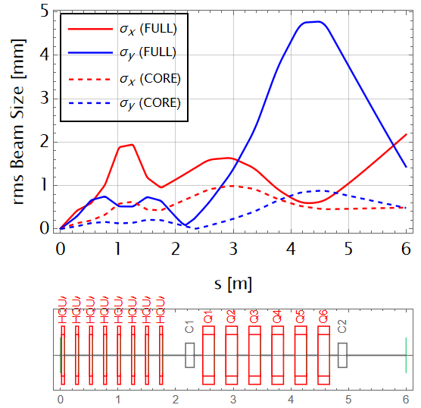
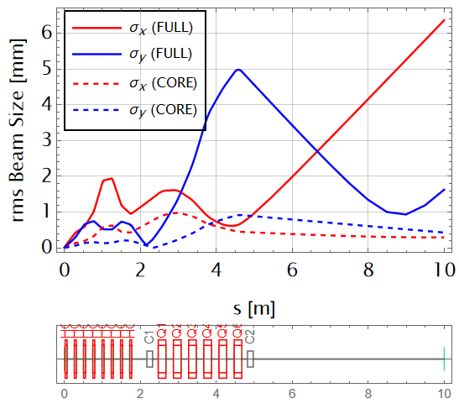
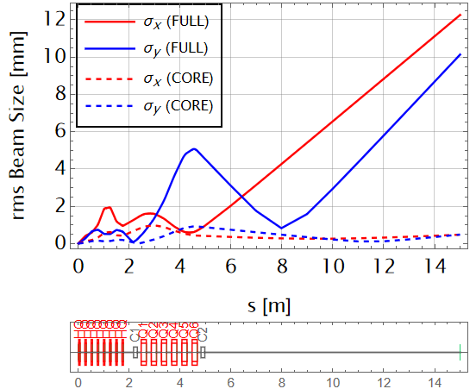
5 GeV electron beamline
6 m
10 m
15 m
Max EMQ Gradient
Core Beam Size @ IP σ_{x}/σ_{y}
Transmission Full (Core)
36.8 T/m
0.49 mm / 0.48 mm
90.17% (99.92%)
36.8 T/m
0.29 mm / 0.43 mm
90.11% (99.92%)
36.8 T/m
0.48 mm / 0.49 mm
90.11% (99.92%)
Start-to-end simulations
Increase to 8 x PMQ + 6 x EMQ
Beam focus can be tuned from 6 – 15 m
Forms a small focus (< 1 mm) containing > 99% of the core electrons
Notes:
Replace this guidance text with your own bullet pointed content.
For further guidance please see https://www.bdadyslexia.org.uk/advice/employers/creating-a-dyslexia-friendly-workplace/dyslexia-friendly-style-guide

Slide 19
EA1 First Experiments
Notes:
The abstract pattern can be removed or repositioned if required. Be careful to ‘Send to Back’ so that it does not obscure any important information.

Slide 20
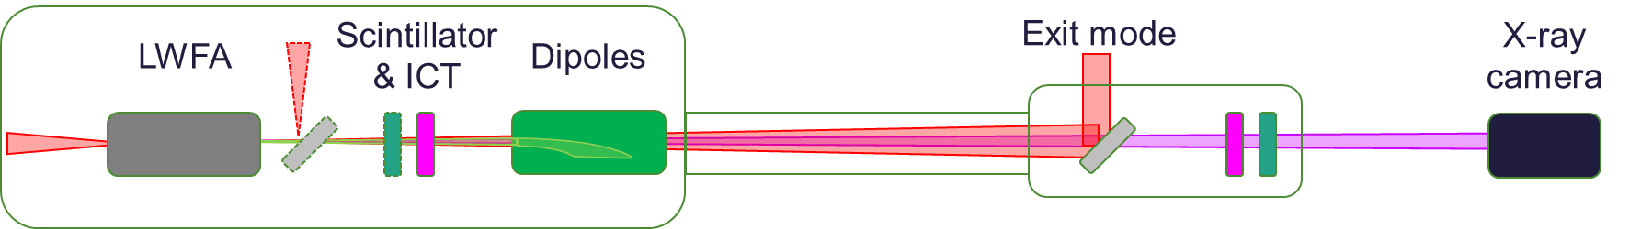
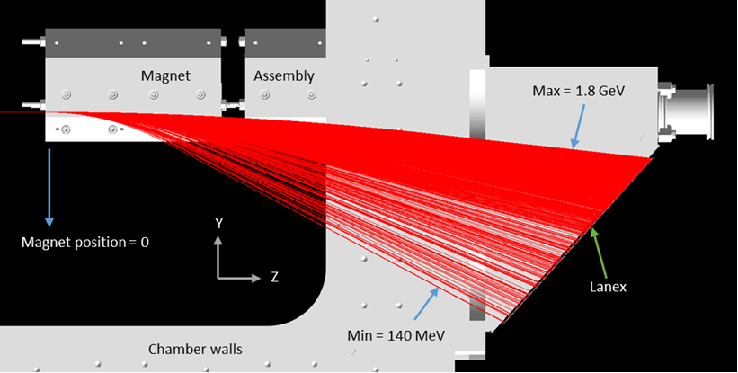
First optimisation experiments will use Gemini LWFA configuration
Dipole magnet inside main chamber can measure 0.14 – 1.8 GeV
Staff and users familiar with the set-up
Easier to find initial conditions
De-bug operation of diagnostics

Slide 21
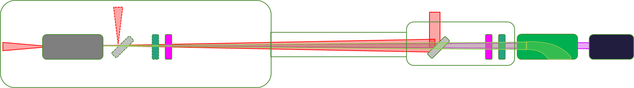
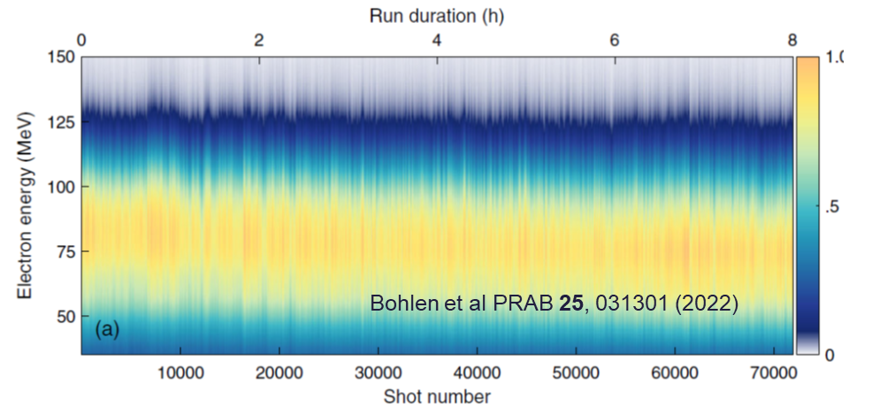
After initial measurements, move to beamline configuration
Spectrometer to end of beamline
(“Bella” configuration)
Higher electron energies
Test automated optimisation routines
Identify and stabilise causes of instability
Prove beam quality and long-term operation
80 MeV electrons at 2.5 Hz (DESY)

Slide 22
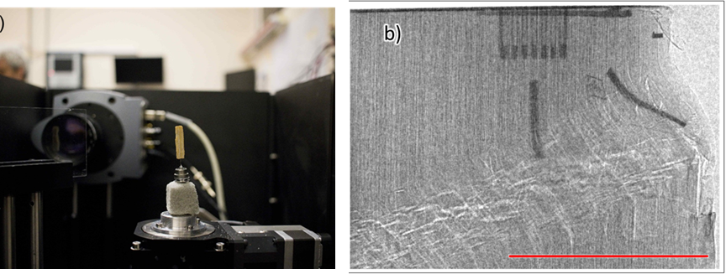
Demonstrate capabilities for x-ray tomography
Folded exit mode
X-ray camera
Dipole
Sample
Fold (or dump) exit mode beam
Clears XCT beamline of obstructions
Optimise phase contrast and resolution at 10 – 100 keV
Show penetration and high resolution with > MeV
Demonstrate fast scanning (~ minutes)
Gemini phase contrast XCT of cm-scale objects

Slide 23
LWFA optimisation using ML techniques
Maximise objective function using laser and target parameters:
Spatio-temporal control of focus
Target control
Robust optimisation code
We aim for routine use of ML simulation and experimental techniques for operations
ML-guided charge optimisation
Jalas et al, PRAB 26, 071302 (2023)
Notes:
Replace this guidance text with your own bullet pointed content.
For further guidance please see https://www.bdadyslexia.org.uk/advice/employers/creating-a-dyslexia-friendly-workplace/dyslexia-friendly-style-guide

Slide 24
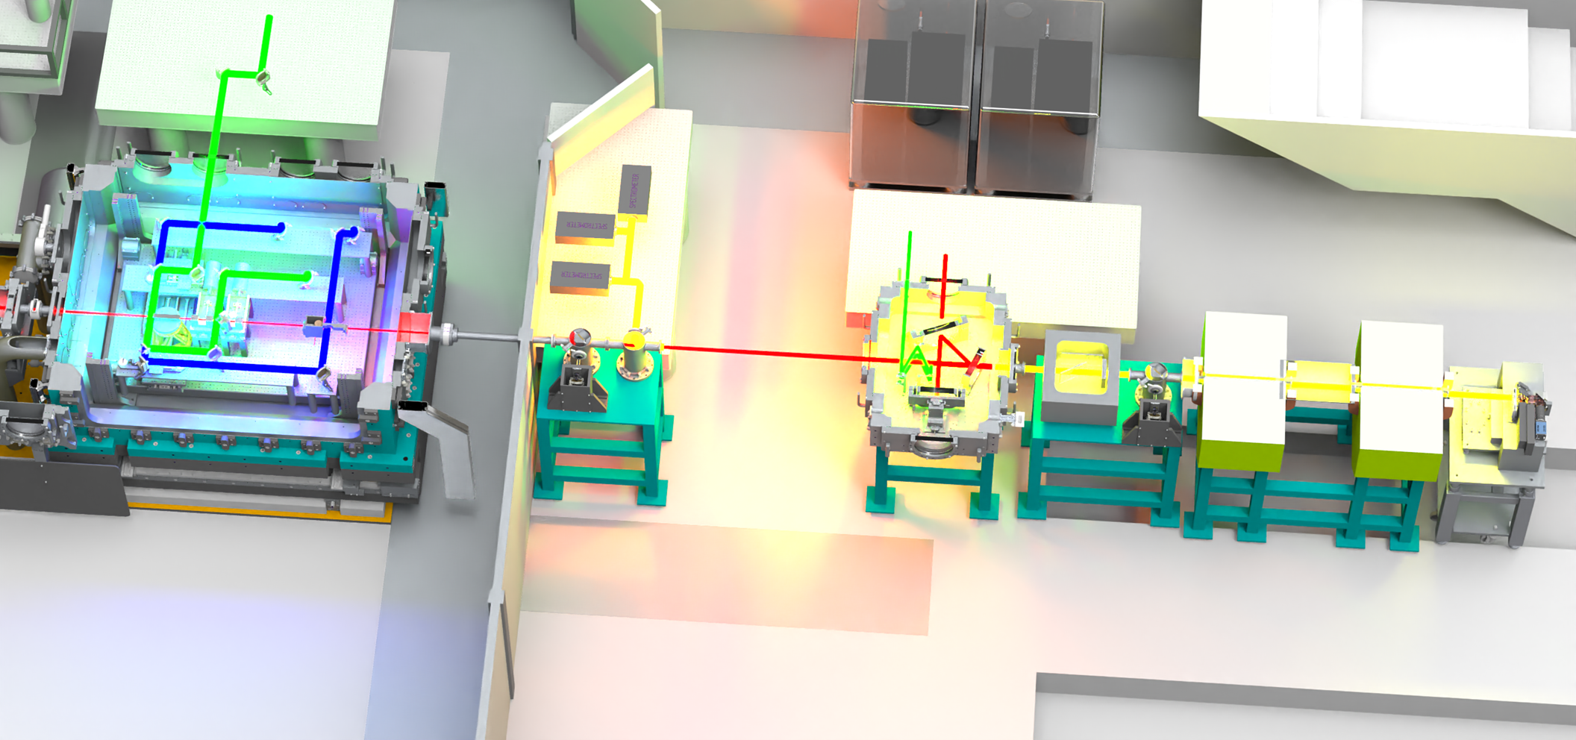
Develop electron beamline
Add quadrupole magnet system
Improved spectrum measurement
Single-shot emittance measurement
Focusing onto samples
Measure transition radiation
Beam profile & emittance
Bunch longitudinal profile (inferred)
These components are important to transition from an experiment to a functioning beamline
Electromagnet spectrometer
Tuneable field strength
Double dipole for energy selection
Notes:
Replace this guidance text with your own bullet pointed content.
For further guidance please see https://www.bdadyslexia.org.uk/advice/employers/creating-a-dyslexia-friendly-workplace/dyslexia-friendly-style-guide

Slide 25
Steps to LWFA beamline delivery
Essential
Stable laser and electron beam delivery
Automated optimisation routines
High quality and rapid x-ray imaging
Beneficial
Machine-learning guided optimisation
Electron beam focusing
Ultrafast optical probing of wakefield
Electromagnet spectrometer
Future developments
Industrial quality application beamlines
Improved and non-invasive electron diagnostics
Notes:
Replace this guidance text with your own bullet pointed content.
For further guidance please see https://www.bdadyslexia.org.uk/advice/employers/creating-a-dyslexia-friendly-workplace/dyslexia-friendly-style-guide

Slide 26
TA2
LWFA Beamline
Notes:
The abstract pattern can be removed or repositioned if required. Be careful to ‘Send to Back’ so that it does not obscure any important information.

Slide 27
TA2 test beamline – Objective 1
LWFA optimisation
Robust control code for automation and ML-guided optimisation
Iterative development of EPAC control and DAQ codes
Move towards accelerator tuning curves
Notes:
Replace this guidance text with your own bullet pointed content.
For further guidance please see https://www.bdadyslexia.org.uk/advice/employers/creating-a-dyslexia-friendly-workplace/dyslexia-friendly-style-guide

Slide 28

TA2 test beamline – Objective 2
X-ray source development
Define figure of merit for image quality
Ensure images meet industrial standard
Establish imaging protocol for consistent performance
Notes:
Replace this guidance text with your own bullet pointed content.
For further guidance please see https://www.bdadyslexia.org.uk/advice/employers/creating-a-dyslexia-friendly-workplace/dyslexia-friendly-style-guide

Slide 29
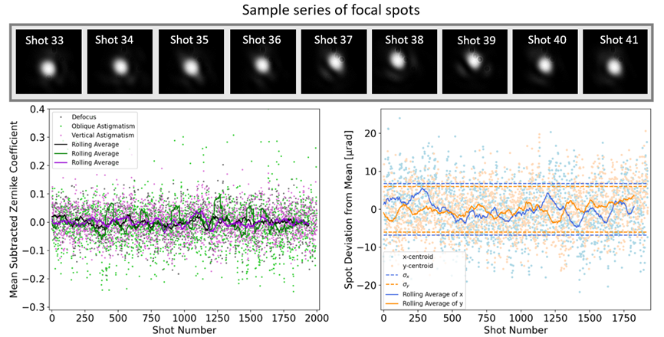
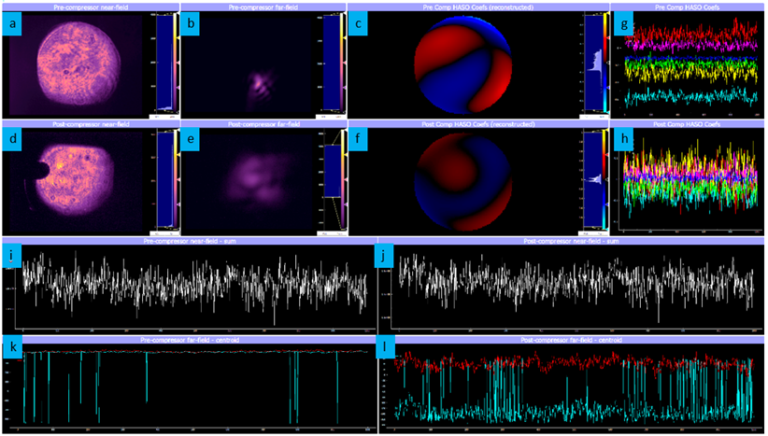
TA2 laser stability tests
Live data plotting
Beam properties recorded over 1 hour
Pointing drift corrected
Plan to implement focal drift correction
Need to investigate causes of shot-to-shot jitter
Notes:
Replace this guidance text with your own bullet pointed content.
For further guidance please see https://www.bdadyslexia.org.uk/advice/employers/creating-a-dyslexia-friendly-workplace/dyslexia-friendly-style-guide

Slide 30
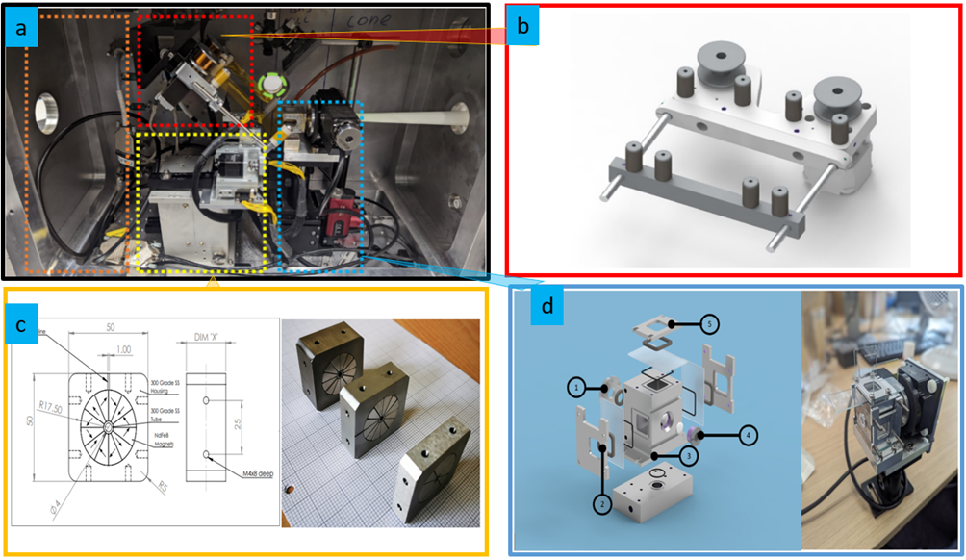
Aiming for 100 MeV beam at 5 Hz
Internal chamber for gas load
Cone delivery for focusing laser
Variable length cell
Plan to trial continuous flow
Compact tape drive beam dump
Space for quadrupole magnets
Exit connects directly to diagnostic chamber

Slide 31
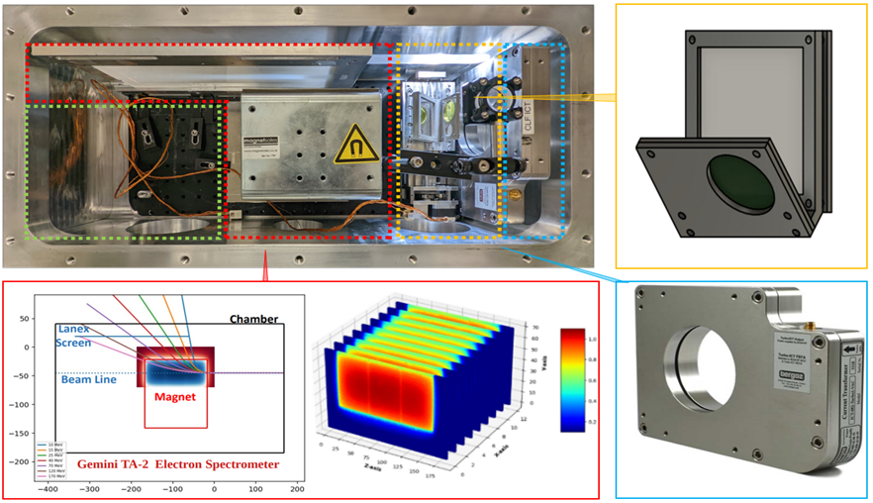
LWFA diagnostic chamber
New magnet designed for size available and expected energy range
Compact scintillator screen (YAG)
ICT for charge
Raptor for betatron emission (~5 keV)

Slide 32
Summary
EA1 laser and LWFA beamline
Most large components on order – delivery by summer 2024
Magnet designs for 1 GeV and 5 GeV beamlines
Started design of optimisation experiments and application beamlines
TA2 test beamline
LWFA set up underway – starting shots soon
First priority is drift correction for stable performance
Then testing ML algorithms and x-ray imaging optimisation
Notes:
Replace this guidance text with your own bullet pointed content.
For further guidance please see https://www.bdadyslexia.org.uk/advice/employers/creating-a-dyslexia-friendly-workplace/dyslexia-friendly-style-guide

